Slide 1
Crypto and Cypherpunk Ethics
This material developed by Patrick Anderson as part of the Mozilla Foundation Responsible Computer Science Challenge. This work is licensed under a Creative Commons Attribution-NonCommercial-ShareAlike 4.0 International License.

Slide 2
The basic Components of Ethical Theory
Means
the ways the outcomes are pursued
Which means are permissible and why?
Ends
the desired outcomes; the results deemed good
What ends are desirable and why?
Notes:
All moral philosophy is built around two concepts: means and ends. The ends are the desired outcomes, and the means are the ways the outcomes are pursued. Following from these two concepts are the basic questions of ethical theory: Which means are permissible and why? and What ends are desirable and why? Answers to such questions are normative or prescriptive, in that they take a stance how people ought and ought not behave.
All ethical theories and ethical analyses have to some idea, some position on means and ends.
In the context of computer science and ethics, anyone working on data communications, networking, cybersecurity, or related security areas of computing must ask these two questions. In terms of desirable ends, computer scientists must go beyond the simple “end” of creating a functioning product. Instead, they must as themselves two questions: “What kind of behavior, what kinds of relationships, do I want to promote with the creation and distribution of this product?” and “Why are these behaviors and relationships morally desirable?”
In terms of permissible means, computer scientists must be able to distinguish between morally permissible and morally impermissible means; that is, they must differentiate action that they must never do from actions that they may do.
Cypherpunk ethics are relevant to computer science ethics because they require us to ask fundamental questions about how humans ought to be. If computer scientists are creating technologies that affect the overall structure of society, which they do by necessity, then they must ask what kind of society they wish to build and which means are justifiable in building that society. Cypherpunk ethics helps us reflect on these matters.

Slide 3
LESSON A
This material developed by Patrick Anderson as part of the Mozilla Foundation Responsible Computer Science Challenge. This work is licensed under a Creative Commons Attribution-NonCommercial-ShareAlike 4.0 International License.

Slide 4
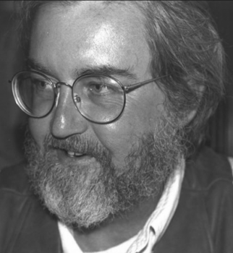
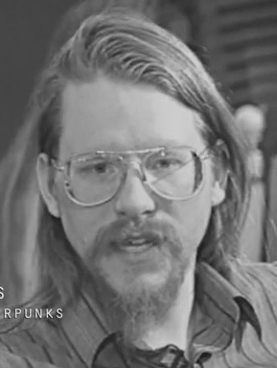
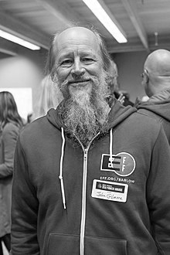
The Who are the Cypherpunks?
Timothy May
Eric Hughes
John Gilmore
“The Crypto Anarchist Manifesto” (1992)
“A Cypherpunk Manifesto” (1993)
“Privacy, technology, and the open society” (1991)
Notes:
The cypherpunks emerged as a grassroots movement simultaneously criticizing the emerging government mass surveillance made possible by the computer revolution and advocating the widespread use of digital encryption as the best means for individuals to protect their personal privacy from such surveillance. The cypherpunk movement formed at a meeting of cryptography enthusiasts in San Francisco in 1992.
The recognized founders of the cypherpunks are Timothy May, a physicist who retired from Intel, John Gilmore, a programmer who retired from Sun Microsystems and later cofounded Electronic Foundation Frontier, and Eric Hughes, who studied cryptography with the famous David Chaum.
[“John Gilmore in 2018” by Kushal Das is licensed under CC BY-SA 4.0.]

Slide 5
Basic Views of the Cypherpunks
The ideal society is an open society, a pluralistic society consisting of diverse religious, ideological, and moral worldviews and governed by mutual toleration.
Privacy is a necessary condition for an open society.
Technological solutions are preferrable to legislative solutions.
Cryptography is the technology that will protect privacy in the computer age.
Notes:
The four core beliefs:
The ideal society is an open society, a pluralistic society consisting of diverse religious, ideological, and moral worldviews and governed by mutual toleration (but not necessarily acceptance) among all.
Privacy is a necessary condition for an open society because it secures a space where difference and diversity can be expressed and exercised even if the politicians who control the government at any given moment do not like difference and diversity.
Technological solutions are preferrable to legislative solutions because laws can be repealed or remain unenforced, while technology is difficult to eliminate once it is publicly available.
Cryptography is the technology that will protect privacy—and by extension, preserve an open society—in the computer age.

Slide 6
READING QUESTIONS
According to Gilmore, what is the relation between privacy and an open society?
Why does Gilmore advocate the use of “physics and mathematics” to preserve privacy rather than “laws”?
How does Hughes define “privacy”?
Given the way Hughes connects privacy and cryptography, how does he seem to understand the moral meaning of cryptography? Identify at least one example.
What does May mean when he argues that cryptography might create the conditions for “abhorrent markets”? Why or why not?
What does May mean when he says that cryptography creates so much openness that it will “alter completely the nature of government regulation, the ability to tax and control economic interactions, the ability to keep information secret, and will even alter the nature of trust and reputation”?
Notes:
These questions can be provided to students to help them Remember (Level 1) and Understand (Level 2) the texts as they do the readings.
This slide is included just so you can remind students of the reading questions and take any questions they might have.

Slide 7
Discussion QUESTIONS, Part 1
Is the definition of privacy offered by Gilmore and Hughes satisfactory? Why or why not? If it is not satisfactory, what would be a better definition and why?
Gilmore argues that an open society is defined by its level of tolerance for difference, but no society can tolerate everything. There must be some line separating what a society will tolerate and what it will not tolerate. What are the limits to toleration? In other words, how to we differentiate things we should tolerate and things we should not tolerate?
To what extent is May correct when he says that cryptography creates so much openness that it will “alter completely the nature of government regulation, the ability to tax and control economic interactions, the ability to keep information secret, and will even alter the nature of trust and reputation”? Does cryptography actually undermine current social relations?
Notes:
These questions are posed to students to help them Apply (Level 3), Analyze (Level 4), Evaluate (Level 5), and Create (Level 6) in response to the readings. These questions do not fit on one slide, so it is helpful to provide students with a handout containing the discussion questions.

Slide 8
Discussion QUESTIONS, Part 2
To what extent is the cypherpunk emphasis on technical solutions to moral problems over legislative solutions to moral problems relevant to computer scientists and why?
Are the cypherpunks right about the relationship between privacy, tolerance, and an open society? Why or why not?
What role, if any, do computer scientists play in promoting the realization of an open society? What are the computer scientist’s ethical obligations in such a role and why?
Notes:
These questions are posed to students to help them Apply (Level 3), Analyze (Level 4), Evaluate (Level 5), and Create (Level 6) in response to the readings. These questions do not fit on one slide, so it is helpful to provide students with a handout containing the discussion questions.

Slide 9
LESSON B
This material developed by Patrick Anderson as part of the Mozilla Foundation Responsible Computer Science Challenge. This work is licensed under a Creative Commons Attribution-NonCommercial-ShareAlike 4.0 International License.

Slide 10
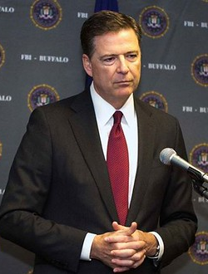

Security vs. privacy, or security vs. security
James Comey
Susan Landau
Notes:
Susan Landau is Bridge Professor in Cyber Security and Policy at The Fletcher School and the School of Engineering in the Department of Computer Science at Tufts University.
James Comey is a lawyer who served as the 7th director of the Federal Bureau of Investigation (FBI) under Barack Obama, from 2013 until May 2017.
"Join us as we play the clip from yesterday's press conference by FBI director James Comey. Listen LIVE at http://ift.tt/1NtUC1A" by Girard At Large is licensed under CC BY-SA 2.0
"Susan Landau" by Saul Tannenbaum is licensed under CC BY-NC-SA 2.0

Slide 11
The “Going Dark” Problem According to COmey
“If the communications provider is served with a warrant seeking those communications, the provider cannot provide the data because it has designed the technology such that it cannot be accessed by any third party… In short, the same ingenuity that has improved our lives in so many ways has also resulted in the proliferation of products and services where providers can no longer assist law enforcement in executing warrants.”
Notes:
This slide is included for the alternative version of Lesson B in which students are not assigned to read Comey’s testimony. His argument can be explained here briefly so students understand the claims.
The basic argument is that cryptography allows people to lock data forever, preventing law enforcement from accessing that data even when they have a warrant.

Slide 12
READING QUESTIONS
What does Comey mean when he claims that the FBI is “going dark”? What seems to be the central moral problem that arises from “going dark” and why?
According to Comey, what role does cryptography play in the “going dark” problem?
What does Landau mean when she claims that the central issue is not a conflict between security and privacy but a conflict between security and security? What seems to be the central moral problem that arises from this “security versus security story” and why?
According to Landau, what role does cryptography play in the “security versus security story”?
Notes:
These questions can be provided to students to help them Remember (Level 1) and Understand (Level 2) the texts as they do the readings.
This slide is included just so you can remind students of the reading questions and take any questions they might have.

Slide 13
Discussion QUESTIONS
In your view, which framing of the issue—Comey’s “privacy versus security” or Landau’s “security versus security”—is more convincing or insightful? Why?
How do computer scientists determine the ethical limitations of their technical contributions to law enforcement and national security agencies? In other words, what principle or principles can computer scientists use to decide when to accept or reject law enforcement and national security requests for technical assistance?
Based on what you know, what seems to be the most ethically sound solution to the law enforcement and national security problems the FBI claims to be facing and why? What would computer scientists have to do to help put this solution into practice?
Notes:
These questions are posed to students to help them Apply (Level 3), Analyze (Level 4), Evaluate (Level 5), and Create (Level 6) in response to the readings. It is helpful to provide students with a handout containing the discussion questions.

