Slide 1
Ethical Design and the Philosophy of Technology
This material developed by Patrick Anderson as part of the Mozilla Foundation Responsible Computer Science Challenge. This work is licensed under a Creative Commons Attribution-NonCommercial-ShareAlike 4.0 International License.

Slide 2
The basic Components of Ethical Theory
Means
the ways the outcomes are pursued
Which means are permissible and why?
Ends
the desired outcomes; the results deemed good
What ends are desirable and why?
Notes:
All moral philosophy is built around two concepts: means and ends. The ends are the desired outcomes, and the means are the ways the outcomes are pursued. Following from these two concepts are the basic questions of ethical theory: Which means are permissible and why? and What ends are desirable and why? Answers to such questions are normative or prescriptive, in that they take a stance how people ought and ought not behave. All ethical theories and ethical analyses have to some idea, some position on means and ends.
In the context of computer science and ethics, anyone working on data communications, networking, cybersecurity, or related security areas of computing must ask these two questions. In terms of desirable ends, computer scientists must go beyond the simple “end” of creating a functioning product. Instead, they must as themselves two questions: “What kind of behavior, what kinds of relationships, do I want to promote with the creation and distribution of this product?” and “Why are these behaviors and relationships morally desirable?”
In terms of permissible means, computer scientists must be able to distinguish between morally permissible and morally impermissible means; that is, they must differentiate action that they must never do from actions that they may do.
Cypherpunk ethics are relevant to computer science ethics because they require us to ask fundamental questions about how humans ought to be. If computer scientists are creating technologies that affect the overall structure of society, which they do by necessity, then they must ask what kind of society they wish to build and which means are justifiable in building that society. Cypherpunk ethics helps us reflect on these matters.

Slide 3
LESSON A
This material developed by Patrick Anderson as part of the Mozilla Foundation Responsible Computer Science Challenge. This work is licensed under a Creative Commons Attribution-NonCommercial-ShareAlike 4.0 International License.

Slide 4
Three Approaches to the Philosophy of technology
technological neutrality
technologies are neutral artifacts that have no meaning until used by individuals
morally relevant questions can be asked only about the users of technology and not about the technology itself
technological pessimism
technology is a force opposed to human autonomy or freedom
the only morally relevant questions involve opposing technology because technology is viewed as intrinsically bad or dangerous
technological hybridity
technology and humans create each other, that they constitute each other
both the user and the technology must be taken into consideration but also that a third element, the designer, must also be considered
Notes:
In the tradition of philosophy of technology, there are two dominant classical views: (1) technological neutrality, the view that technologies are neutral artifacts that have no meaning until used by individuals and (2) technological pessimism, the view that technology is a force opposed to human autonomy or freedom. In the last thirty years, however, a third, new philosophy of technology paradigm has emerged: (3) technological hybridity, the view that technology and humans create each other, that they constitute each other.
With the emergence of technological hybridity paradigm, it became possible to ask meaningful questions about the ethics of technology in general and about the ethics of design in particular. The technological neutrality paradigm assumes that morally relevant questions can be asked only about the users of technology and not about the technology itself. The technological pessimism paradigm assumes that the only morally relevant questions involve opposing technology because technology is viewed as intrinsically bad or dangerous. In other words, technological neutrality focuses on the agency of the user at the expense of the asking questions about the technology, while technological pessimism focuses on the seeming determinism of the technology at the expense of asking questions about user agency.
The technological hybridity paradigm, however, not only argues that both the user and the technology must be taken into consideration but also that a third element, the designer, must also be considered. On this view, any analysis of technology must account for the agency of the user, the values embedded in the technology, and the decisions and/or processes of the designers. In the context of computer science, the technological hybridity paradigm requires us to ask moral questions not only about the users and the hardware/software but, most importantly, about the way the designers themselves conceive, build, and distribute their creations.

Slide 5
Peter-Paul Verbeek
Mediation Theory
Notes:
Peter-Paul Verbeek is a Dutch philosopher of technology, chair of the philosophy department at the University of Twente, a member of the Dutch council for the Humanities, and chair of the Society for Philosophy and Technology. Mediation theory is the version of technological hybridity that will be covered in these lessons.
"Peter Paul Verbeek and Harold Bekkering" by TonZ is licensed under CC BY-NC-SA 2.0

Slide 6
READING QUESTIONS, Part 1
What does Verbeek seem to mean when he says that “humans and technologies should not be seen as two ‘poles’ between which there is an interaction; rather, they are the result of this interaction…[humans and technologies] are not pre-given entities but rather ones that mutually shape each other in the relations that come about between them”?
According to Verbeek, what is the difference between “extension” relations and “dialectics” relations between humans and technologies?
According to Verbeek, what are “hybridity” relations between humans and technologies, and why does he seem to favor this way of thinking about humans and technology?
Notes:
These questions can be provided to students to help them Remember (Level 1) and Understand (Level 2) the texts as they do the readings. This slide is included just so you can remind students of the reading questions and take any questions they might have.

Slide 7
READING QUESTIONS, Part 2
What is one “type of relation” identified by Verbeek? Can you think of an example of a technology not mentioned by Verbeek that represents this type of relation?
What are the four “points of contact” described by Verbeek?
What are the “types of influence” identified by Verbeek? Can you think of any example technologies that fit one of these types of influence?
What does Verbeek seem to mean when he says that “Designers materialize morality”?
Notes:
These questions can be provided to students to help them Remember (Level 1) and Understand (Level 2) the texts as they do the readings. This slide is included just so you can remind students of the reading questions and take any questions they might have.

Slide 8
Points of Contact
Point | Form | Description
To the Hand | Physical | When humans physically interact with a technological object
Before the Eye | Cognitive | When humans receive or interpret information provided by a technological object
Behind the Back | Contextual | When technology is part of the infrastructure of the human’s environment
Notes:
These mediation analysis charts are included in case instructors want to discuss or go over them.

Slide 9
Types of Relations
Embodiment | A relation in which the human and technology temporarily “merge” to interact with the world, like a telephone or a microscope
Hermeneutic | A relation in which the human interacts with a temporary “merger” of a technology with the world, like an MRI or a metal detector
Alterity | A relation in which the human interacts with a technology while the world remains in the background, like an ATM
Background | A relation in which technologies are part of the ambient background of human experience, like the humming of a refrigerator or air conditioner
Cyborg | A relation in which the human and technology permanently “merge” to interact with the world, such as a chip implanted in the brain (the main difference between an embodiment relation and a cyborg relation is the duration and depth of the merger between human and technology)
Immersion | A relation in which the human interacts with a permanent “merger” of a technology with the world, such as the internet of things and smart assistants (the main difference between a hermeneutic relation and a immersion relation is the duration and depth of the merger between technology and the world)
Augmentation | A relation in which there is a simultaneous embodiment and hermeneutic relation, such as with Google Glass
Notes:
These mediation analysis charts are included in case instructors want to discuss or go over them.

Slide 10
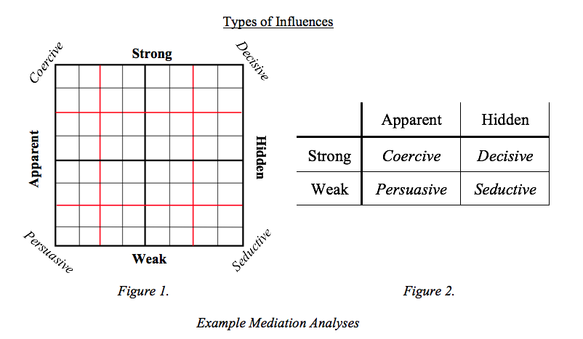
Notes:
These mediation analysis charts are included in case instructors want to discuss or go over them.

Slide 11
Mediation Analysis Questions
Ends: What kind of humanity does this technology seem to promote? Identify specific relationships or behaviors as evidence for your answer.
Means: What type of influence does this technology seem to impose on the human user: coercive, decisive, persuasive, or seductive? What is the evidence for this conclusion?
Notes:
These questions are posed to students to help them Apply (Level 3), Analyze (Level 4), Evaluate (Level 5), and Create (Level 6) in response to the readings. These questions do not fit on one slide, so it is helpful to provide students with a handout containing the discussion questions.

Slide 12
LESSON B
This material developed by Patrick Anderson as part of the Mozilla Foundation Responsible Computer Science Challenge. This work is licensed under a Creative Commons Attribution-NonCommercial-ShareAlike 4.0 International License.

Slide 13
Mediation Analysis Stage 1
Given the technology under consideration, determine the following:
What is the point of contact between the human and this specific technology: physical, cognitive, or contextual? What is the evidence for this conclusion?
What is the type of relation between the human and this specific technology? What is the evidence for this conclusion?
What type of influence does this specific technology seem to impose on the human user: coercive, decisive, persuasive, or seductive? What is the evidence for this conclusion?
Notes:
These questions are posed to students to help them Apply (Level 3) and Analyze (Level 4) in response to the readings.

Slide 14
Mediation Analysis Stage 2
Given the technology under consideration, determine the following:
Does the technology promote at least one type of desirable human relationship or behavior? If yes, what is that relationship or behavior and why/how does the technology promote it?
Does the technology impede at least one type of desirable human relationship or behavior? If yes, what is that relationship or behavior and why/how does the technology impede it?
To what extent do you think the designers intentionally or unintentionally designed the technology to promote or impede these relationships and behaviors? Do you think they would make any changes to the technology if you explained your analysis to them? Why or why not?
Notes:
These questions are posed to students to help them Apply (Level 3) and Analyze (Level 4) in response to the readings.

