Slide 1
Tribal Identity and the Rise of the American Indian/Alaskan Native population
By: Angel M. Stevens
Senior Thesis 2022
Advisor: Dr. Patrick Donnay
Bemidji State University

Slide 2
Who identifies the American Indian/Alaskan Native?
What determines the American Indian/Alaskan Native identity?
Why is it important to identify an American Indian/Alaskan Native?
What factors contribute to the recent surge in the AI/AN population?

Slide 3
Tribal Identity and the Rise of the AI/AN Population
There are 574 federally recognized tribes, according to the Federal Register. There are more than 400 tribes that are not federally recognized.
Recently, the AI/AN population had a tremendous surge. From 2 million in 2000 to 10 million in 2020 according to the US Census Bureau
Information obtained by the Census is used to determine the distribution of state & federal funding to assist tribes. In 2019, $675 million was used.

Slide 4
“What it means to be American Indian is complicated by the existence of tribal governments, indigenous homelands, tribal enrollment blood quantum requirements, and political relationships with the federal government. A person deciding whether to mark American Indian has extra dimensions to consider: ‘American Indian’ includes sometimes knotty political and/or legal statuses (and related contested identities) that are not an issue in nonindigenous groups”
Joining, Leaving, and Staying in the American Indian Race Category
Carolyn A. Liebler, Renuka Bhaskar, and
Sonya R. Porter (nee’ Rastogl)

Slide 5
Office of Management and Budget, 1997
”The federal definition of American Indian or Alaska Native is “a person having origins in any of the original peoples of North and South America (including Central America) and who maintains tribal affiliation or community attachment”

Slide 6
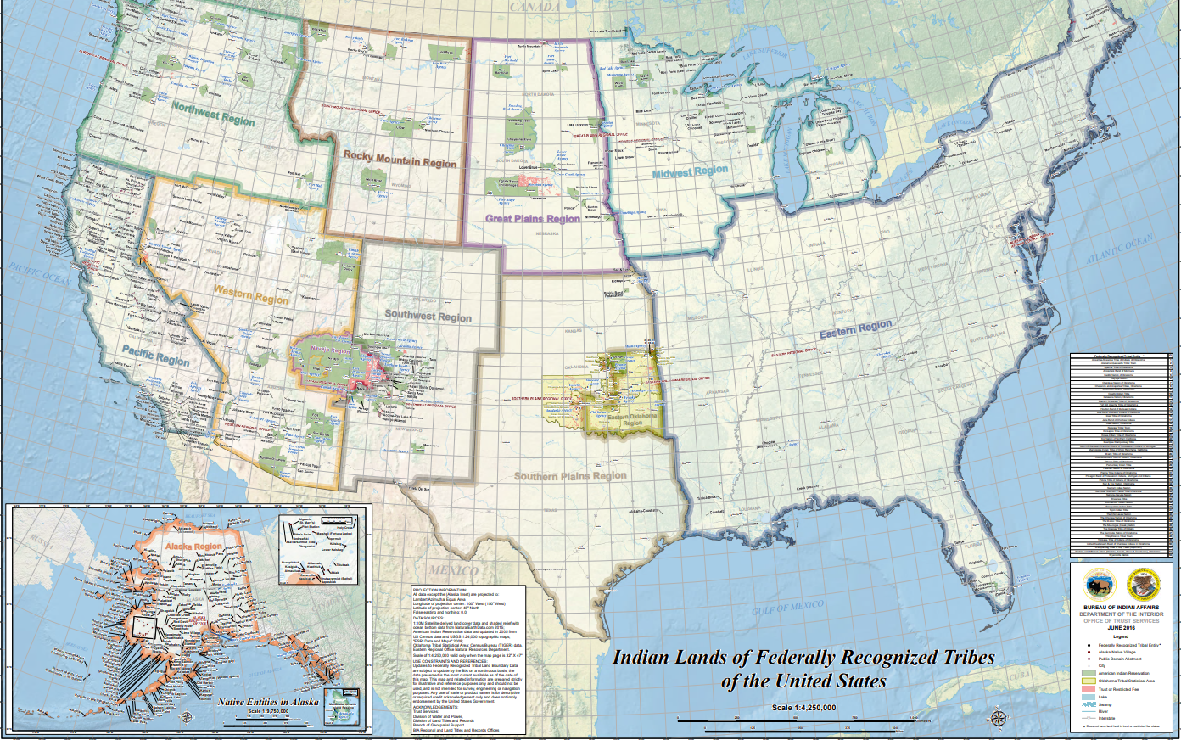
BIA TRIBAL REGIONS

Slide 7
Northwest Region
Idaho
Oregon
Washington
Rocky Mountain Region
Montana
Wyoming
Great Plains Region
North Dakota
South Dakota
Nebraska
Midwest Region
Minnesota
Wisconsin
Michigan
Iowa
Western & Southwest Region
Arizona
Colorado
Nevada
New Mexico
Utah
Southern Plains Region
Kansas
Oklahoma
Texas
Alaskan Region
Alaska
Hawaiin Region
Hawaii
Pacific Region
California
Eastern Region
Alabama
Arkansas
Mississippi
Connecticut
Delaware
District of Columbia
Florida
Georgia
Illinois
Indiana
Kentucky
Louisiana
Maine
Maryland
Massachusetts
Missouri
New Hampshire
New Jersey
New York
North Carolina
Ohio
Pennsylvania
Rhode Island
South Carolina
Tennessee
Vermont
Virgina
West Virgina

Slide 8
Hypothesis #1: Those who self-identify as American Indian/Alaskan Native will more than likely claim a specific tribal nation.

Slide 9
Hypothesis #2: Those who provide a specific tribal nation will be more than likely be located within the Western and Southwest Region.

Slide 10
Hypothesis #3: Those who provide a specific tribal nation will be more than likely be living in urban areas.
Rural/Rez: Chi Square = .000, Phi = .536 Cramers V = .379
Mixed: Chi Square = .000, Phi = .258, Cramers V = .183
Urban: Chi Square = .000, Phi = .400, Cramers V = .282

Slide 11
Hypothesis #4: Hispanic American Indian/Alaskan Native, specifically Mexicans, are more than likely to identify with a tribal nation.

Slide 12
Hypothesis #5: Those with higher education are more likely to provide a tribal identification.
MALE: Chi Square = <.001, Phi = .025 Cramers V = .018
FEMALE: Chi Square = <.001, Phi = .038, Cramers V = .027

Slide 13
The complexity of tribal identification is identified by various variables and factors, such as region and sex. This study shows that Urban Natives are most likely to identify as the American Indian/Alaskan Native. Education is not one of those factors that contribute to self identification. The American Community Survey now allows this population to express their own lineage. This seemingly simple gesture symbolizes the complex history of the AI/AN and their sense of identity.

