Slide 1

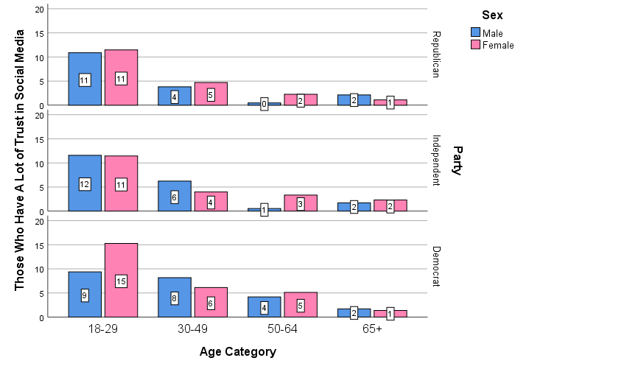
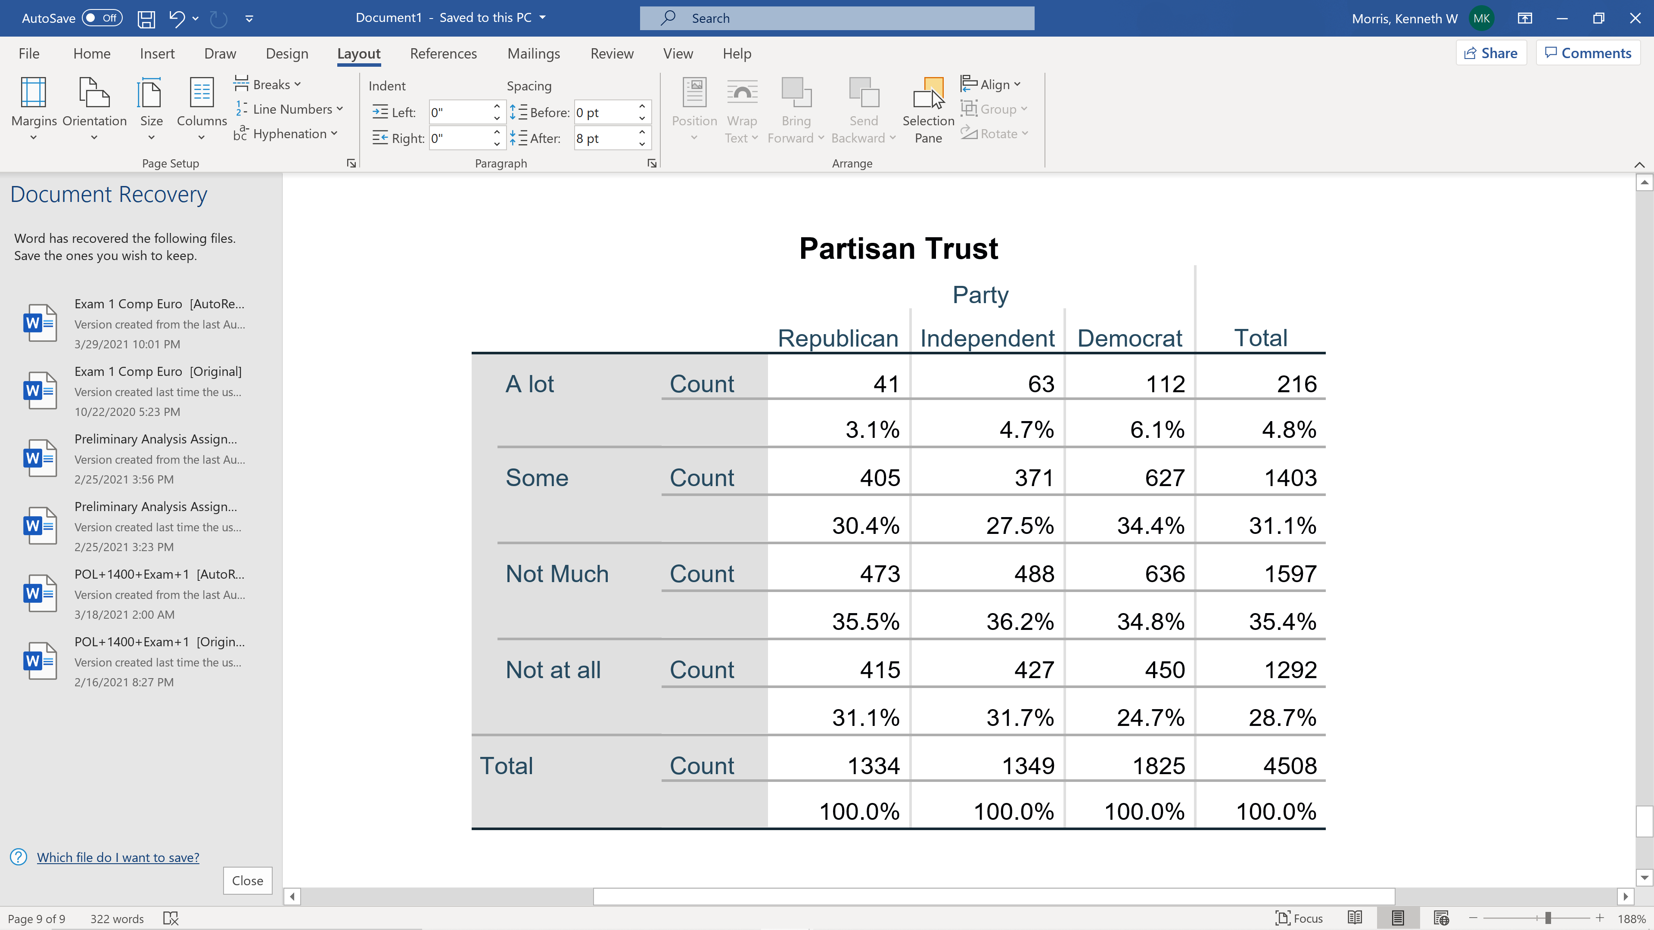
Partisan Trust in Social Media
Introduction
The use of social media to receive news has exploded in recent years and has raised the concerns of censorship and favoritism towards different political viewpoints. A survey by the PEW Research Center shows how different genders and age groups, within a political party, trust news received on social media.
Hypothesis and Analysis
Hypothesis: The younger age group (18-29) will
have more trust in social media than the older
age group (65+).
Hypothesis: Republicans will have less trust in social media than Democrats.
Literature
Crews & Melugin (2020) Embracing the idea of unregulated fake news everywhere
Pew Research Center (2019) Americans Are Wary of the Role Social Media Sites Play in Delivering the News
47 U.S. Code § 230 (Section 230)
Somers’d = -.071
Chi-Squared = 44.813, p < .001
Somers’d = .232
Chi-Squared = 431.345, p < .001
Results and Implications
The data results from both tests accept the hypotheses, showing that Republicans and the age group of 65 and older are more skeptical and have less trust in the news on social media platforms.
Kenneth Morris

