Slide 1

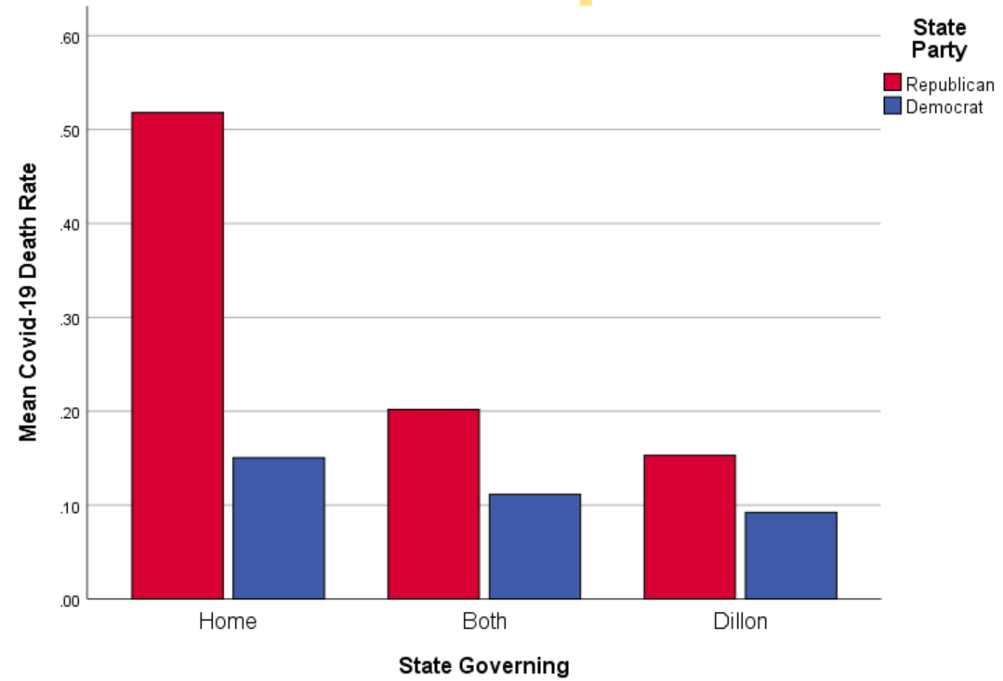
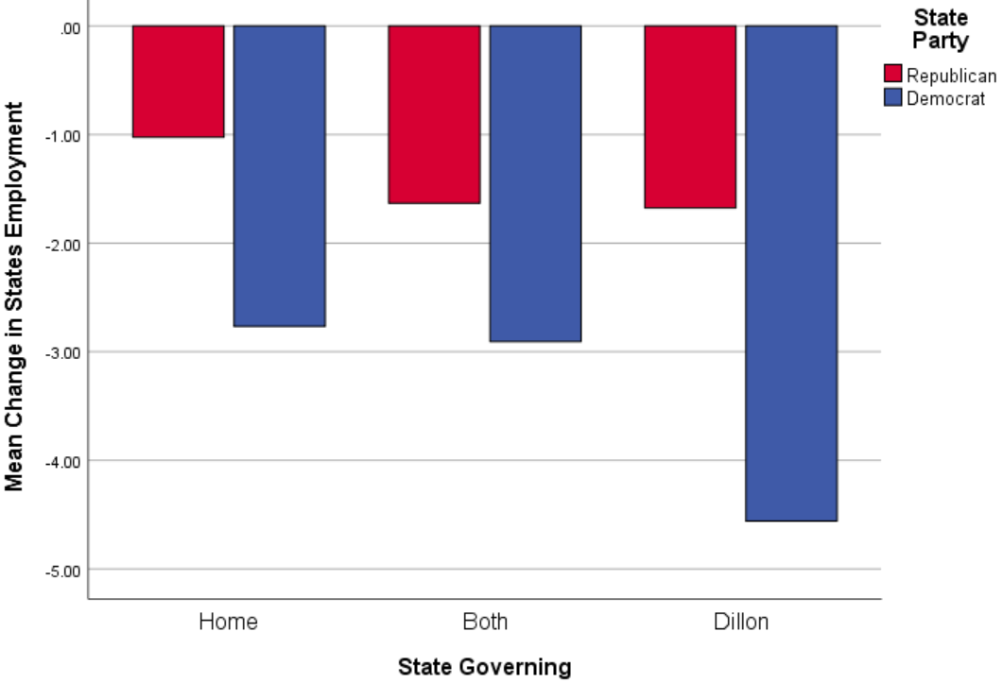
Dillon Rule States versus Home Rule States: Do the Different State Systems Make an Impact on Addressing COVID-19
Introduction
How does a state measure success when dealing with a pandemic like Covid-19? How does a state keep their citizens happy and protected during a pandemic? When local governments must wait for the state to create policies, really the best option for the state?
Hypothesis and Analysis
Lambda = .156, sig = .157, Chi Square = 3.695, sig = .449
Literature
Dillon’s Rule v. Home Rule
Covid-19 unemployment and death counts
State preemption better or worse
Local governments or state preemptions
Lambda = .121, sig=.279, Chi Square = 2.482, sig = .648
Implications / Results
The data shows that States under Dillon’s Rule have higher unemployment cases, but lower deaths due to the Covid-19 pandemic.
States that have more authority over the day-to-day policies, have a higher success rate than those of the local government authority.

