Slide 1
The Impact of Women and Intersectionality on Bill Success
Maggie Lowrey
Bemidji State University
Thesis Advisor: Dr. Patrick Donnay
Senior Thesis

Slide 2

Introduction
Bill success in State Legislatures
The importance of co-sponsors for women
Notes:
Most bills that are introduced in state legislatures do not progress to the voting stage let alone actually passing and becoming a law. A significant factor that leads to bill success is the sponsorship of bills. So who sponsors a bill and why? There are many factors that contribute to who is sponsoring a bill and why. A few of the factors that I focused on are women alone and the racial diversity of women. I also studied the effect of political party and bipartisan sponsors. My research is a continuation of Mirya Holman, Anna Mahoney, and Emma Hurler’s article Let’s Work Together: Bill Success via Women’s Cosponsorship in U.S. State Legislatures, in which their research focused on women and bipartisanship exclusively.
Their research highlighted the notion of “power in numbers” regarding women cosponsorship. They found that women sponsored bills were most successful with multiple women sponsors and if they had women from both republican and democratic parties supporting the bill.

Slide 3
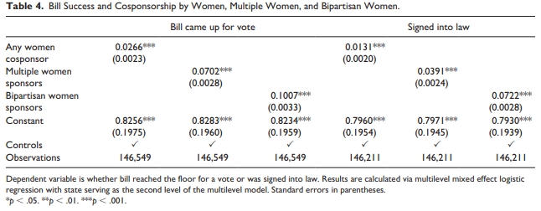
Introduction
Notes:
According to their analysis, there is a positive relationship between women cosponsors and whether bills came up for a vote or were signed into law. With at least one-woman cosponsor a bill was 2.6% more likely of coming up for a vote and 1.3% more likely of being signed into law. When there were multiple women sponsors the chances of a bill coming up for a vote increased by 7% and increased by 3.9% to be signed into law. When they controlled for Bipartisan women sponsors, the odds increased by 10% for coming up for a vote and 7.2% to be signed into law. This table represents these relationships in a logistic regression analysis which is how I also analyzed my data.

Slide 4
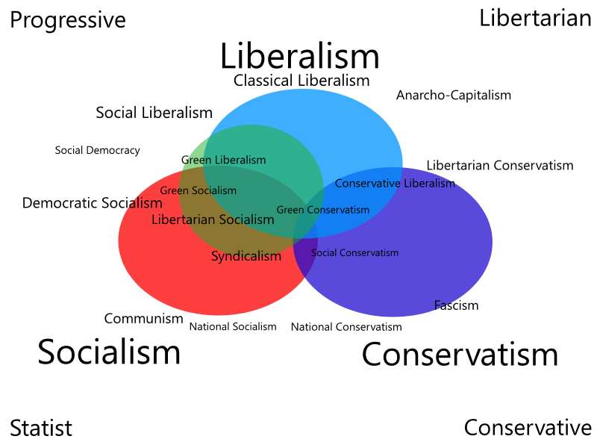
What else affects bill success?
Type of bill
  High Quality/Necessary bills
Legislator characteristics
  Party Affiliation
  Expertise
  Ideology
Notes:
Many bills struggle to even come up for a vote if they are not considered high quality or necessary such as budget bills. The quality of the bill is a major driving factor it is success as higher quality bills are more likely to attract expert sponsors and increase the total number of sponsors. (Hitt, Volden, and Wiseman 2017; Alder and Wilkerson 2015)
Legislator Characteristics also affect bill success. A few significant characteristics are a legislator’s party affiliation, majority or minority party status, their credibility on their expertise, and their personal ideologies (Kirkland 2011). Members of the majority party see more of their bills pass through legislation as do those with greater expertise on the content of the bill. Minority parties and extreme ideological sponsors are likely to encourage and shoulder excessive investments to ensure the passage of their bills. Because this does tactic does not guarantee success it can be an ineffective way to try to pass legislation (Hitt, Volden, and Wiseman 2017).

Slide 5
How do gender and race factor in?
Marginalization
  leads to overcompensation of their efforts
  Creates a need for collaboration
Policy Priorities
  “women’s issues”
  Created women’s caucuses and commissions
Notes:
Women face the struggle of marginalization when they are in these leadership positions. This leads to overcompensation of their efforts in order to accurately compete with their male colleagues. Because of this, women often lean into collaboration with others on bills to increase their expertise, sponsor more bills, and proactively respond to constituent concerns (Lazarus and Steigerwalt 2018). Read quote 2: Speculation about the effects of this collaboration and networking will lead to future electoral success.
Policy priorities are a factor that differs among men and women. Women have introduced types of bills that address issues that did not appear to be relevant prior to the increase in women legislators. These bills are typically labeled as “women’s issues” such as nursing rooms and women’s bathrooms in public places. This change in bill type led to the creation of women’s caucuses and commissions (Holman and Mahoney 2019; Kanthak and Krause 2012). These policy priorities have initiated a change in the issue agenda of many legislative bodies (Atkeson and Carrillo 2007; Osborn 2012; Swers 2002).

Slide 6
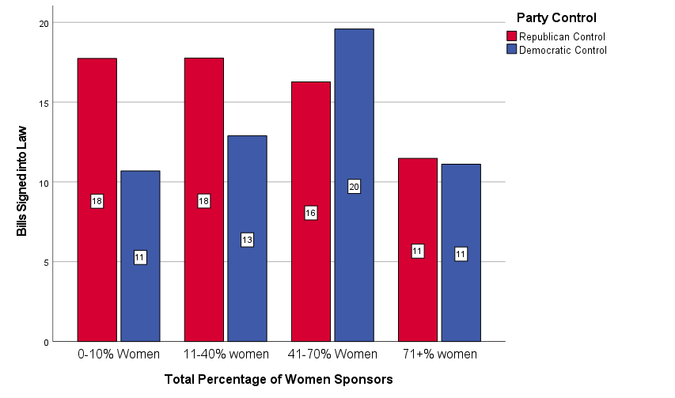
How the Success of a Bill Becoming a Law is Affected by the Percentage of Women Sponsors
 | 0-10% Women Sponsors | 11-40% women Sponsors | 41-70% Women Sponsors | 71+% Women Sponsors | Total
Bills became law under Republican Control | 17.7% | 17.8% | 16.3% | 11.5% | 16.9%
Bills became law under Democratic Control | 10.7% | 12.9% | 19.6% | 11.1% | 12.4%
This categorical variable shows statistical significance of Chi = p<0.001 and signifies a weak relationship measured by Cramer’s V with a value of 0.045.
Notes:
Overall rep control has higher passage of bills as pct of women increases. This difference can be attributed to the fact that moderate sponsors

Slide 7
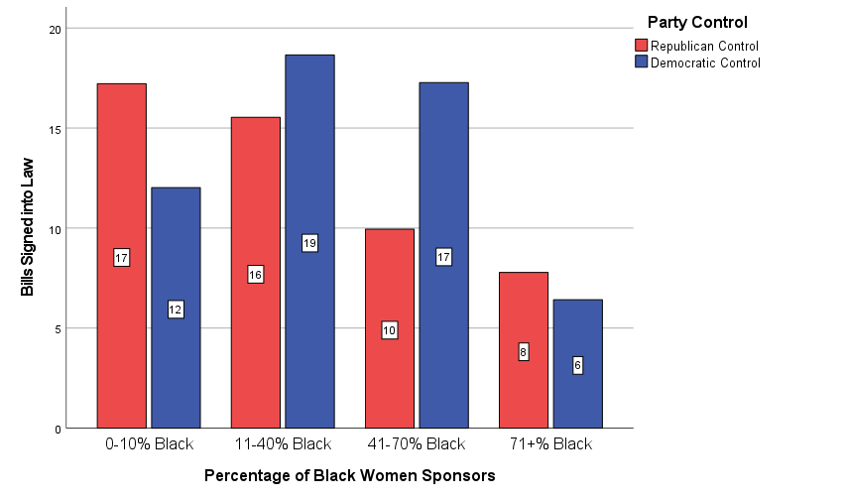
How the Success of a Bill Becoming a Law is Affected by the Percentage of Black Women Sponsors
 | 0-10% Black Women Sponsors | 11-40% Black Women Sponsors | 41-70% Black Women Sponsors | 71+% Black Women Sponsors | Total
Bills became law under Republican Control | 17.2% | 15.5% | 9.9% | 7.8% | 16.9%
Bills became law under Democratic Control | 12.0% | 18.7% | 17.3% | 6.4% | 12.4%
This categorical variable shows statistical significance of Chi = p<0.001 and signifies a weak relationship measured by Cramer’s V with a value of 0.035.
Notes:
Overall dem control has higher bill passage as pct of blacks increase

Slide 8
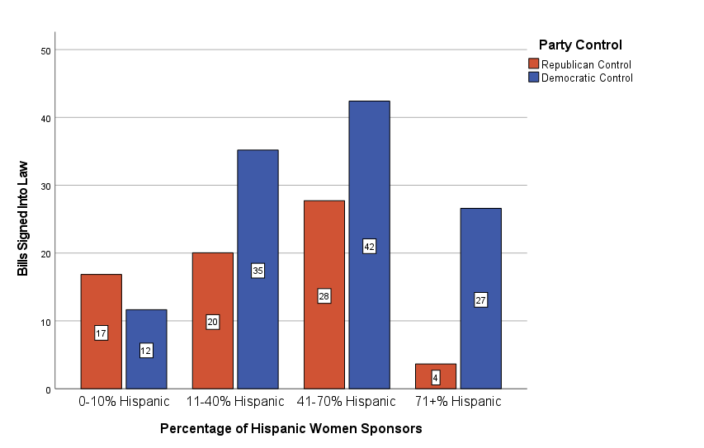
How the Success of a Bill Becoming a Law is Affected by the Percentage of Hispanic Women Sponsors
 | 0-10% Hispanic Women Sponsors | 11-40% Hispanic Women Sponsors | 41-70% Hispanic Women Sponsors | 71+% Hispanic Women Sponsors | Total
Bills became law under Republican Control | 16.9% | 20.0% | 27.7% | 3.7% | 16.8%
Bills became law under Democratic Control | 11.7% | 35.2% | 42.4% | 26.6% | 12.4%
This categorical variable shows statistical significance of Chi = p<0.001 and signifies a weak relationship measured by Cramer’s V with a value of 0.052.
Notes:
Overall dem control has higher passage of bills as pct of Hispanics increase

Slide 9
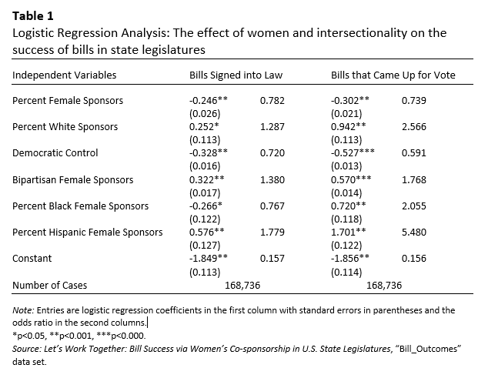
Results
Notes:
The odds Ratio = -22% Signed into Law and -26% of a bill coming up for a vote

Slide 10
Results
Notes:
Odds Ratio = -28% signed into law and -41% coming up for vote

Slide 11
Results
Notes:
Odds Ratio = -23% Blacks Signed into law +78% Hispanics signed into law

Slide 12
References
Alder, E. Scott, and John D. Wilkerson. 2013. Congress and the Politics of Problem Solving. Cambridge University Press.
Atkeson, Lonna Rae, and Nancy Carrillo. 2007. “More Is Better: The Influence of Collective Female Descriptive Representation on External Efficacy.” Gender and Politics 3 (1) 79-101.
Hitt, Matthew P., Craig Volden, and Alan E. Wiseman. 2017. “Spatial Models of Legislative Effectiveness.” American Journal of Political Science 61 (3) 575-90
Holman, Mirya R., and Anna Mahoney. 2019. “The Choice Is Yours: Caucus Typologies and Collaboration in U.S. State Legislatures.” Representation 55 (1): 47-63. doi:10.1080/00344893.2019.1581079
Holman, M. R., Mahoney, A., & Hurler, E. (2021). Let’s work together: Bill Success via women’s cosponsorship in U.S. state legislatures. Political Research Quarterly, 106591292110201. https://doi.org/10.1177/10659129211020123
Kanthak, Kristin., and George A. Krause. 2012. The Diversity Paradox. New York: Oxford University Press.

Slide 13
References
Kirkland, Justin H. 2011. “The Relational Determinants of Legislative Outcomes: Strong and Weak Ties between Legislators.” The Journal of Politics 73 (3): 887-98.
Lazarus, Jeffery., and Amy Steigerwalt. 2018. Gendered Vulnerability. Ann Arbor: University of Michigan Press.
Osborn, Tracy. 2012. How Women Represent Women: Political Parties, Gender and Representation in the State Legislatures. New York: Oxford University Press.
Swers, Michele L. 2002. The Difference Women Make: The Policy Impact of Women in Congress. Chicago: University of Chicago Press.

Slide 14

Questions?

