Slide 1
Tribal Identity and the Rise of the American Indian/Alaskan Native population
By: Angel M. Stevens
Senior Thesis 2022
Advisor: Dr. Patrick Donnay
Bemidji State University

Slide 2
Who identifies the American Indian/Alaskan Native?
What determines the American Indian/Alaskan Native identity?
Why is it important to identify an American Indian/Alaskan Native?
What factors contribute to the recent surge in the AI/AN population?

Slide 3
Tribal Identity and the Rise of the AI/AN Population
There are 574 federally recognized tribes, according to the Federal Register. There are more than 400 tribes that are not federally recognized.
Recently, the AI/AN population had a tremendous surge. From 2 million in 2000 to 10 million in 2020 according to the US Census Bureau
Information obtained by the Census is used to determine the distribution of state & federal funding to assist tribes. In 2019, $675 million was used.

Slide 4
“What it means to be American Indian is complicated by the existence of tribal governments, indigenous homelands, tribal enrollment blood quantum requirements, and political relationships with the federal government. A person deciding whether to mark American Indian has extra dimensions to consider: ‘American Indian’ includes sometimes knotty political and/or legal statuses (and related contested identities) that are not an issue in nonindigenous groups”
Joining, Leaving, and Staying in the American Indian Race Category
Carolyn A. Liebler, Renuka Bhaskar, and
Sonya R. Porter (nee’ Rastogl)

Slide 5
  Office of Management and Budget, 1997
”The federal definition of American Indian or Alaska Native is “a person having origins in any of the original peoples of North and South America (including Central America) and who maintains tribal affiliation or community attachment”

Slide 6
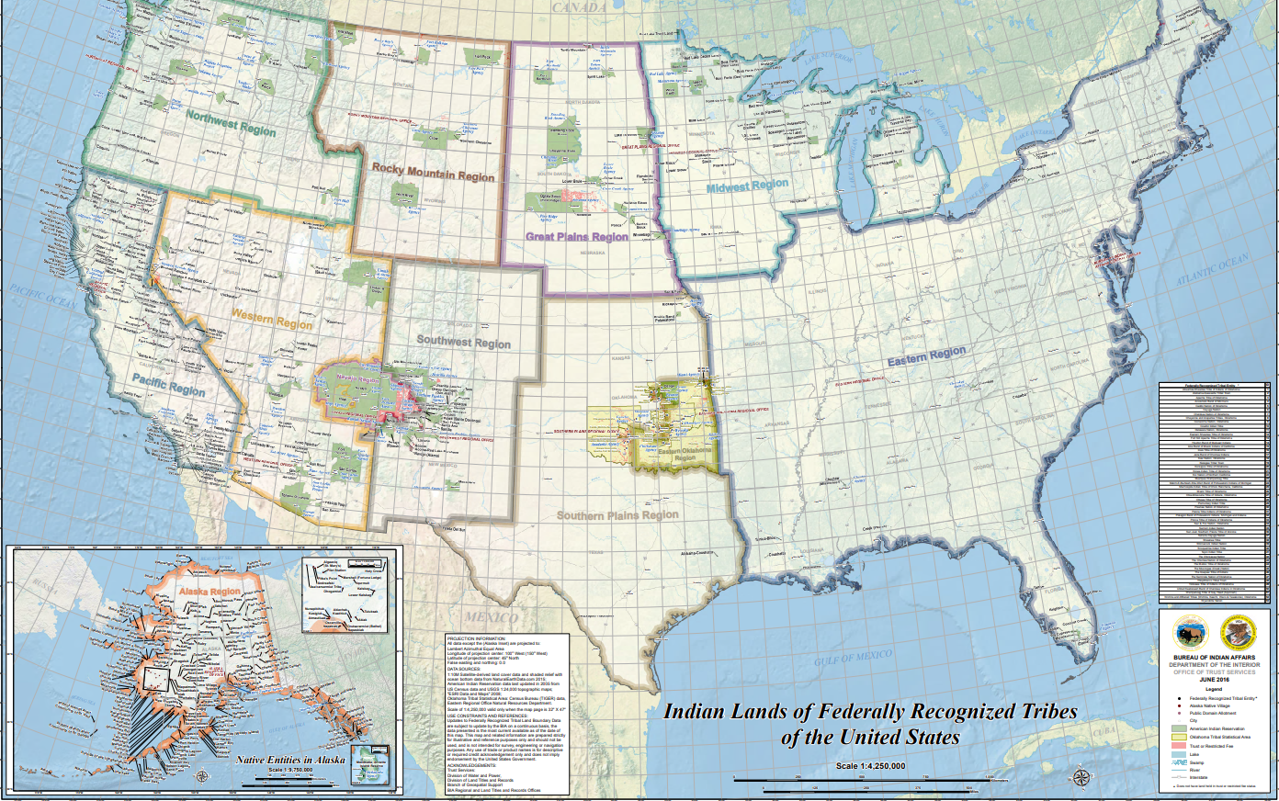
BIA TRIBAL REGIONS

Slide 7
Northwest Region
  Idaho
  Oregon
  Washington
Rocky Mountain Region
  Montana
  Wyoming
Great Plains Region
  North Dakota
  South Dakota
  Nebraska
Midwest Region
  Minnesota
  Wisconsin
  Michigan
  Iowa
Western & Southwest Region
  Arizona
  Colorado
  Nevada
  New Mexico
  Utah
Southern Plains Region
  Kansas
  Oklahoma
  Texas
Alaskan Region
  Alaska
Hawaiin Region
  Hawaii
Pacific Region
  California
Eastern Region
  Alabama
  Arkansas
  Mississippi
  Connecticut
  Delaware
  District of Columbia
  Florida
  Georgia
  Illinois
  Indiana
  Kentucky
  Louisiana
  Maine
  Maryland
  Massachusetts
  Missouri
  New Hampshire
  New Jersey
  New York
  North Carolina
  Ohio
  Pennsylvania
  Rhode Island
  South Carolina
  Tennessee
  Vermont
  Virgina
  West Virgina

Slide 8
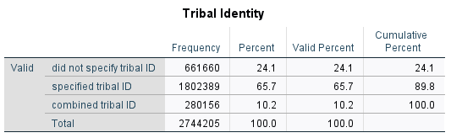
Hypothesis #1:
Those who self-identify as American Indian/Alaskan Native will more than likely claim a specific tribal nation.

Slide 9
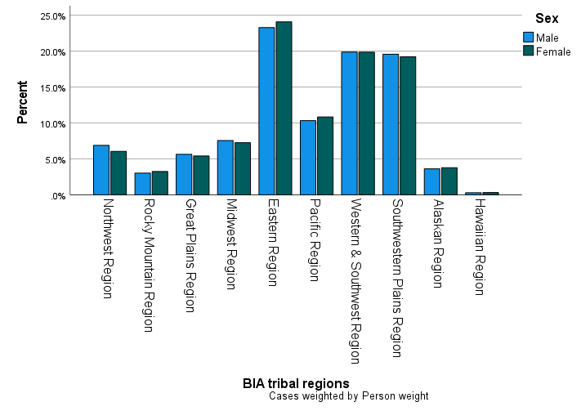
Hypothesis #2: Those who provide a specific tribal nation will be more than likely be located within the Western and Southwest Region.

Slide 10
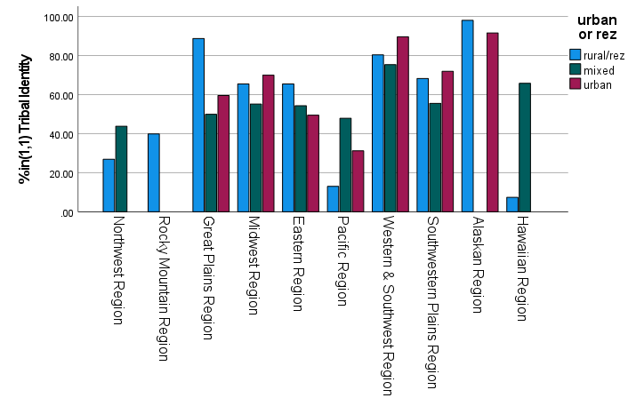
Hypothesis #3: Those who provide a specific tribal nation will be more than likely be living in urban areas.
Rural/Rez: Chi Square = .000, Phi = .536 Cramers V = .379
Mixed: Chi Square = .000, Phi = .258, Cramers V = .183
Urban: Chi Square = .000, Phi = .400, Cramers V = .282

Slide 11
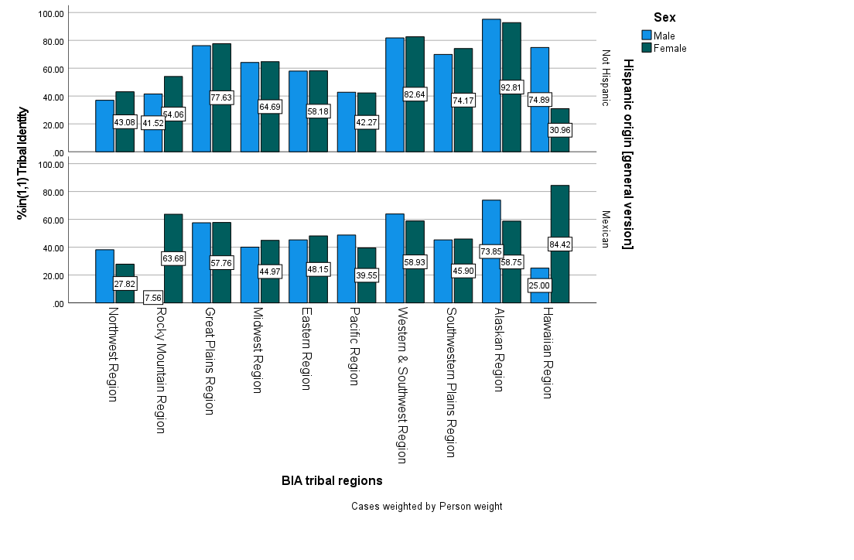
Hypothesis #4: Hispanic American Indian/Alaskan Native, specifically Mexicans, are more than likely to identify with a tribal nation.

Slide 12
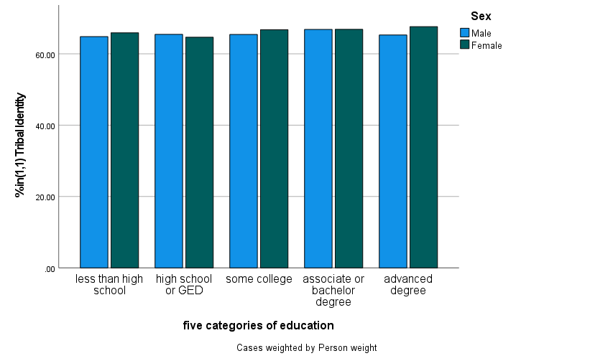
Hypothesis #5: Those with higher education are more likely to provide a tribal identification.
MALE: Chi Square = <.001, Phi = .025 Cramers V = .018
FEMALE: Chi Square = <.001, Phi = .038, Cramers V = .027

Slide 13
The complexity of tribal identification is identified by various variables and factors, such as region and sex. This study shows that Urban Natives are most likely to identify as the American Indian/Alaskan Native. Education is not one of those factors that contribute to self identification. The American Community Survey now allows this population to express their own lineage. This seemingly simple gesture symbolizes the complex history of the AI/AN and their sense of identity.

