Slide 1
Do voter ID requirements impact voter turnout in Minnesota and Wisconsin?
Jacob Berg
Senior Thesis 2022

Slide 2
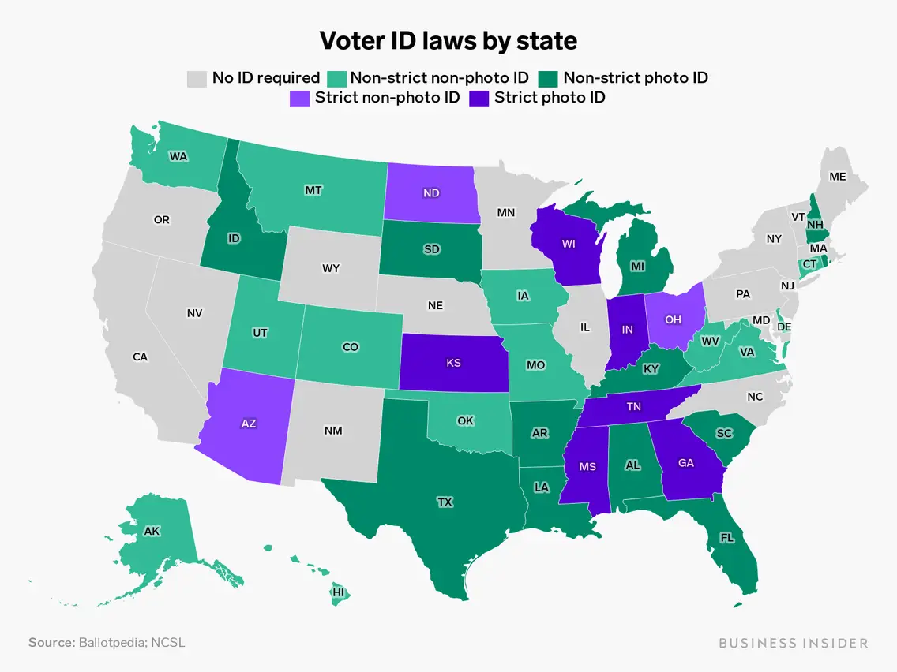
Voter ID requirements
Two types of laws
  Strict voter ID laws
  Non-strict Voter ID laws
    34 States with A form of voter ID
Wisconsin
Voter ID passed in 2012

Slide 3
Previous Literature
“There are substantial drops in minority turnout in strict voter ID states and no real changes in white turnout.” (Hajnal et al., 2017)
  Used CCES Data
“While augmented national survey data have useful applications, they have limited use in this context.” (Grimmer et al., 2018)
“It appears that neither set of authors actually, reports a key quantity of interest: the net effect of voter ID laws on minority turnout.” (Burden, 2018)

Slide 4
Data Sources
Census Bureau
  ACS(American Community Survey)
Minnesota Secretary of State
Wisconsin Election Commission
Census bureau
  Age
  Race
  Education
  Voting Age Population
Minnesota Secretary of State
  Registered Voters
  Total votes cast in each county
Wisconsin Election Commission
  Registered Voters
  Total votes cast in each county

Slide 5
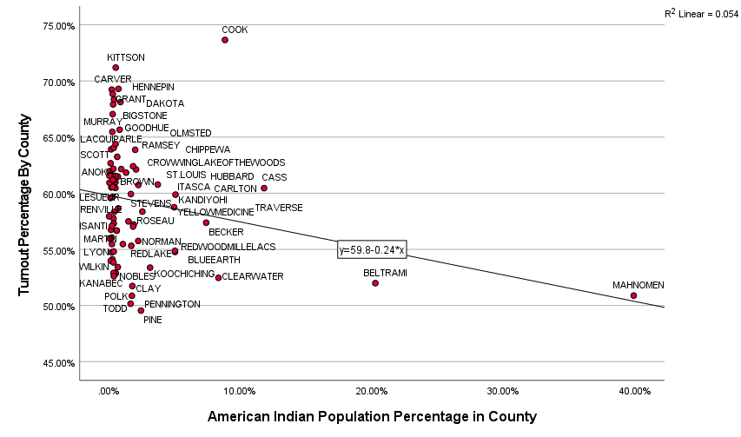
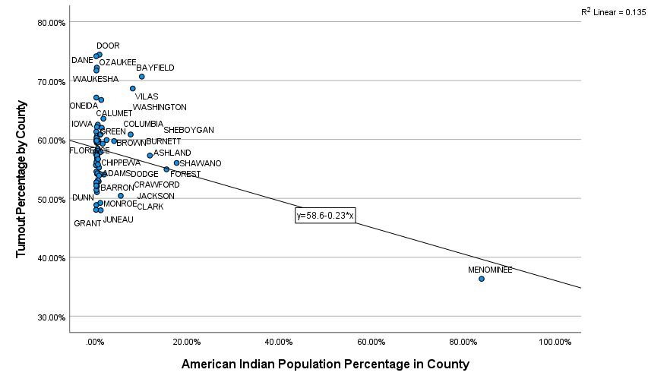
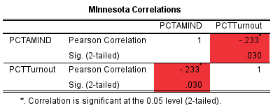

Minnesota Vs Wisconsin American Indian Turnout

Slide 6
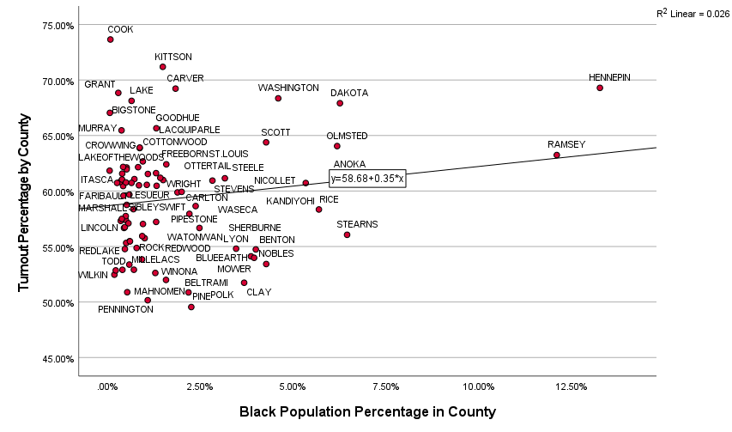
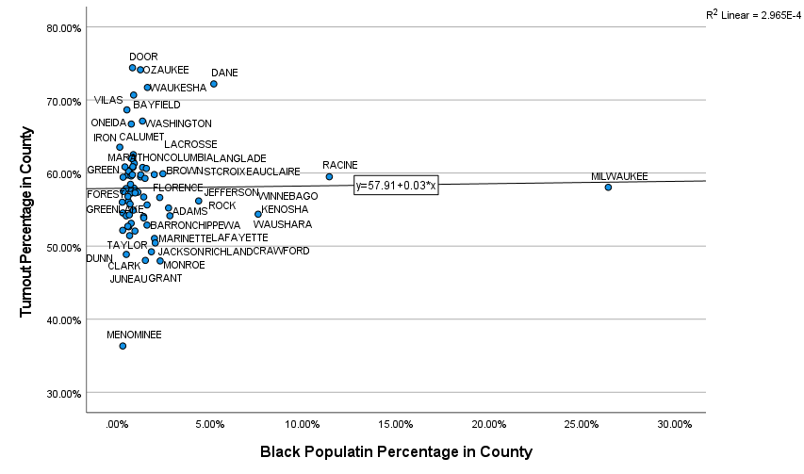
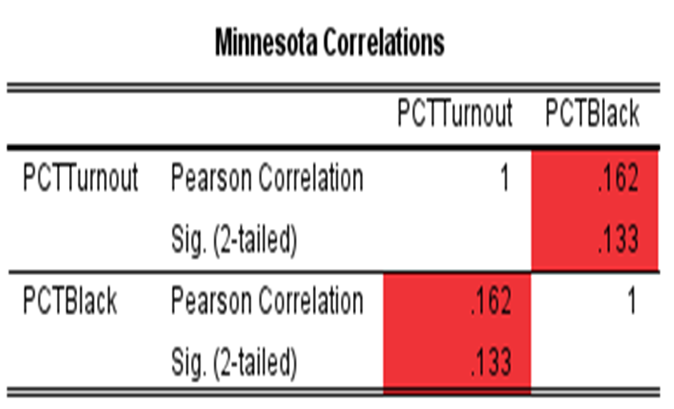

Minnesota Vs. Wisconsin Black Turnout

Slide 7
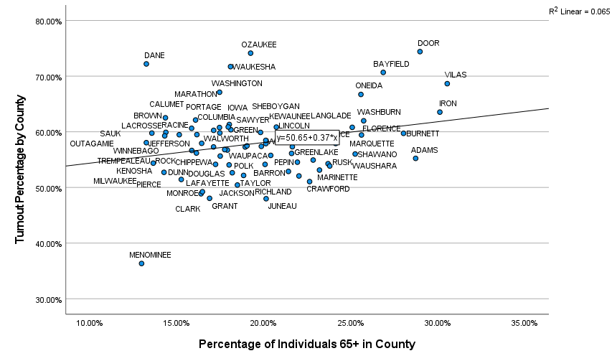
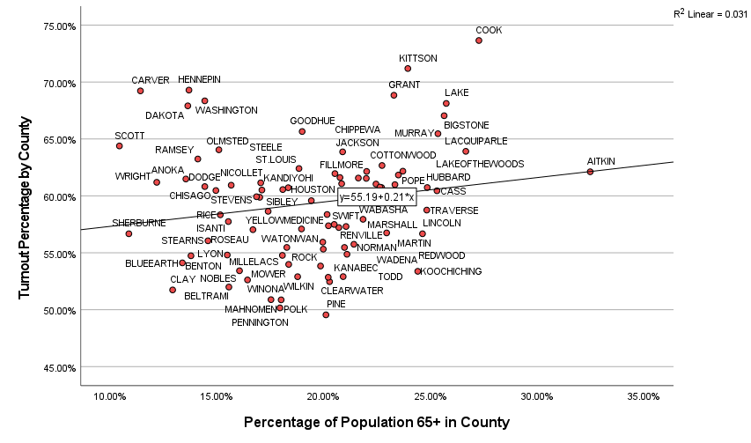
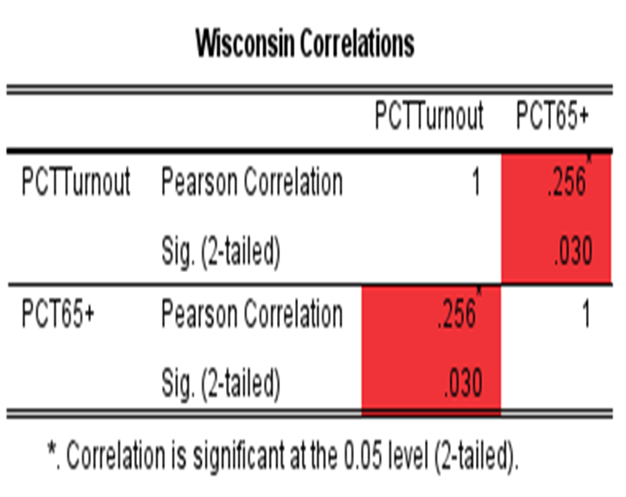
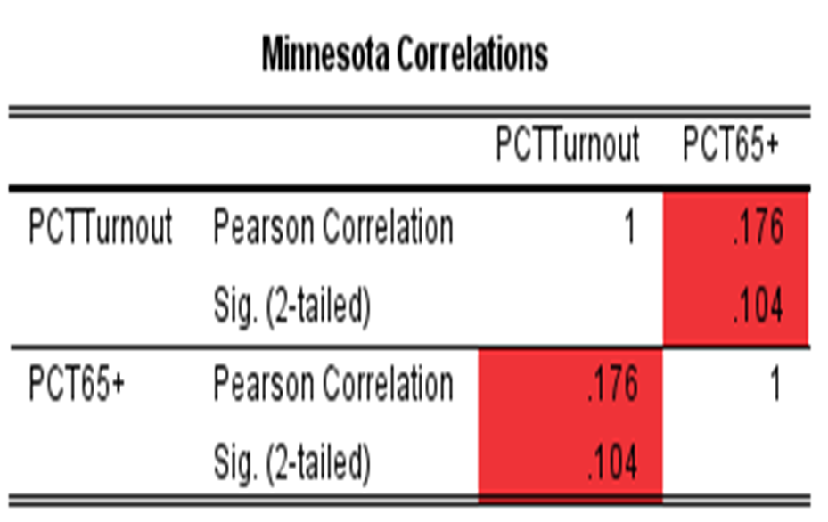
Minnesota Vs Wisconsin Age 65+ Turnout

Slide 8
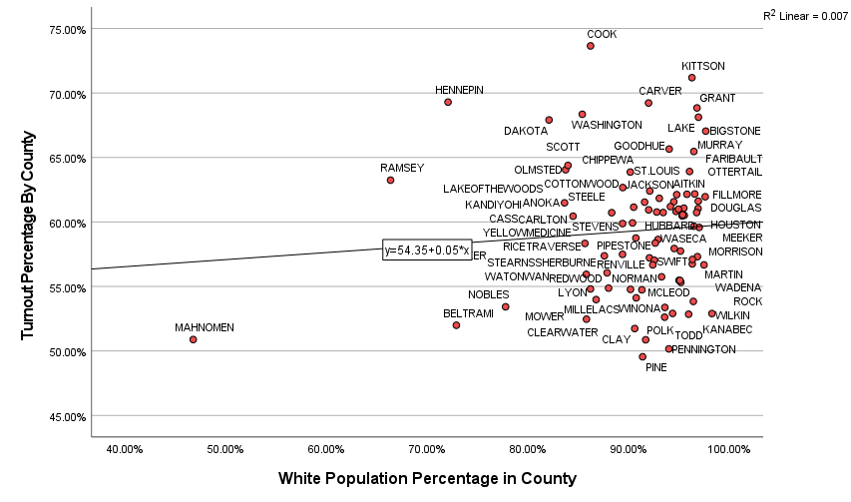
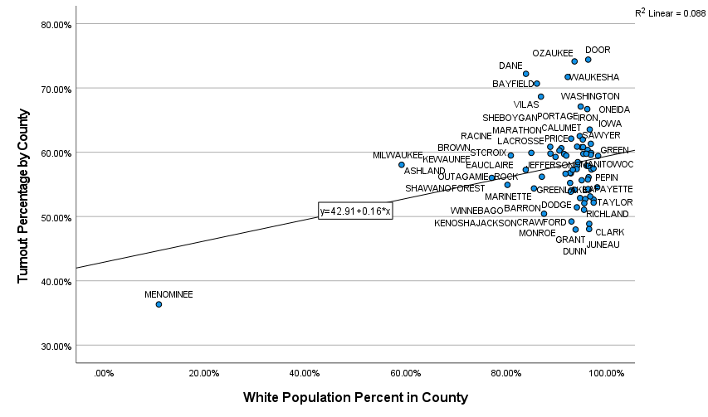
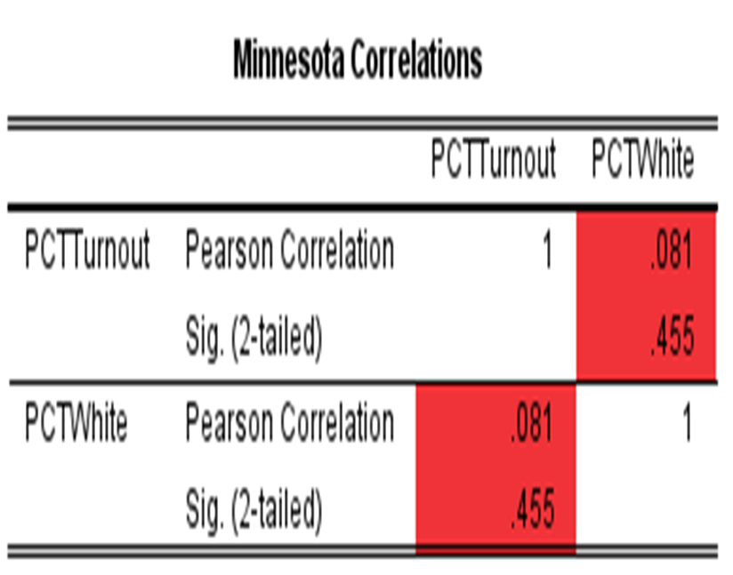
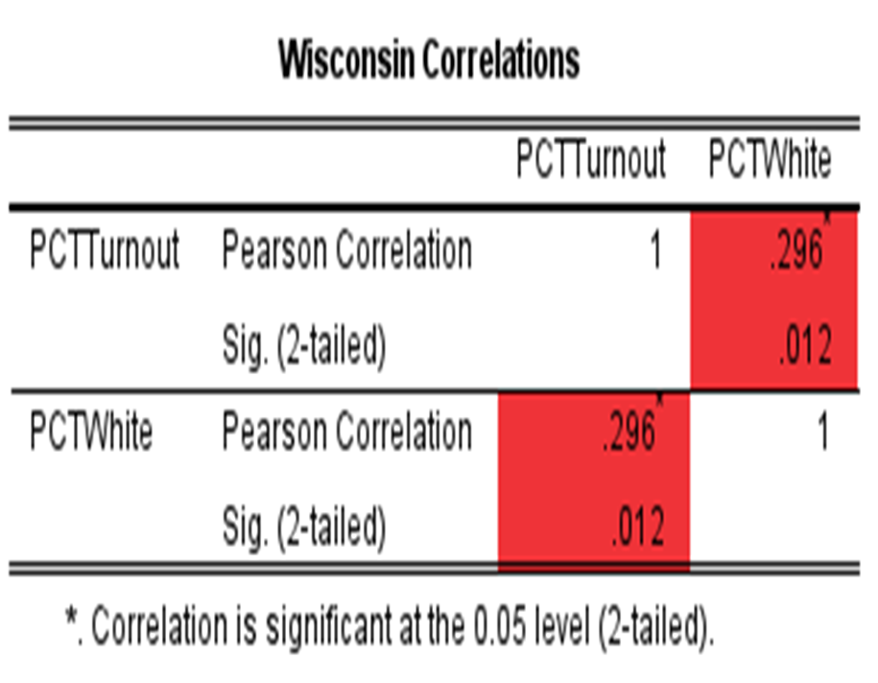
Minnesota Vs Wisconsin White Turnout

Slide 9
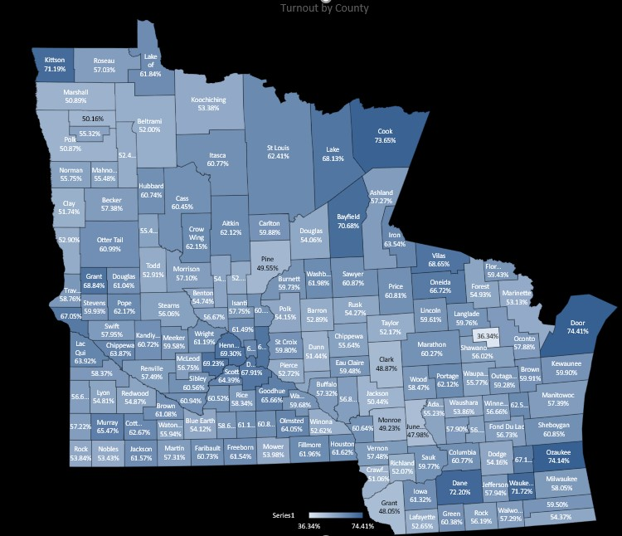
Minnesota Vs. Wisconsin Total Turnout by County

Slide 10
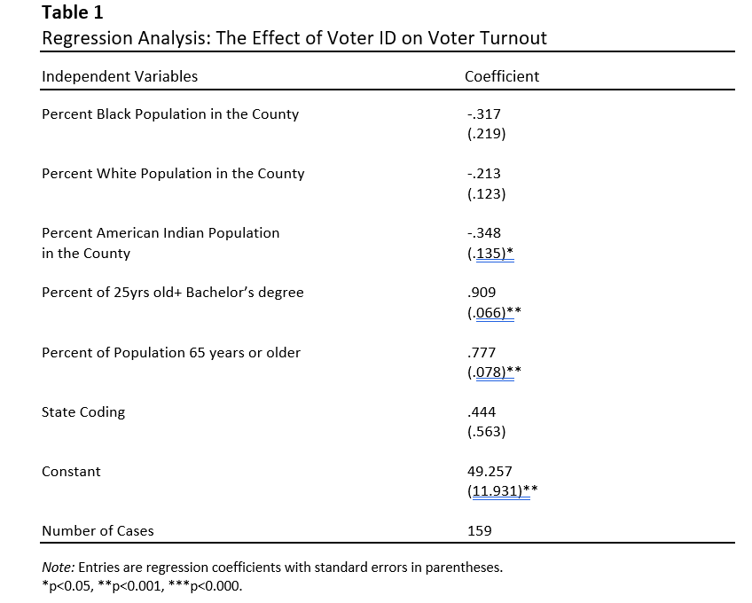
Regression Analysis

Slide 11
What does this mean?
The results are mixed
  Native Americans are the only group is negatively affected
  Bachelor degree holders and age group 65+ turnout is significant between Wisconsin and Minnesota
  Black turnout is not significantly affected between Wisconsin and Minnesota

Slide 12
Thank You
Questions?

