Slide 1


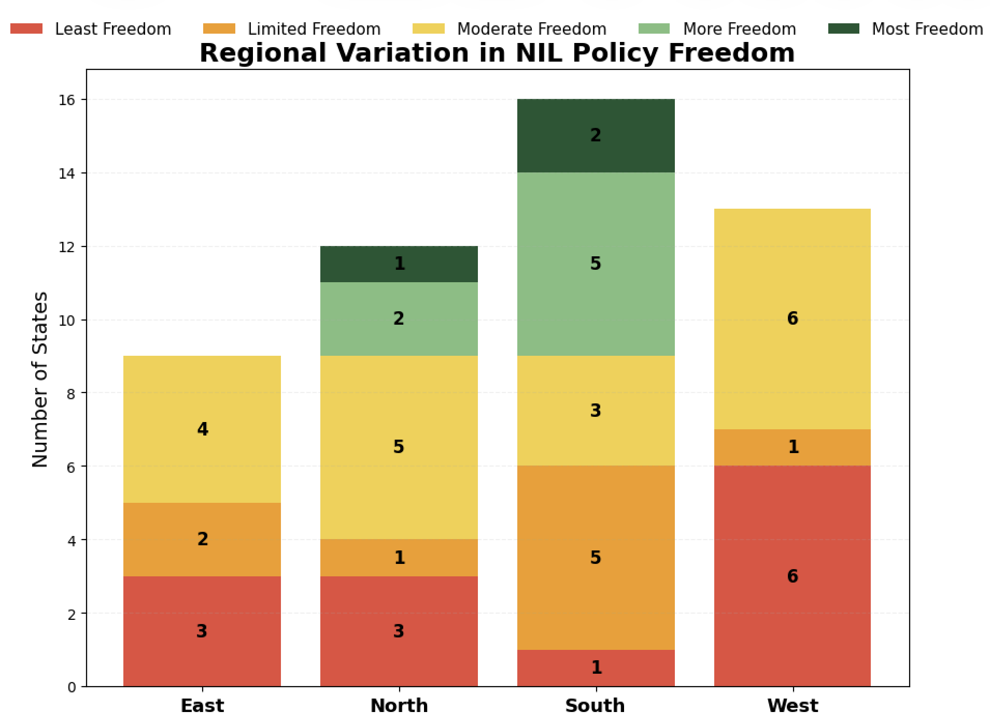
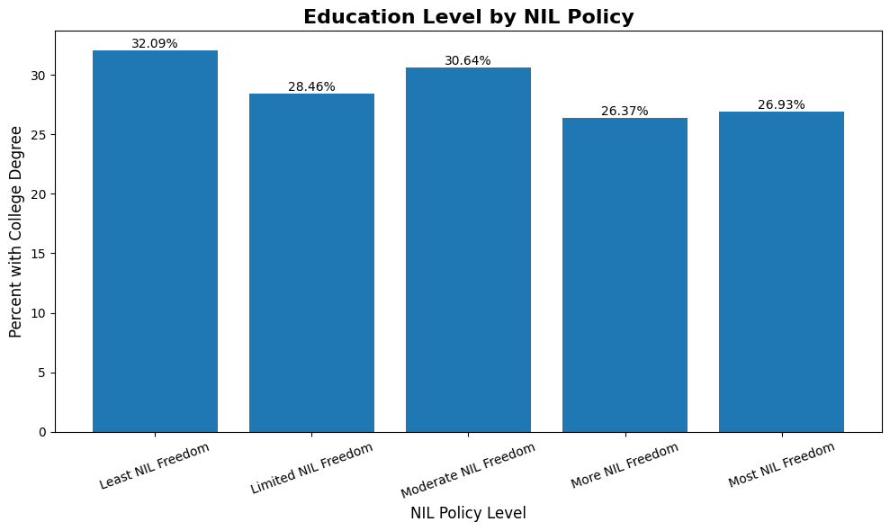
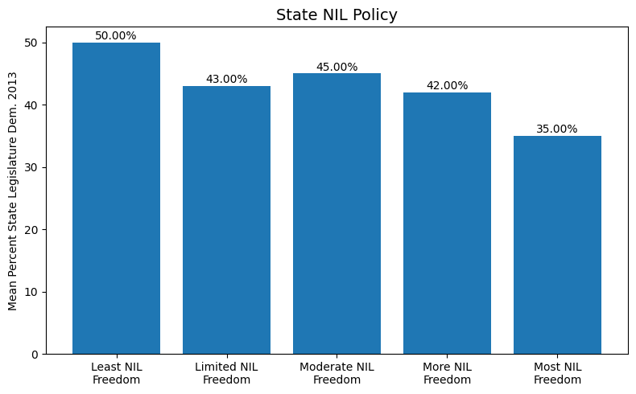
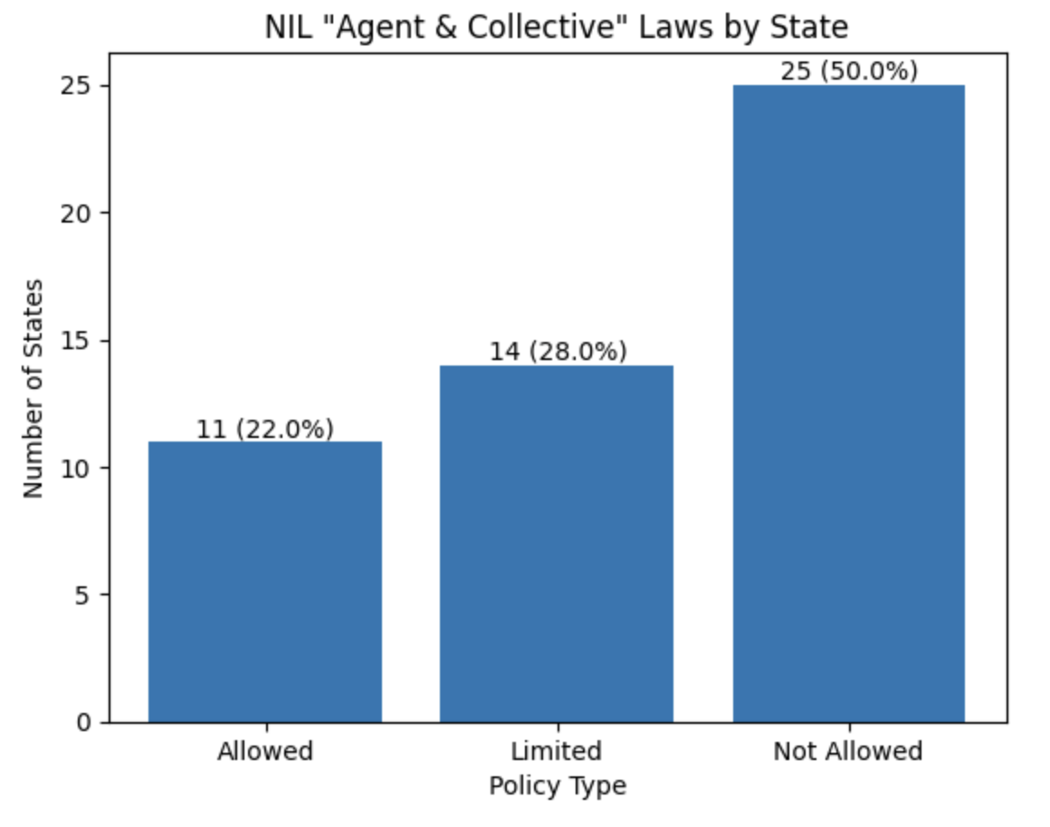
State Control of NIL Regulation: A Comparative Analysis of State NIL Statutes
By: Benjamin J. Corradi
Hypotheses and Analysis
Abstract
Name, Image, and Likeness (NIL) policies have transformed college athletics by allowing athletes to earn money from their own brands, but they also introduce inequalities and unfair regulations. Key issues include legal disputes, unequal competition, financial instability, and differences in institutional support. While NIL expands opportunities, it raises questions about oversight, fairness, and long-term effects. This highlights the need for more comprehensive research.
Hypothesis 1:
Southern states tend to have more NIL freedoms
while other states tend to have less.
Hypothesis 2:
States with higher college education levels
tend to have fewer NIL freedoms.
Hypothesis 3:
States with democratic representation are more likely
to have more NIL restrictions.
Hypothesis 4:
States are more likely to prohibit NIL agent and
collective involvement rather than regulating it.
Results and Implications
NIL policies differ by region and politics, with the South and less Democratic states being more NIL friendly.
Education levels don't appear to significantly influence NIL policy.
Many states lack clear NIL policies, fostering unfair advantages.
Literature
Colvin, R., & Jansa, J. M. (2024). Athletic competition between the states: The rapid spread of name, image, likeness laws and why it matters for understanding policy diffusion. Policy Studies Journal, 52(2), 451–468.
Fortunato, J. (2025). An ethical application to student-athlete name, image, and likeness (NIL) sponsorship. Journal of Intercollegiate Sport, 18(1).
Lovell, D., & Mallinson, D. (2024). Name, Image, and Likeness Policies: Institutional Impact and States’ Responses

