Slide 1
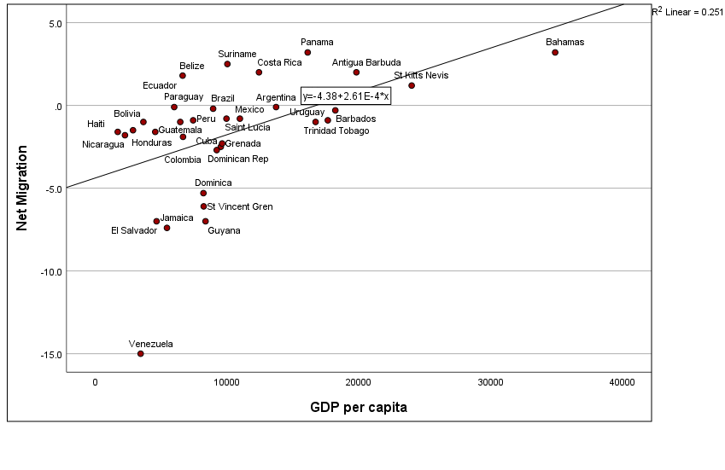
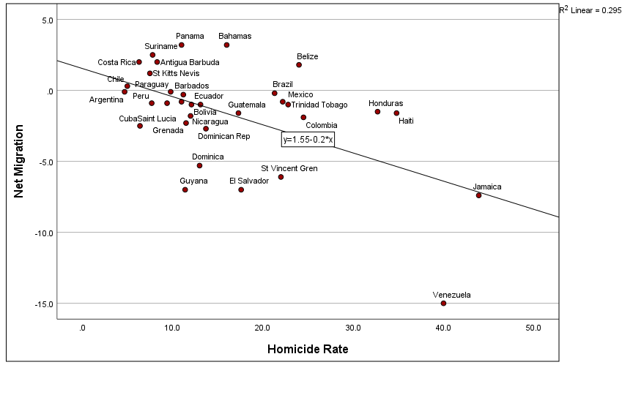
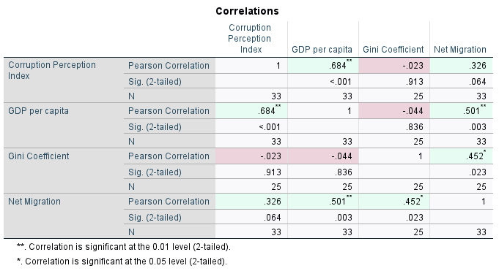
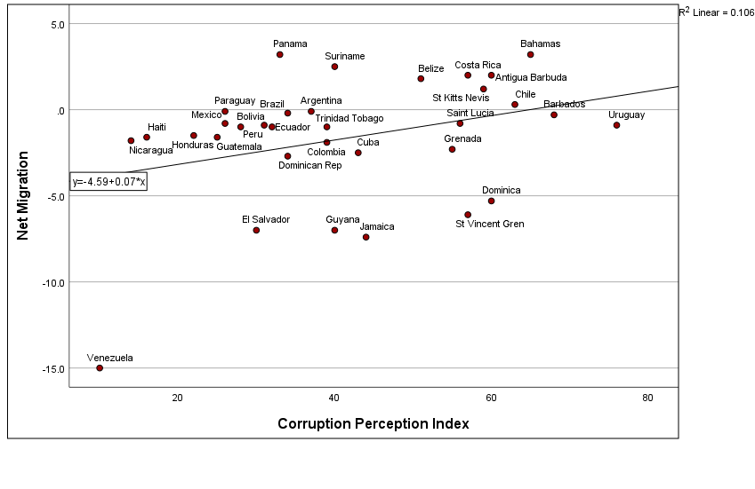

Introduction
Results and Implications
Hypothesis and Analysis
This thesis examines the push and pull factors related to migration from Latin America, providing the argument that emigration from this region cannot be explained by solely economic incentives alone but by viewing the complex intersections of economic inequality, institutional instability, violence, and policy environments. The research includes data across the 33 Latin American and Caribbean nations by applying quantitative analysis to identify the conditions in which most strongly predict migration factors.
The quantitative analysis provides strong statistical support for the push and pull factor framework applied to Latin American migration. GDP per capita produced the strongest relationship with net migration rates at r = .501 and p = .003, confirming that economic conditions are the most reliable predictor of emigration pressure across the region, while income inequality as measured by the Gini coefficient also showed a statistically significant correlation of r = .452 and p = .023, supporting the argument that wealth distribution matters just as much as overall national wealth. The Corruption Perceptions Index showed a moderate relationship of r = .326 but did not reach significance at p = .064, suggesting institutional quality influences migration more through its connection to economic conditions than as a standalone driver. These findings carry important implications for policy, as the significance of both GDP and inequality together suggests that economic growth alone is insufficient to reduce emigration and that governments must also address how wealth is shared. Examples such as Venezuela demonstrate that a single crisis can overwhelm all other indicators, while countries like Uruguay and Barbados show that low corruption and economic equity consistently produce lower emigration pressure, and the remittances data further confirms that in much of Central America and the Caribbean emigration has become so structurally embedded that reducing it will require building domestic alternatives rather than simply addressing push factors in isolation
Hypothesis 1: Countries with lower GDP per capita will show more negative net migration rates, revealing stronger push factors economically will compel individuals to seek better economic opportunities abroad.
Literature
Massey, D. S., Arango, J., Hugo, G., Kouaouci, A., Pellegrino, A., & Taylor, J. E. (1999). Worlds in Motion. Oxford University Press.
Hanson, G., Orrenius, P., & Zavodny, M. (2023). US Immigration from Latin America in Historical Perspective. The Journal of Economic Perspectives, 37(1), 199–222.
Hiskey, J. T., Córdova, A., Malone, M. F., & Orcés, D. M. (2018). Crime Victimization, US Deterrence Policy, and the Emigration Decision in Central America. Latin American Research Review, 53(3), 429–447.
Clemens, M. A. (2020). The Emigration Life Cycle: How Development Shapes Emigration from Poor Countries. IZA Institute of Labor Economics.
UNHCR. (2024). UNHCR global trends: Forced displacement in 2023. United Nations.
Hypothesis 2: Countries with higher homicide rates will show more negative migration rates, suggesting that violence and physical insecurity function as significant push factors for emigration from Latin America.
Hypothesis 3: Countries who demonstrate lower Corruption Perceptions Index scores reflecting higher corruption throughout the country will show more negative migration rates, suggesting that institutional failure and weak governance serve as push factors that reduce an individual’s confidence in their opportunities throughout their home country.
Josiah Bloom
Political Science Senior Thesis
Bemidji State University
Dr. Patrick Donnay, Advisor
Push and Pull Factors in Migration from Latin America

