Slide 1

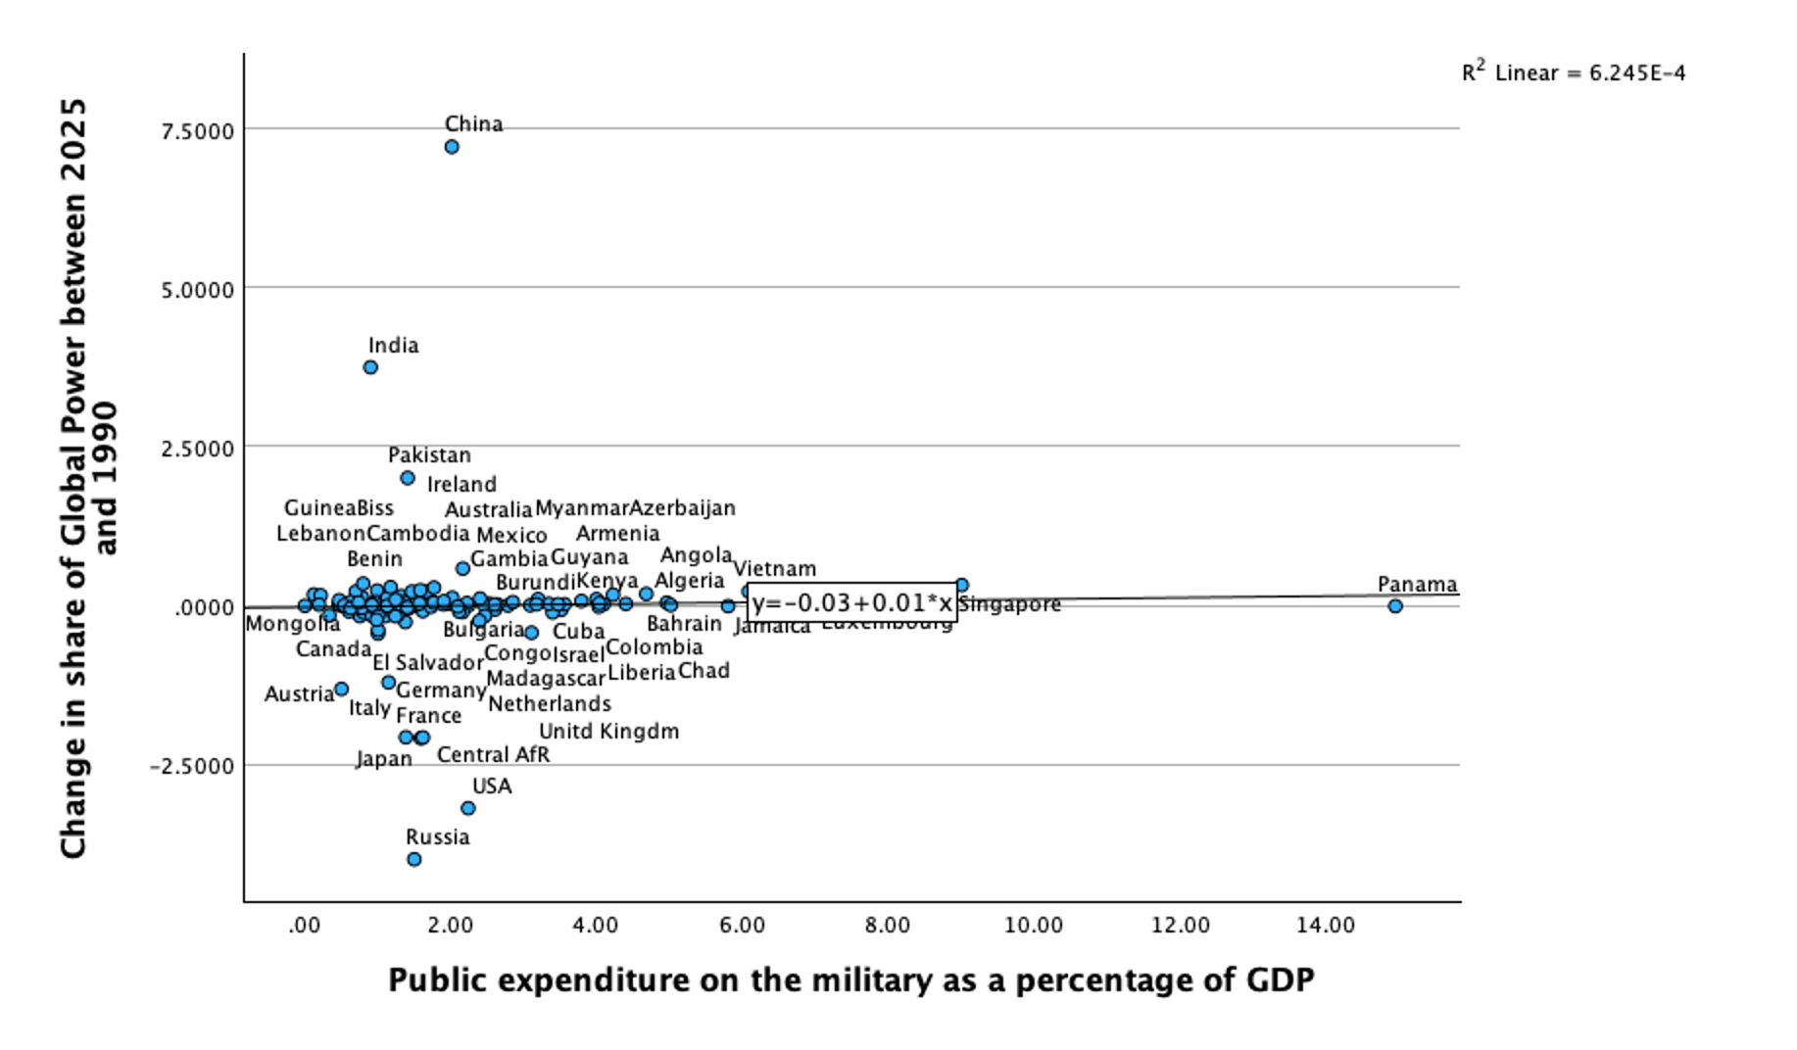
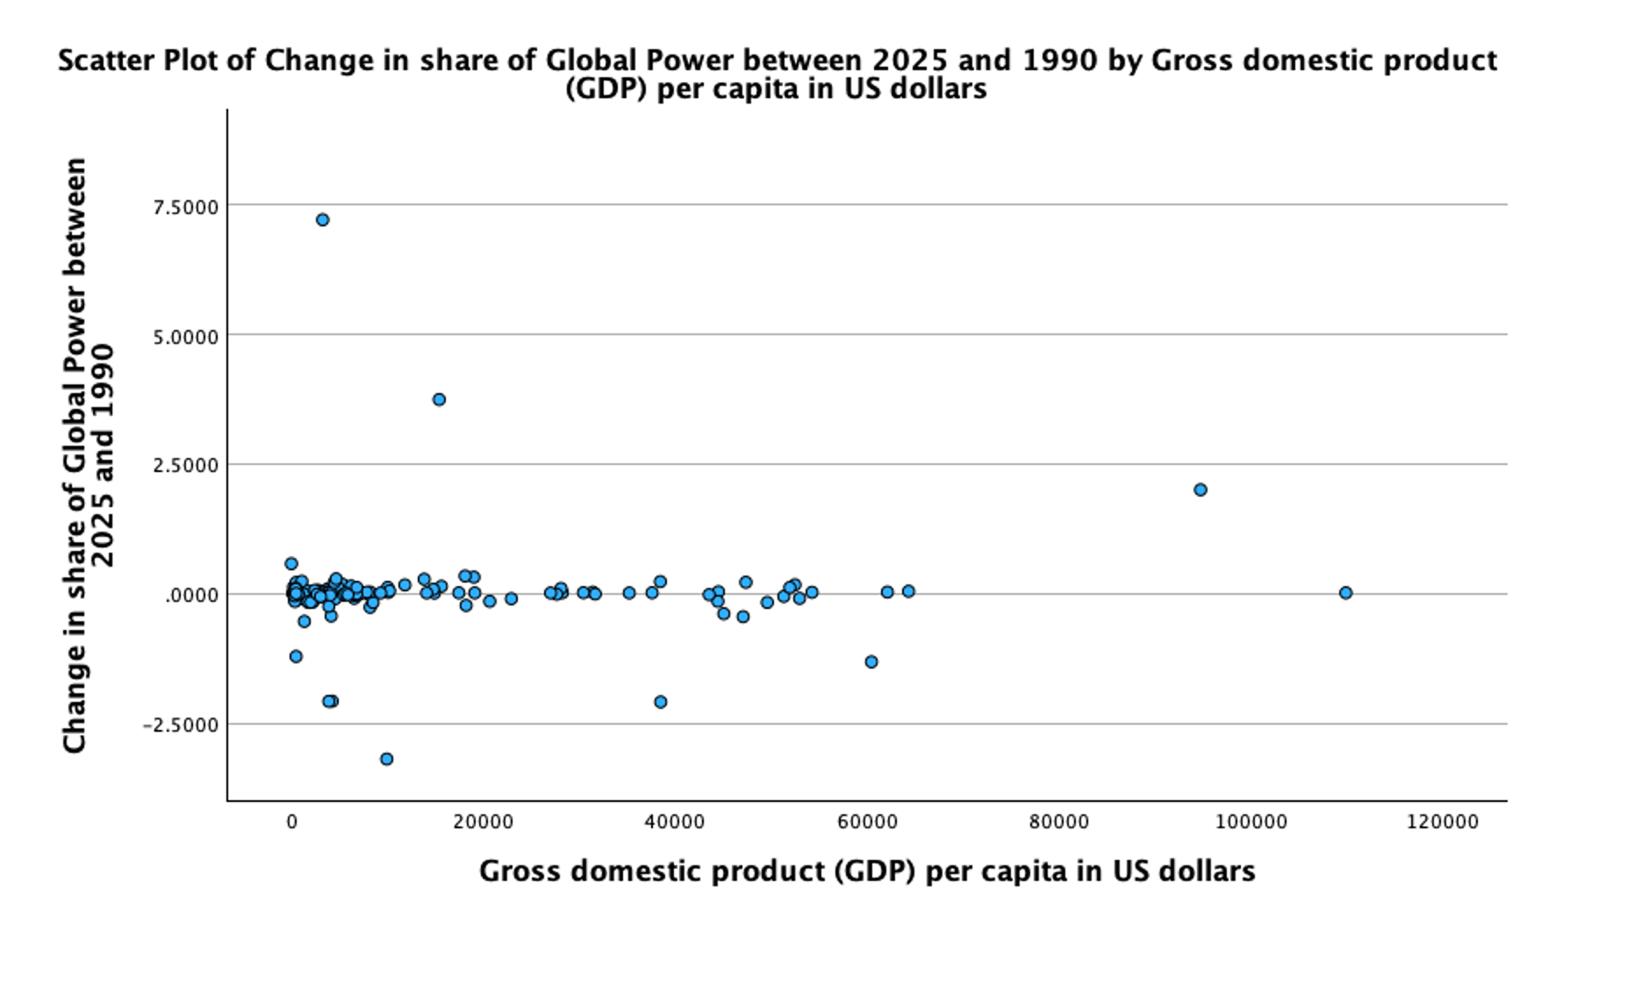
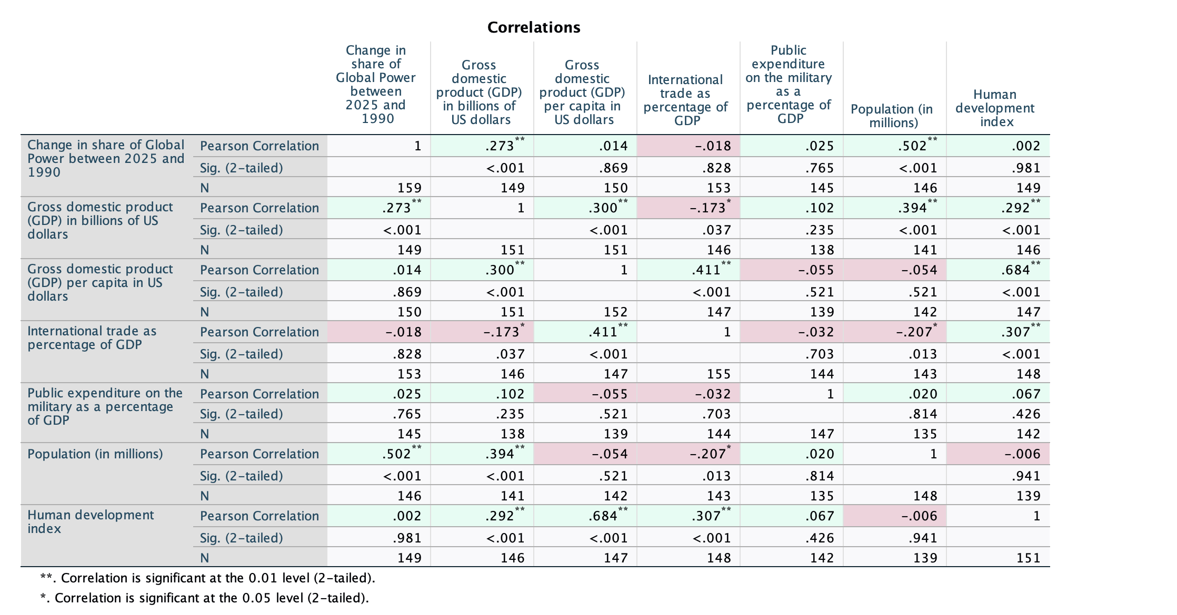


Introduction
This study examines how economic strength contributes to national power in the international system. Using quantitative data from the DiME Power Index, it analyzes the relationship between economic indicators and broader measures of state influence. The findings show a positive relationship: states with larger, more productive economies tend to rank higher in national power. However, economic strength by itself does not immediately create power as institutions, strategy, and diplomacy are vital parts in how resources are converted into geopolitical influence.
Hypothesis and Analysis
Literature
Babic, M., Fichtner, J., & Heemskerk, E. M. (2017). States versus corporations: Rethinking the power of business in international politics. The International Spectator, 52(4), 20–43.
Beckley, M. (2010). Economic development and military effectiveness. Journal of Strategic Studies, 33(1), 43–79.
Beckley, M. (2018). The power of nations: Measuring what matters. International Security, 43(2), 7–44.
Gallarotti, G. M. (2022). Esteem and influence: Soft power in international politics. Journal of Political Power, 15(3), 383–396.
Goldmann, K. (1977). Notes on the power structure of the international system. Cooperation and Conflict, 12(1), 1–20.
Hypothesis 1: Countries with greater overall economic strength, rather than simply higher military spending as a percentage of GDP, are more likely to experience increases in global power over time.
Hypothesis 2: Higher GDP per capita is associated with a modest increase in a country’s share of global power between 1990 and 2025, supporting the argument that economic strength contributes to national power
Results and Implications
The scatterplot shows no real linear relationship between military expenditure as a percentage of GDP and change in share of global power between 1990 and 2025, as the trend line is nearly flat and the extremely low R² value shows how military spending has almost no effect on the variation in global power changes. Although countries such as China and India gained power while the United States, Russia, and Japan declined, these shifts are not systematically linked to defense spending as a share of GDP, showing how providing a larger share of GDP to the military does not by itself increase global power and instead supports the argument that broader economic strength is a more important contributor to national power.
The scatter plot shows a weak positive relationship between GDP per capita and changes in a country’s share of global power from 1990 to 2025. While the data is dispersed and includes outliers, countries with higher GDP per capita tend to show slightly more favorable power outcomes. This offers partial support for the thesis that economic strength contributes to national power, but also indicates that GDP per capita individually does not explain changes in global power.
The correlation analysis found a significant positive relationship between GDP and change in share of global power $\left(r , =.273p<.001\right)$, showing that countries with larger economies were more likely to gain global power over time. Population as well showed positive relation $\left(r , =.502p<.001\right)$, while GDP per capita, trade, military spending, and HDI were not significant. These results support the thesis by suggesting that national power is dependent on the overall scale of a country’s resources than on indicators like per capita wealth.
Hypothesis 3: There is a positive relationship between a country’s economic strength, as measured primarily by total GDP, and increases in its share of global power.
Adrian Falcon
Political Science Senior Thesis
Bemidji State University
Dr. Patrick Donnay, Advisor
Economic Strength and National Power: A Quantitative Analysis of Global Influence

