Slide 1

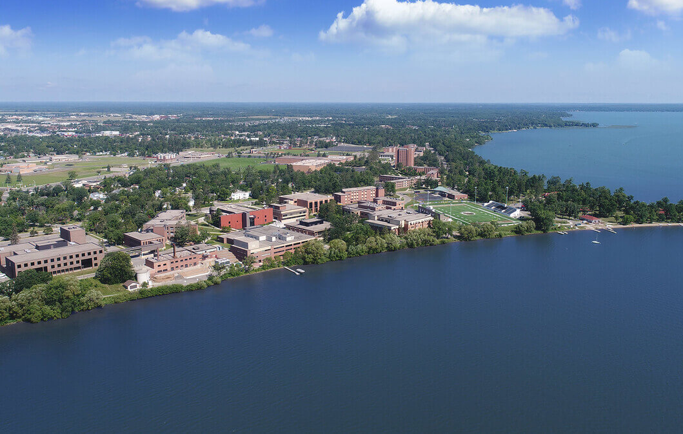

Erasing History: Historical White Washing and DEI in U.S. Classrooms
Grace Kaiser
5
Introduction
History is a topic that is constantly changing, and that extends to how it is taught. Across the United States, state education standards play a central role in shaping narratives by choosing what to emphasize and what to exclude. This is seen particularly in controversial topics. By looking at the language of school curricula, this study examines how political, cultural, and institutional influences shape collective understandings of the past. Understanding how these ideas are shaped is essential for recognizing how historical memory is constructed and why a more critical comparative approach to the past is important.
What Gets Left Out
From interviews, I found that time restraints, curriculum priorities, state legislation, and sensitivity around certain topics result in simplified narratives or the exclusion of marginalized perspectives, which contribute to gaps in students’ understanding of history
“There are so many standards to get through, there is little time to elaborate.”
--8th grade teacher
“Previously, students were taught that Christopher Columbus founded America, and now we focus on Indigenous history.”
-1st grade teacher
“In the past, they (Christopher Columbus) were seen as heroes and founders- these have changed with the New Native American standards.”
-1st grade teacher
“We try to put a positive look on everything we teach… not all history was positive, but… what did we learn or grow from that time.”
-1st grade teacher
Political and Institutional Influence
I found that many teachers express how external forces like state legislation, school policies, and community values impact classroom instruction. Teacher responses show the significant role these factors play in determining which historical topics are emphasized or left out.
“Legislation, pretty much dictates what should be covered.”
-8th-grade teacher
“I live in a fairly politically conservative area, and am always conscious of how I address current events and work to maintain neutrality
-1st grade teacher
“I have to be super careful… particularly if I have a very vocal. Right-wing leaning student, they seem to be empowered to speak that rhetoric.”
-8th-grade teacher
“Education in grade school is highly systematized… heavily legislated so certain versions of history are taught.”
-1st grade teacher
“There is a forced centering… portraying America in a certain light… There is a forced moderation of history.”
-College professor
13
Literature Review
Collective memory is deeply tied to political power, with governments and institutions actively shaping and sometimes weaponizing memory to support national identity.
-Sierp, A et al.
Historical narratives are constructed through institutional decisions, showing how certain perspectives are valued while others are excluded in educational contexts.
- Peterson, E. et al.
Political debates and civic goals shape historical education, school curriculum often reflects broader societal conflicts over national identity.
-American Historical Association
Recent legislation efforts have been made to restrict discussions of race, systemic racism, and inequality in schools. These policies reflect ideological issues over how history should be taught.
-Tresvant, T et al.
Teacher Freedom
While educators may have flexibility in instructional methods, their responses reveal that curriculum standards and developmental expectations often limit the content that can be presented, shaping the overall historical narrative students receive.
“I feel free to teach how I wish, not necessarily the ‘what.”
-8th-grade teacher
“We follow Minnesota standards to teach social studies… we teach just the very basic or not at all, as first graders are not developmentally ready.”
-1st grade teacher
“We have almost complete freedom to choose what to teach as long as what you say is not completely crazy and as long as you meet the learning outcomes.”
-College professor
12

