Slide 1

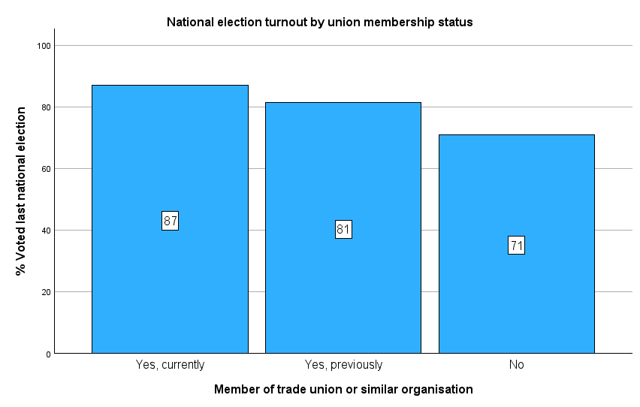
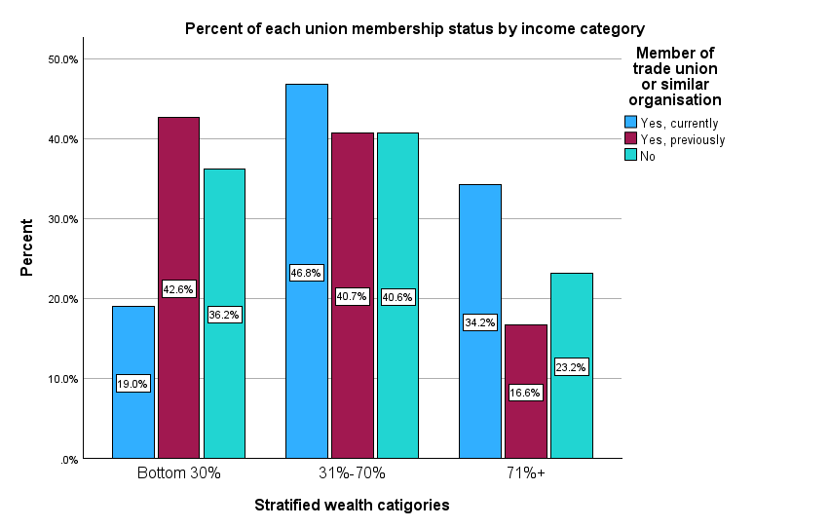
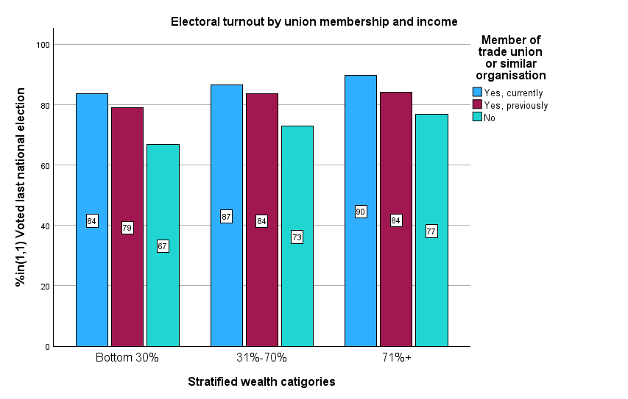
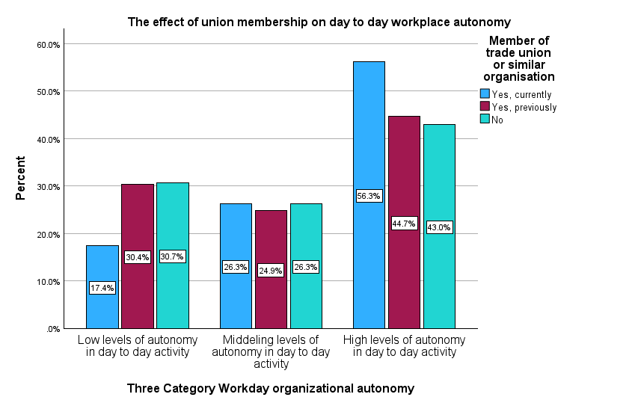
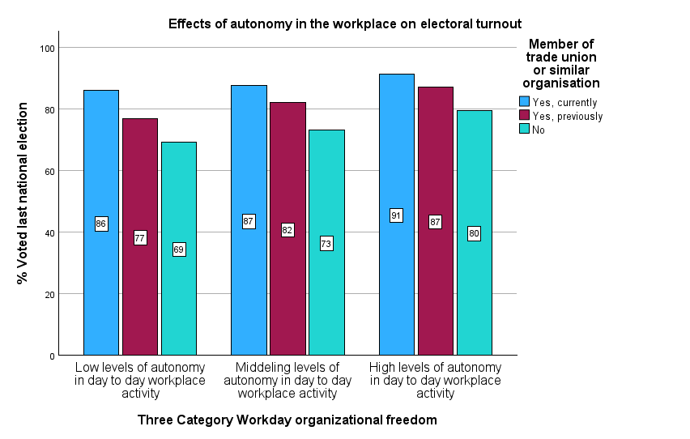
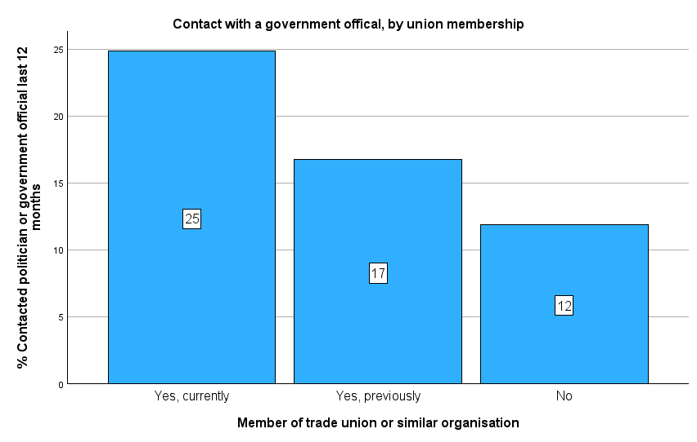

Introduction
The correlations between greater worker autonomy and civic participation have been studied since the sixties. However, it is only in recent times in which large scale surveys such as the General social survey (GSS) or the European social survey (ESS) have provided enough data to measure and compare civic participation based off multiple different forms of workplace autonomy.
Hypothesis and Analysis
Results and Implications
Between union and nonunion members, there is an increase in turnout of just over 15% as of the most recent election in 2020. Union membership stands out as the autonomy factor with the most effect, likely due to its effect on many other variables. Although Hypothesis 2 is mostly correct, the change in union turnout by wealth is not as significant when compared to the change in nonunion turnout. However, that does not disqualify income from being a factor of worker autonomy. Hypothesis 3 has similar weak results for union members; however, the effects are stronger than hypothesis 2, and there is still a clear effect in nonunion members. By introducing a new factor of political participation in the final hypothesis, the door is opened to more than just effects on voting turnout, but for workplace autonomy factors to encourage a more active roll in a person's civic life.
Hypothesis 2: When comparing income from one’s main job, union members will be more likely to have a job in with income in the 70th percentile than those who aren’t union. Those who are in the 70th percentile also have higher voter turnout rates.
Hypothesis 1: When comparing voter turnout rates, current union members will have a higher turnout than both former union members and those who have never been in a union.
Hypothesis 3: When comparing opinions on workplace autonomy, those who are union members experience greater day to day autonomy in the workplace compared to those who are not. Those who experience greater autonomy also have higher voting turnout than those who experience less autonomy.
Hypothesis 4:When comparing the percentage of those who have reached out to a politician recently, union members are more likely to have done so than nonunion members.
Data
European Social Survey European Research Infrastructure (ESS ERIC) (2025) ESS5 - integrated file, edition 3.6 (Austria not included) [Data set]. Sikt - Norwegian Agency for Shared Services in Education and Research. https://doi.org/10.21338/ess5e03_6.
European Social Survey European Research Infrastructure (ESS ERIC) (2023) ESS10 - integrated file, edition 3.3 [Data set]. Sikt - Norwegian Agency for Shared Services in Education and Research. https://doi.org/10.21338/ess10e03_3.
Matthew Voss
Political Science Senior Thesis
Bemidji State University
Dr. Patrick Donnay, Advisor
The Effects of Worker Autonomy on Political Participation

