Slide 1
Accounting on the Web Training
Accessing Financial Information Web ISRS Accounting Module

Slide 2
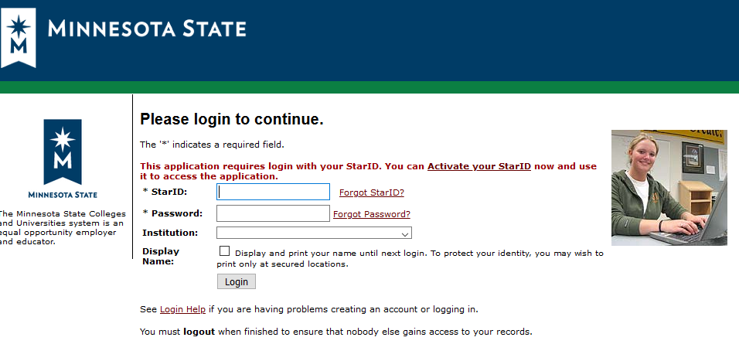
Access & Log-in
Website:
Log in using Star ID and password (same ID used to access timesheets)
https://eservices.minnstate.edu/employee/public/secure

Slide 3
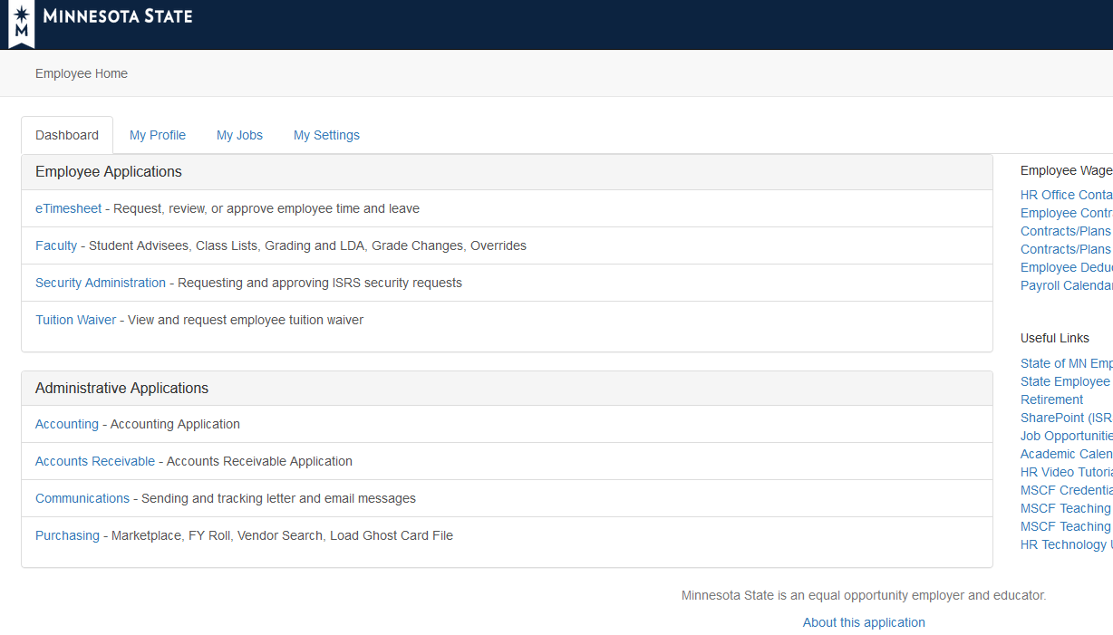
Access & Log-in
Select “Accounting” under Administrative Applications

Slide 4
Access & Log-in
If “Accounting” is not available under Administrative Applications section, select “Security Administration” under Employee Applications. From menu on the left select Dashboard, next select Web, continue as follows:
Click green plus sign for “Add Web Roles”
Click on drop down menu in Approval Group, select Finance, select Search
Check the box for AC_VIEW_DEPARTMENT_DATA
Select Add Checked Web Roles at the bottom of the list
This will generate an e-mail to the Web Manager. When access is granted, a confirmation e-mail will be sent to you.
If you do not have access to the cost centers you need to view after access to Accounting on the Web has been granted, contact Business Services to have rights assigned for those specific cost centers.

Slide 5
Accounting Home
Menu

Slide 6
Queries
Click on Queries header to expand
If lettering is white, you have access

Slide 7
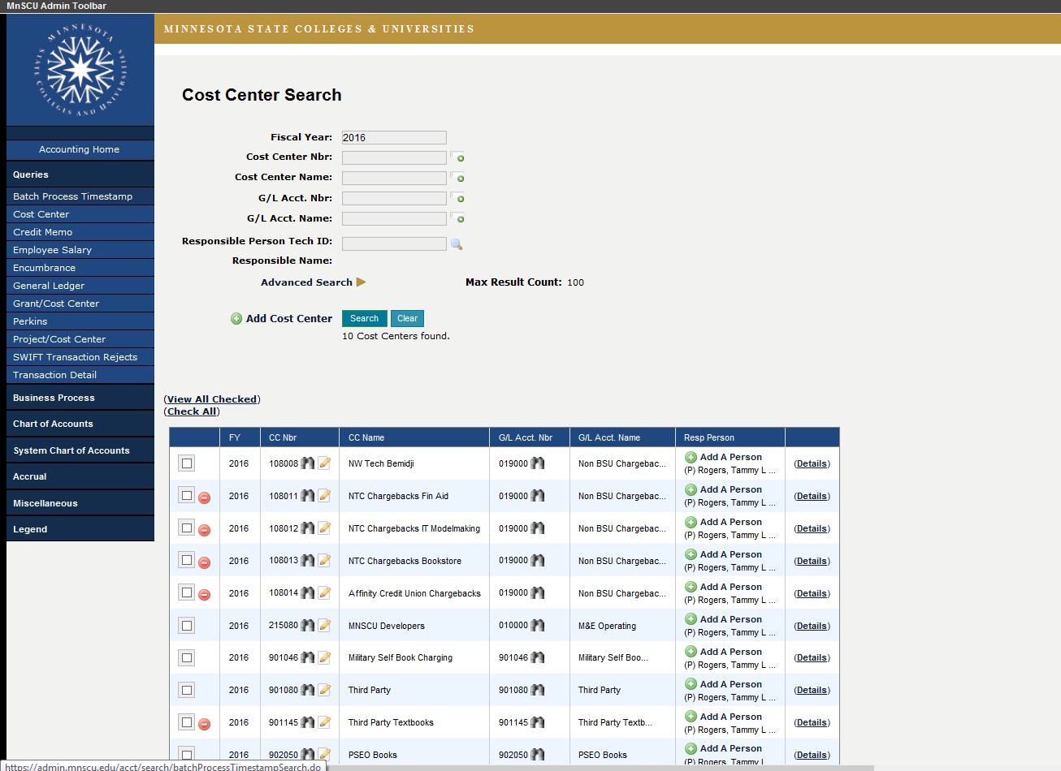
Cost Center
First select Cost Center within Queries options.
Secondly, type in current fiscal year and press Search.
This will display all cost center you have access to view.
Note: Fiscal Years run from
July 1 – June 30
Selecting Details will allow you to view Cost Center detail as well.
Finally, check boxes individually or select “check all” to view all cost centers.
Then select “View All Checked”.

Slide 8
Cost Center – Viewing Multiple
Use drop down arrow to select cost center you wish to view

Slide 9
Cost Center Detail
Notes:
1. General Fund (M & E):
You receive an allocation and spend according to budget. You can’t look to balance sheet to see cash available. Balance is not carried forward annually.
2. Non-Allocation Income (NAI):
Budget is not reflective of available, use balance sheet to see cash available.

Slide 10
Cost Center Detail
Click green money symbol to expand and view revenue detail
Click expand all to view expenditure detail.
Click arrow to expand and view expenditure detail.

Slide 11
Cost Center – Expenditure Detail
Budget code category 0999 includes all non-salary expenditures
Click on binocular symbol to view encumbrance or transaction detail
Object codes are specific expenditure categories within a cost center

Slide 12
Transaction Types: Categorized & Identified
Transactions that establish or modify budgets
CB | control budget
Transactions that record or reverse receipts
CP | cash receipt
RE | account receivable receipt
XP | reverse cash receipt
Transactions that establish or reduce encumbrances
EF | forced encumbrance
EN | normal encumbrance (subject to budget constraints)
Transactions that record or reverse payments or expenses
EV | miscellaneous bank charge
PR | payroll expense – includes employee expense reimbursement
PV | vendor payment
CD | cash disbursement
XD | reverse cash disbursement
XV | reverse vendor payment
Transactions that record credit memos
CM | Credit memo entry / adjustment
CA | Credit memo applied
Transactions that record journal entries Includes internal chargebacks (postage, printing, BSU fleet vehicles, etc.), p-card transactions and manual adjustments from budget transaction forms
JC | expenditure correction (journal entry affecting cash)
JG | general journal voucher

Slide 13
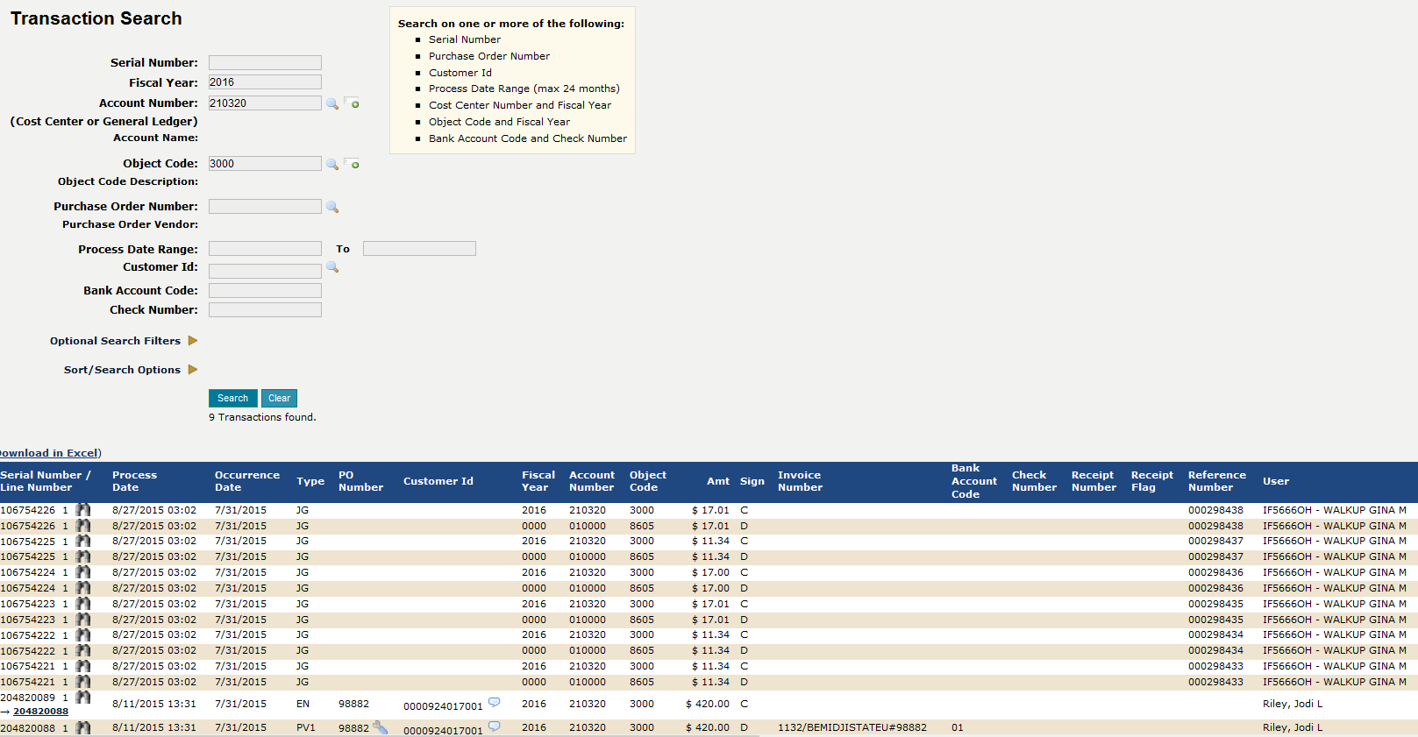
Cost Center - Expenditure Detail
After clicking on binoculars, Transaction Search screen shows individual transactions that make up the total expenditures within an object code category.
Transaction type (see previous slide):
CP: cash receipt
RE: accounts receivable receipt
XP: reverse cash receipt
EF: Forced Encumbrance
EN: Normal Encumbrance
EV: miscellaneous bank charge
PR: payroll expense
PV: vendor payment
CD: cash disbursement
XD: reverse cash disbursement
XV: reverse vendor payment
JC: expenditure correction
JG: General Journal Voucher
Clicking on binocular symbol will give further transaction detail
Hovering cursor over call-out symbol will show Vendor detail

Slide 14
Cost Center - Expenditure Detail Example
Vendor information for payment voucher
Invoice and purchase order number and payment process date

Slide 15
Cost Center - Budget
Current budget for budget category 0999 Non Salary Expenditures
Expenditure totals for current month and total for the year. MTD is included in YTD Total
Remaining Budget Balance

Slide 16
Reports
To run reports from Accounting on the Web, select “Reports” in the upper right corner of the screen.

Slide 17
Reports
Request report by typing report number in report field or selecting from drop down menu
Suggested Reports:
AC0510CP – Budget Balance by Fund/Campus/GL – this is a summarized report of activity in the cost center for the fiscal year. This report also shows the remaining budget available for the fiscal year.
AC0531CP – Transactions by Fund/GL/CC/Object – this report should be run once per month to assure transactions in the cost center are correct.

Slide 18
Reports – AC0510CP – Budget Balance by Fund
Not all fields need to be completed but to avoid system slow down or stoppage, complete at least the following fields:
Fiscal Year: will default to current fiscal year, you may enter previous fiscal years if needed
Object Code Range: select 0900-4000 for most reports (if object code is left blank, report will include all payroll transactions)
Cost Center and/or Range: Enter cost center number or select from drop down. Multiple cost centers can be selected by placing a comma between each cost center or using drop down menu to select multiple cost centers
You may receive reports 1 of 3 ways by selecting Delivery Method
Select Submit Report. Green bar across the top of the screen will indicate report has been submitted. Finally, select Process Monitor to view report

Slide 19
Reports – Process Monitor
Report requests will show on this screen. If you do not see the report or if the status is blank or active, you may need to select “refresh” occasionally until the report is complete and ready to view. Status will indicate “complete”
Select blue highlighted report name to view report

Slide 20
Reports – Output (AC0510CP)
Report can be viewed on screen, printed, emailed or copied to excel
Report AC0510CP shows current budget, encumbrances, current Month actual, YTD actual and remaining Budget Available by budget and expenditure category

Slide 21
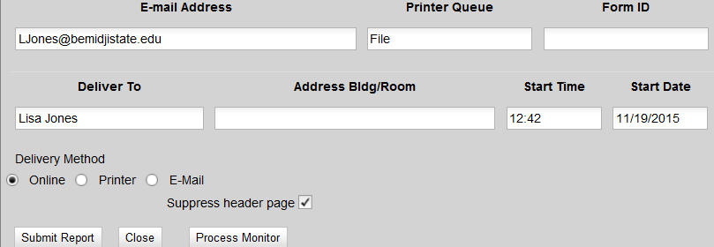
Reports – AC0531CP Transactions by Fund/GL/CC/Object
Not all fields need to be completed but to avoid system slow down or stoppage, complete at least the following fields:
Starting date: Fiscal year begins 07/01/20XX. If you want to run a report for the current year, the beginning date would be 7/1/16
End date: You may leave blank to get data through the current date or you may choose to run at a specific month-end using a MM/DD/YY format
Cost center number range: Enter cost center number or select from drop down. Multiple cost centers can be selected by placing a comma between each cost center or using drop down menu to select multiple cost centers
Object code range: recommend using 0900-4000 unless you want to include payroll
Transaction Type(s): Either type in the following or select each from drop down arrow: PV,XV,CP,XP,JG,JC,PR
Sub-total by object code: Y
Print Trans Description: Y
Print Trans Comment: Y
Changing these fields will help provide useful detail and make report easier to read
You may received reports 1 of 3 ways by selecting Delivery Method
Select Submit Report. Green bar across the top of the screen will indicate report has been submitted. Finally, select Process Monitor to view report

Slide 22
Reports – Output (AC0531CP)
Report shows detail for expenditures within each object code
Vendor detail

Slide 23
Questions?
Please contact:
Kate Pearlson – kate.pearlson@bemidjistate.edu, ext. 2448
Monte Hegg – monte.hegg@bemidjistate.edu, ext. 2903
Lisa Jones – lisa.jones@bemidjistate.edu, ext. 2898

