Slide 1
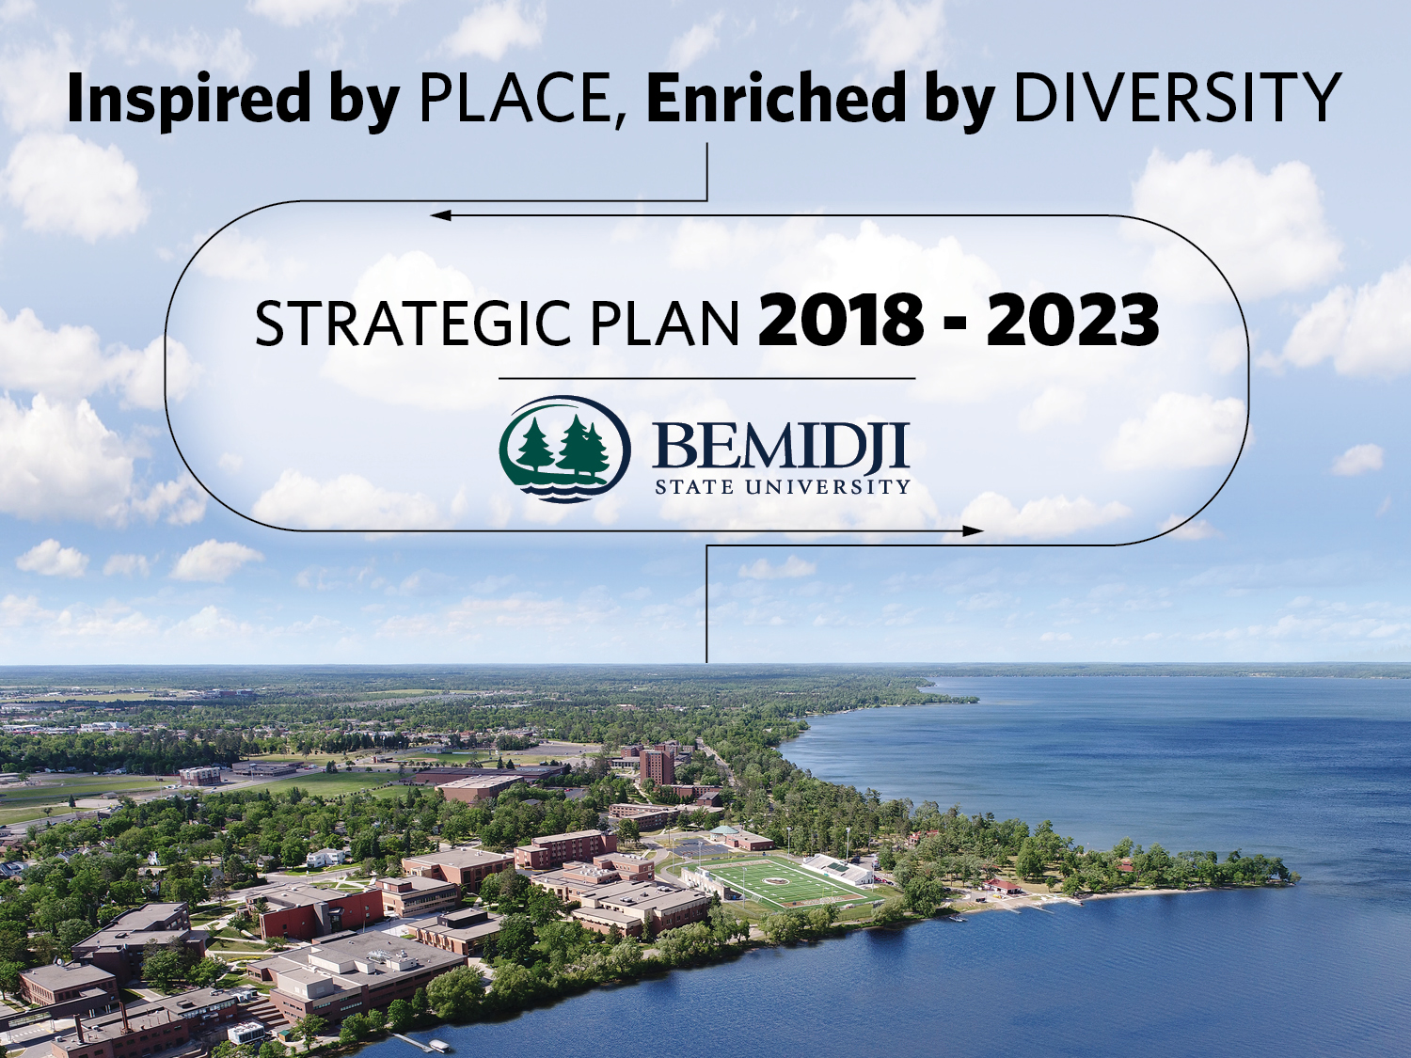

Slide 2


Slide 3

MISSION
We create an innovative, interdisciplinary, and highly accessible learning environment committed to student success and a sustainable future for our communities, state, and planet. Through the transformative power of the liberal arts, education in the professions, and robust engagement of our students, we instill and promote service to others, preservation of the earth, and respect and appreciation for the diverse peoples of our region and world.

Slide 4
VISION
We educate people to lead inspired lives.

Slide 5
VALUES
Shared Fundamental Values
Civic engagement and leadership
International and multicultural understanding
Belief in the power of the liberal arts
Environmental stewardship

Slide 6

Faith Hensrud, President
Tony Peffer, Provost/VP for Academic & Student Affairs
Karen Snorek, VP Administration and Finance
Michelle Frenzel, Executive Director for Enrollment Management
Jesse Grant, Interim Dean of Students
Marla Patrias, Executive Director, BSU Alumni & Foundation
Bill Blackwell, Executive Director, AIRC
Randy Westhoff, Interim Associate VP for Academic Affairs
Peter Gable, student
Galen Hlavsa, student

Slide 7
COMMITTEE MEMBERSHIP CONTINUED
IFO
Debbie Guelda — College of Arts & Sciences
Tim Goodwin — College of Health Science & Human Ecology
Bill Graves — College of Business
Amber Fryklund — Athletics

Slide 8
COMMITTEE MEMBERSHIP CONTINUED
MAPE
Brodie Karger – Information Technology Services
MMA
Sandra Beck – Facilities Services Supervisor
MSUAASF
Kelli Steggall – Director of TRiO McNair/SSS, Upward Bound
AFSCME
Thomas Skime – Theatre Technician

Slide 9
STEERING COMMITTEE
Faith Hensrud
Tony Peffer
Karen Snorek
Michelle Frenzel
Randy Westhoff
Debbie Guelda

Slide 10
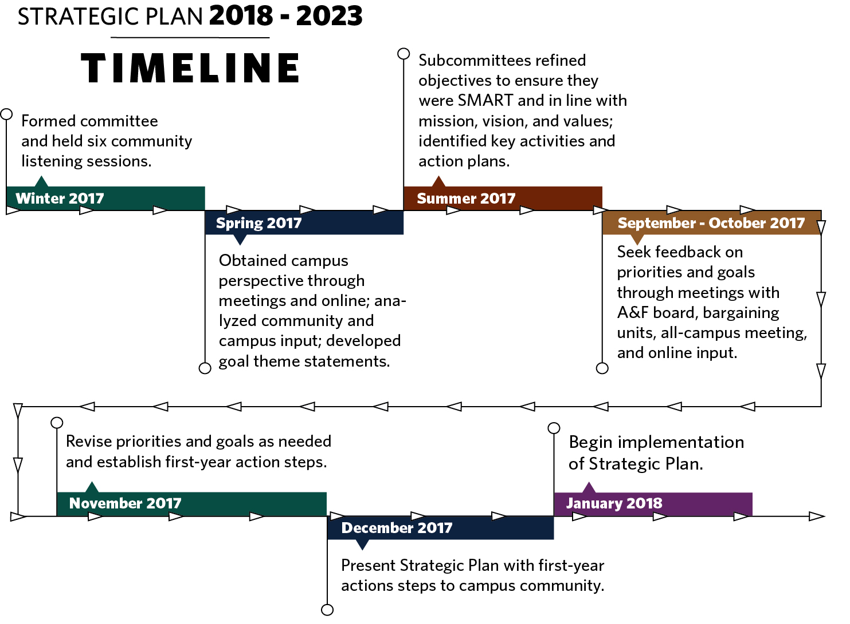

Slide 11
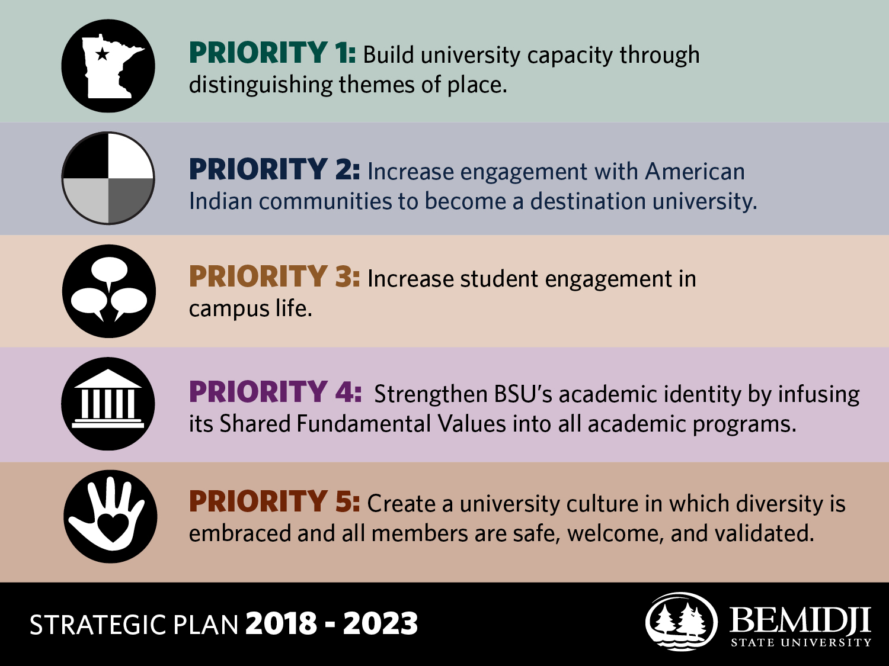

Slide 12
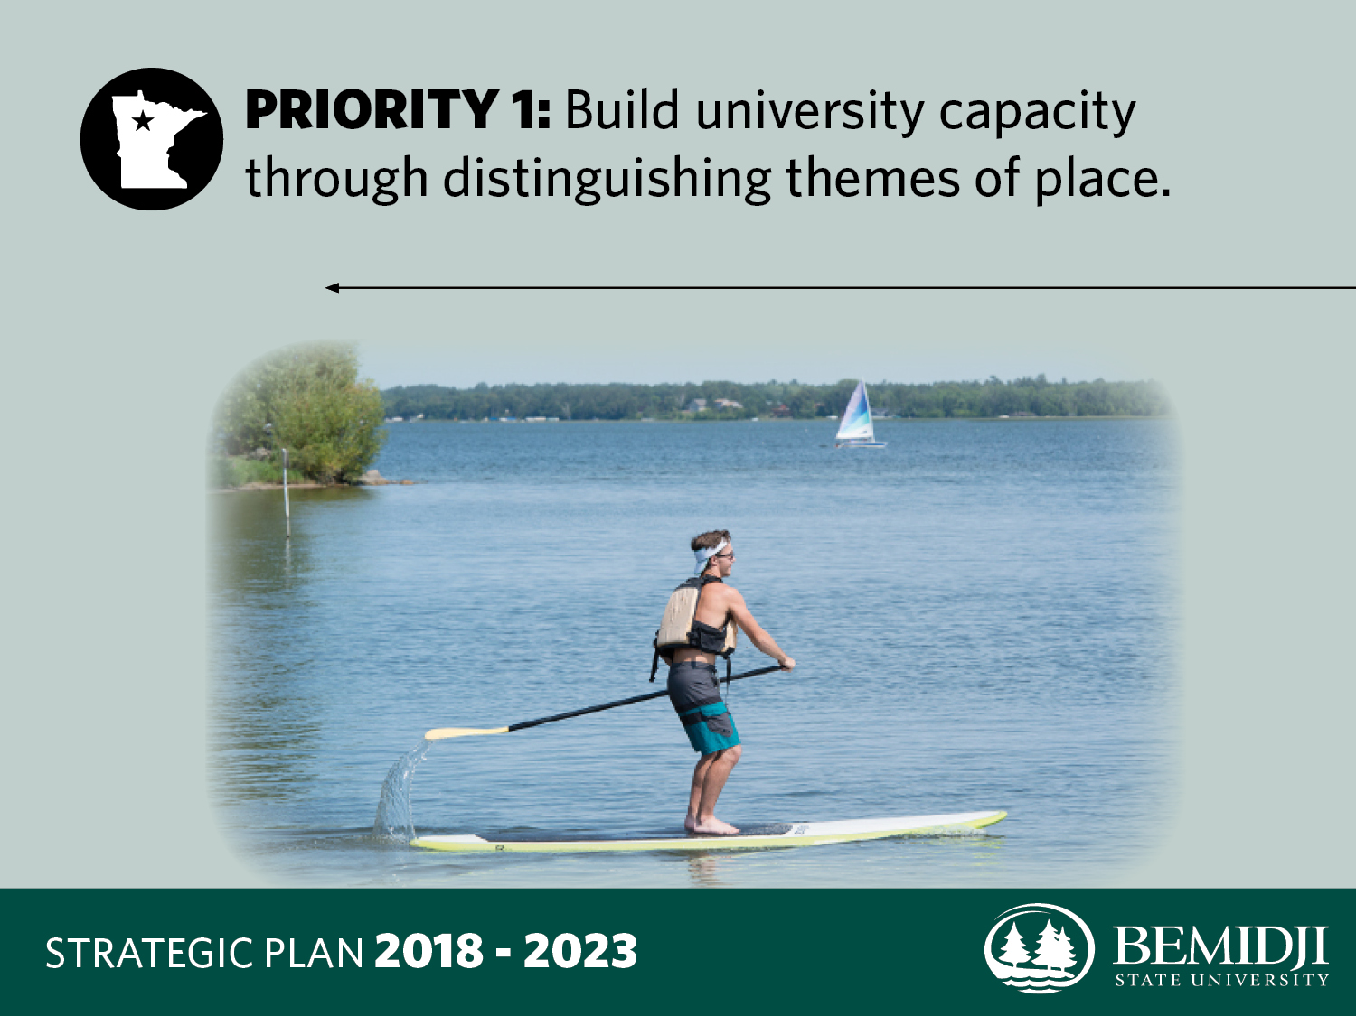

Slide 13
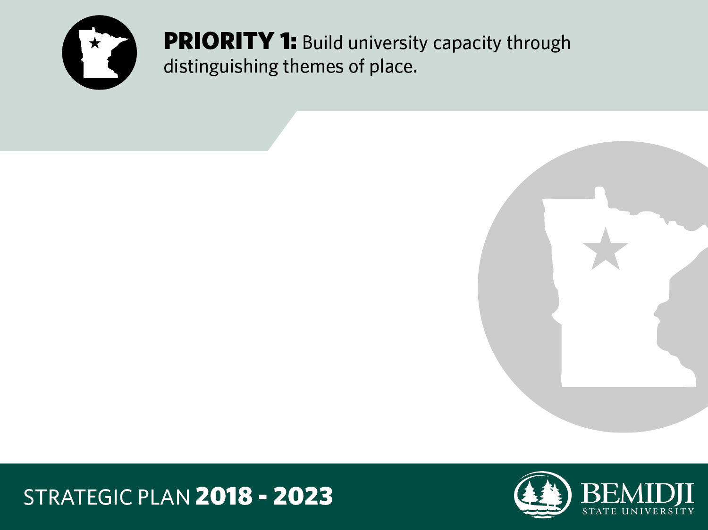
GOAL 1
Beginning Fall 2019, create at least one new undergraduate or graduate program a year that incorporates one or more themes of place.

Slide 14
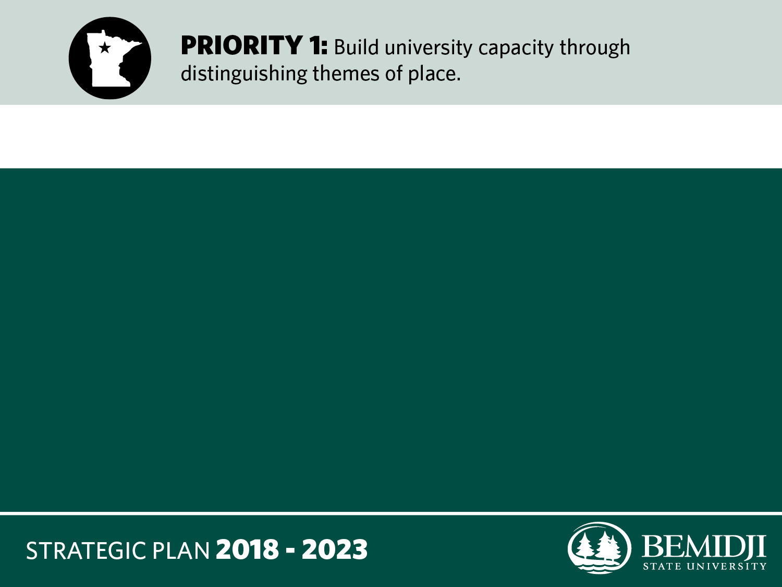
GOAL 1 — KEY ACTIVITIES
a. Engage faculty and administrators in establishing a structure for evaluating the incorporation of place themes and values into existing and proposed programs.

Slide 15
GOAL 1 — KEY ACTIVITIES
b. Assess impact of curricular initiatives on student internalization of place themes, refining as guided by evidence.

Slide 16
GOAL 2
By Spring 2019, complete a comprehensive study to clarify and focus the university brand as an expression of place themes and devise correlated strategies to improve recruitment and retention of students and employees.

Slide 17
GOAL 2 — KEY ACTIVITIES
a. Apply and optimize use of theme- and value-based branding strategies through continual testing, measurement, analysis, and refinement of messages and marketing tactics.

Slide 18
GOAL 2 — KEY ACTIVITIES
b. Beginning Fall 2018, use annual research to establish a baseline for and measure change in whether and how identification with place is influential in student and employee decisions to become and remain members of the university community.

Slide 19
GOAL 3
Beginning Fall 2018, develop at least one new initiative and/or collaboration a year that reflects place themes within and among academics, student life, athletics, and the community.

Slide 20
GOAL 3 — KEY ACTIVITIES
a. Review current place- and value-related activities within academics, student life, and athletics. Identify ways to expand, leverage, and/or connect them to maximize student learning and growth.

Slide 21
GOAL 3 — KEY ACTIVITIES
b. Incorporate place themes into employee orientation and campus-wide events.

Slide 22
GOAL 3 — KEY ACTIVITIES
c. Utilize relevance to learning through place themes as a key measure of worth for engagement between the university and surrounding communities.

Slide 23
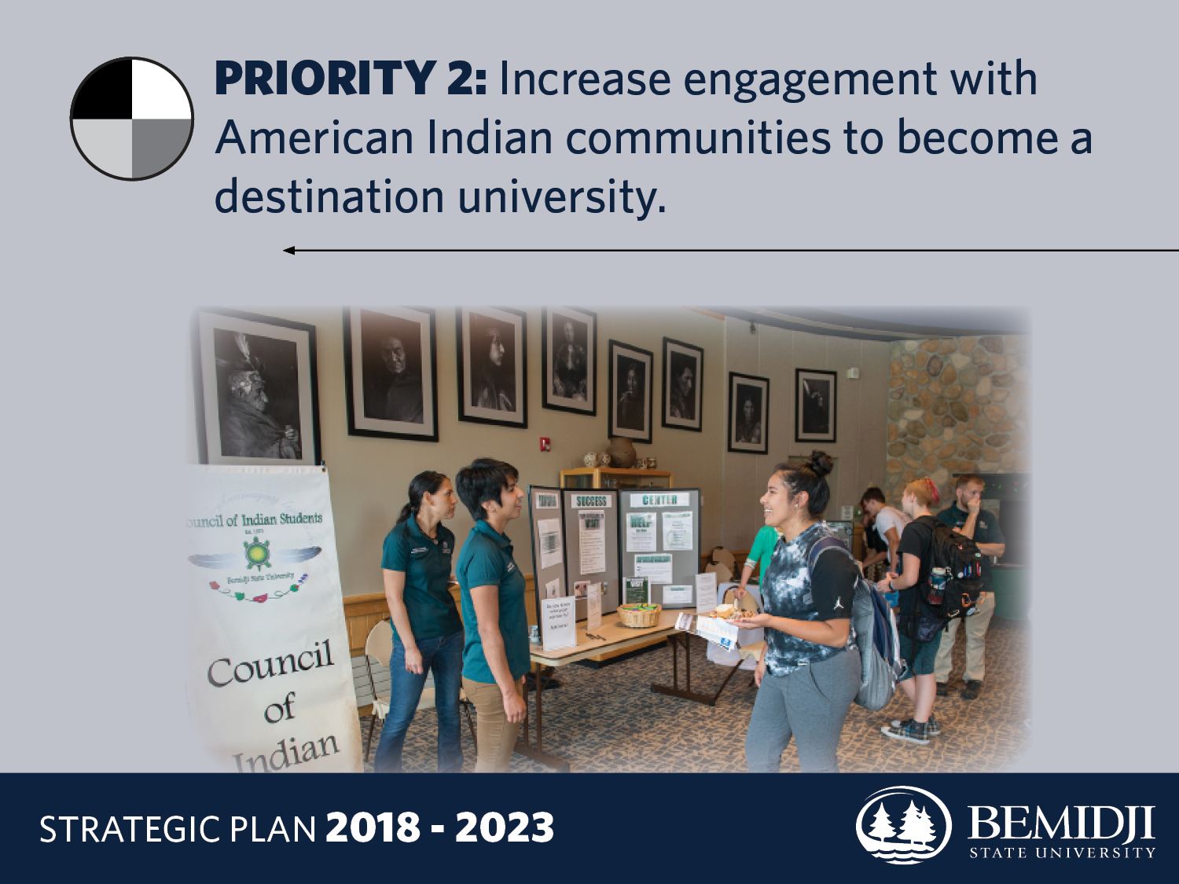

Slide 24
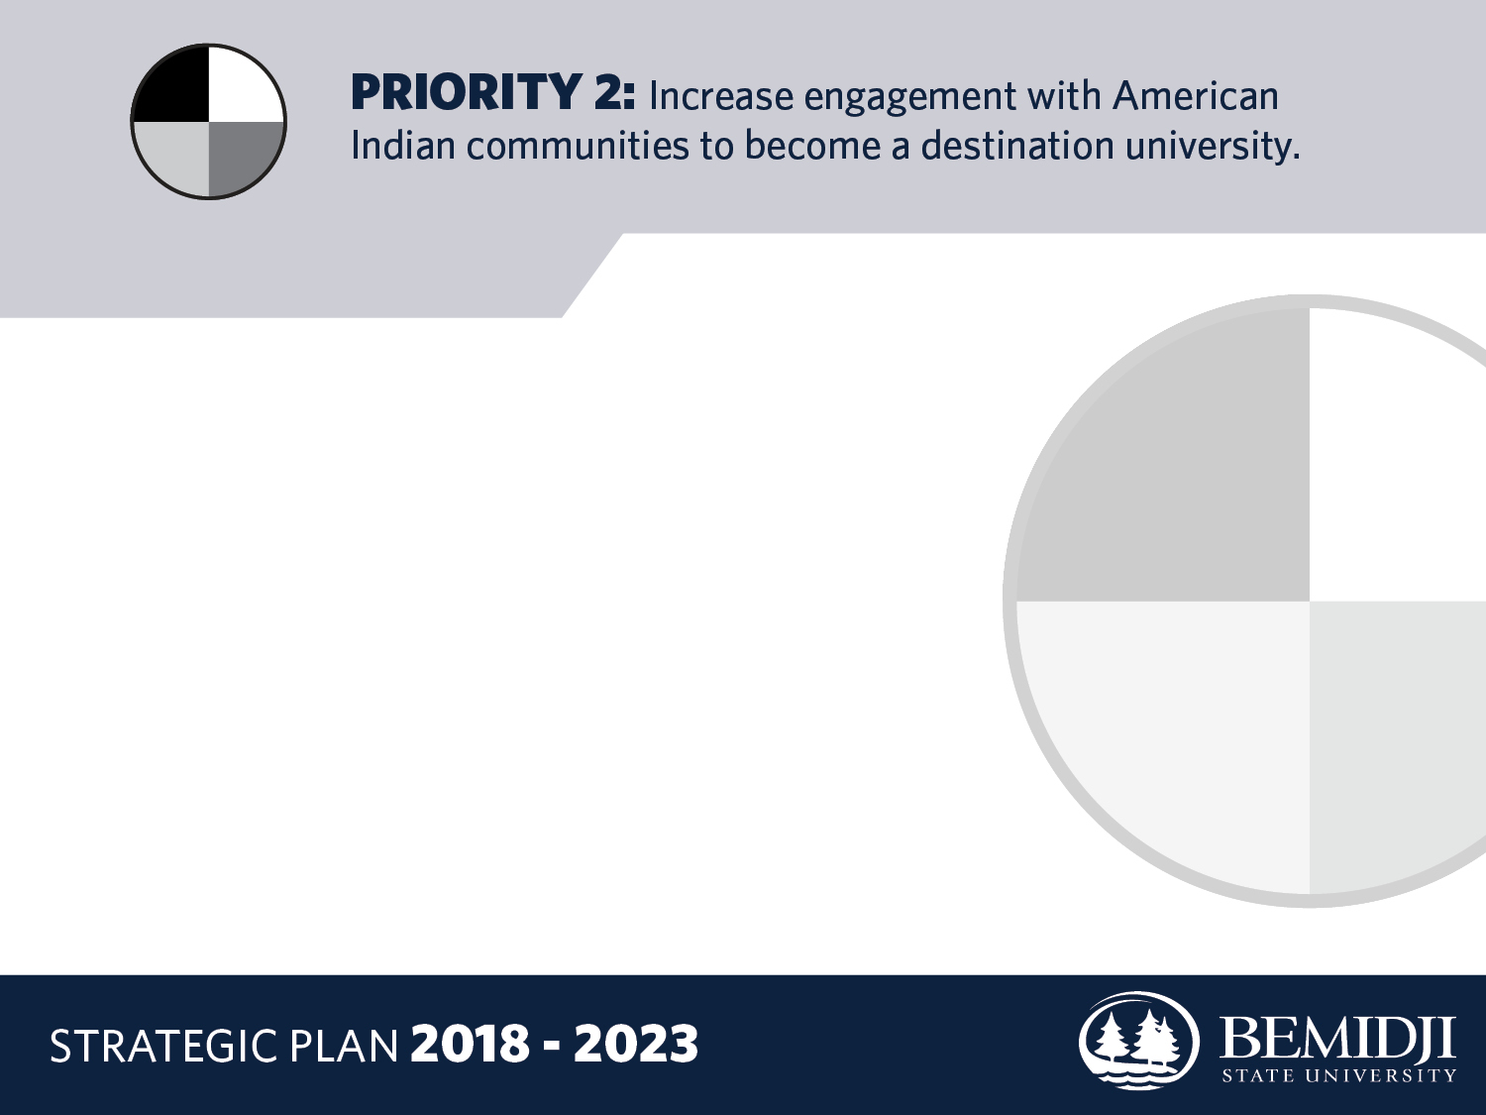
GOAL 1
Strengthen relationships with American Indian communities by doubling the number of experiential learning opportunities available to BSU students in tribal communities by Fall 2022.

Slide 25
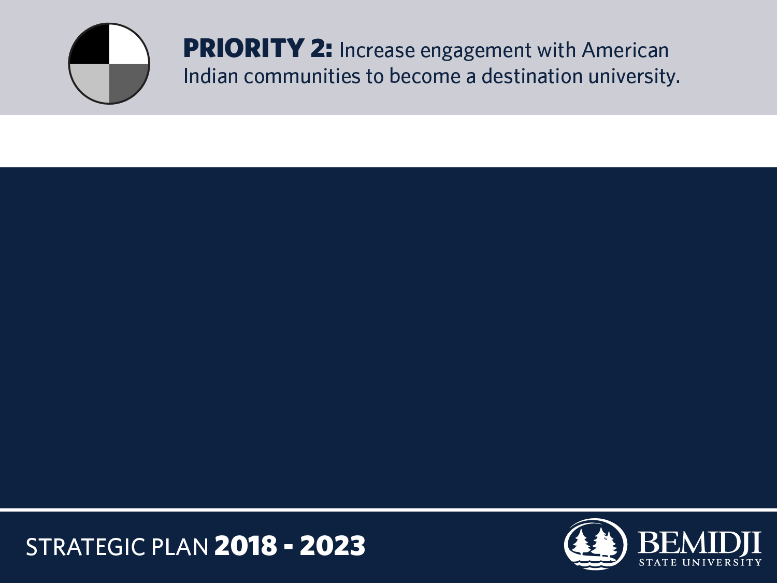
GOAL 1 — KEY ACTIVITIES
a. Assess opportunities for internships, clinicals, practica, and student teaching in American Indian communities to determine where and how to best increase those for mutual benefit.

Slide 26
GOAL 1 — KEY ACTIVITIES
b. Develop and implement strategies to expand opportunities for internships, clinicals, practica, and student teaching to increase opportunities by 50%.

Slide 27
GOAL 2
Increase enrollment of American Indian students to 350 (36.7% gain from 2017) by Fall 2022.

Slide 28
GOAL 2 — KEY ACTIVITIES
a. Develop and implement an American Indian student recruitment plan.

Slide 29
GOAL 2 — KEY ACTIVITIES
b. Develop and implement an American Indian student retention plan.

Slide 30
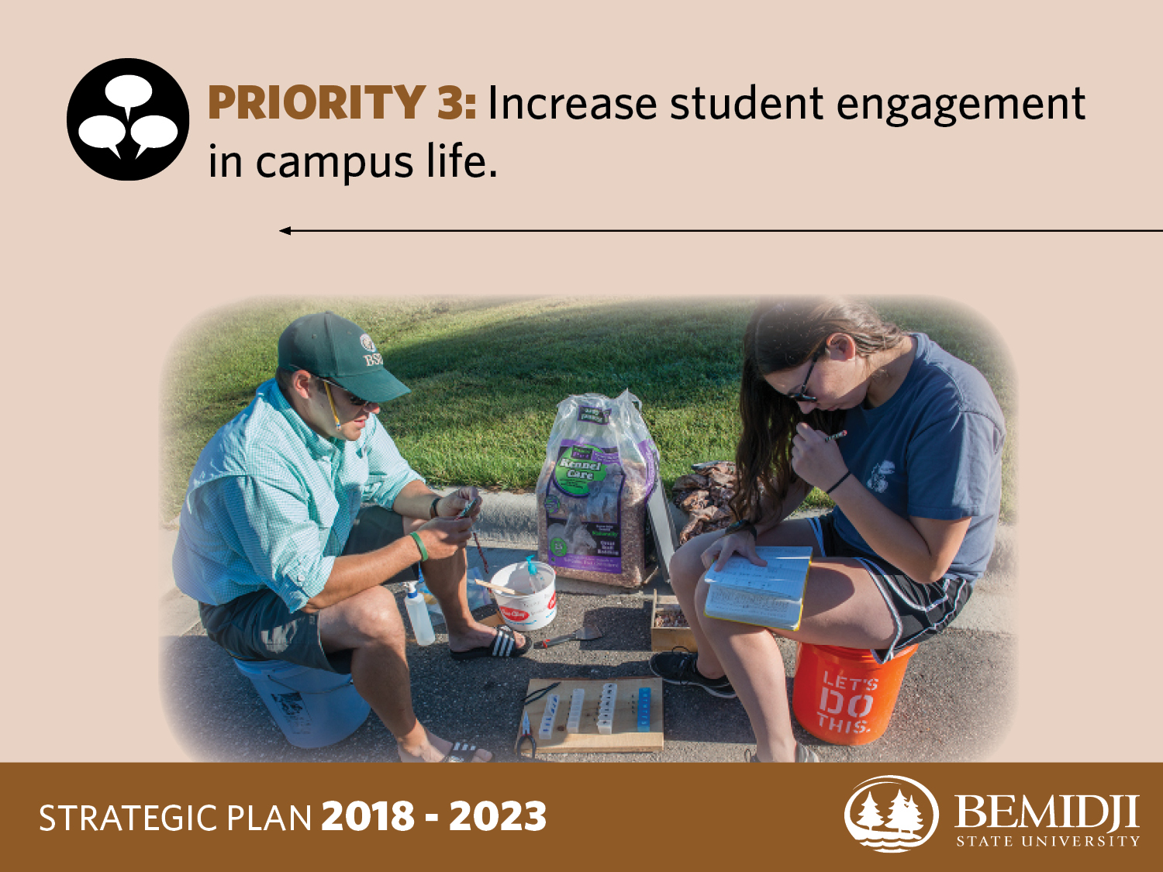

Slide 31
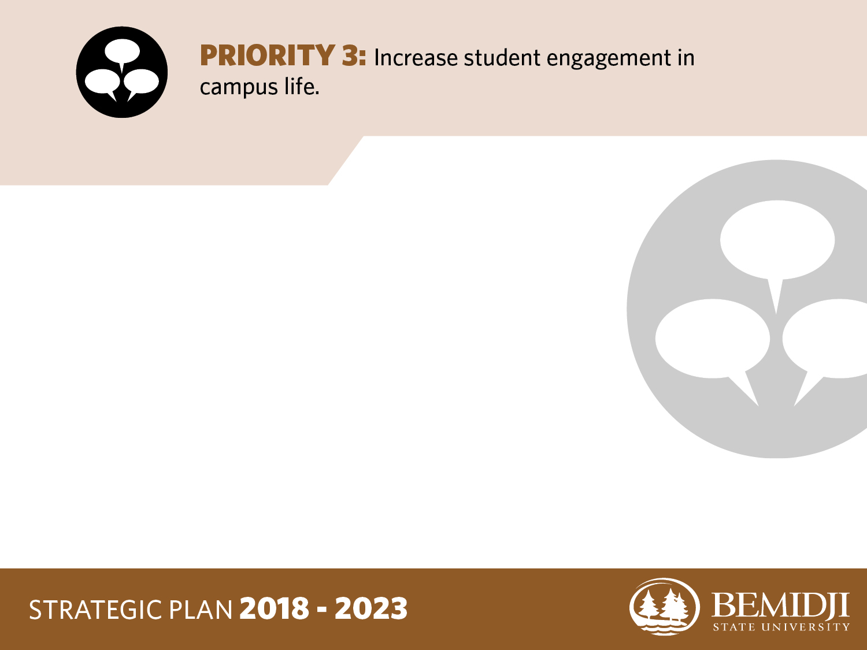
GOAL 1
Increase participation in the following NSSE areas to Carnegie Class means by Fall 2022:
Attendance at art exhibits, plays, or other art
and music performances;
Formal leadership roles in student groups or organizations;
Opportunities to be involved socially, attending events and activities (includes athletic events), and attend events that address important issues.

Slide 32
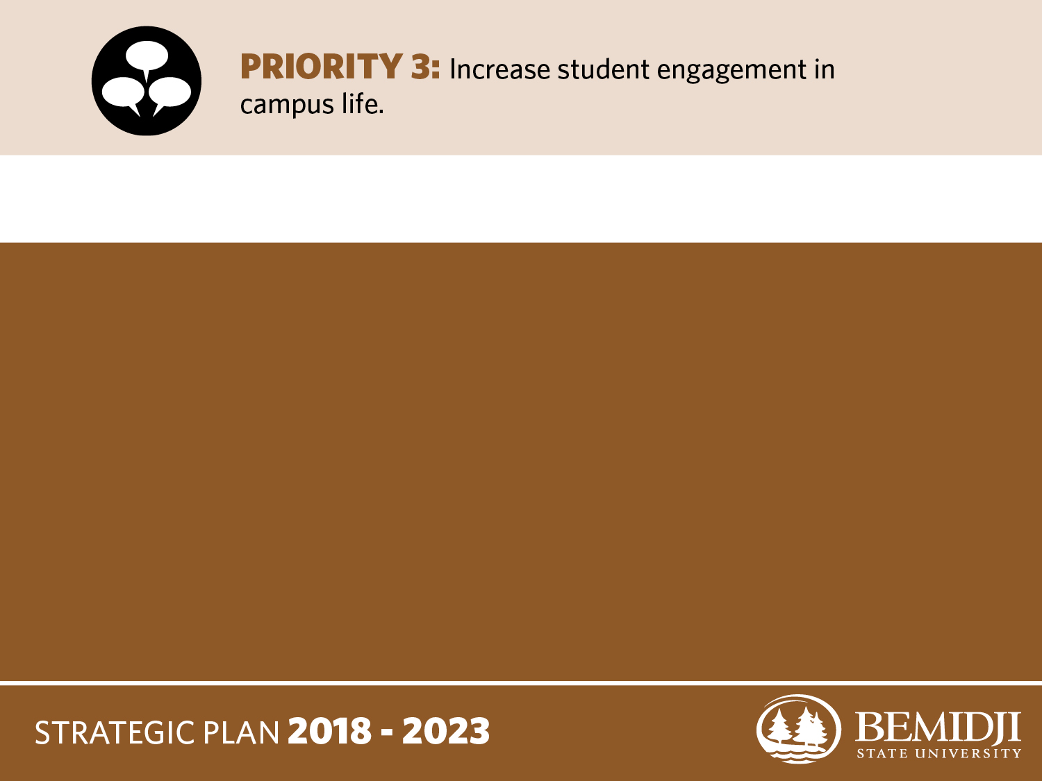
GOAL 1 — KEY ACTIVITIES
a. Work with student union, athletics, and academics to devise and implement a consistent method of tracking student participation.

Slide 33
GOAL 1 — KEY ACTIVITIES
b. Hobson Union will encourage student organizations to create and implement a membership plan for recruitment, retention and leadership succession.

Slide 34
GOAL 1 — KEY ACTIVITIES
c. Housing & Residential Life will initiate resident participation in weekly arts and/or social activities.

Slide 35
GOAL 2
Increase opportunities for faculty and students to engage with one another outside the classroom to the NSSE Carnegie Class means by Fall 2022.

Slide 36
GOAL 2 — KEY ACTIVITIES
a. Each semester, academic departments will schedule at least one talk or other event to which students are invited.

Slide 37
GOAL 2 — KEY ACTIVITIES
b. Facilitate timely and comprehensive use of the university events calendar on the BSU website for all campus events.

Slide 38
GOAL 2 — KEY ACTIVITIES
c. Promote faculty and staff event participation by identifying and reducing barriers to attendance.

Slide 39
GOAL 3
Improve the quality of interactions with students, academic advisers, faculty, student services staff, and other administrative staff to the NSSE Carnegie Class means by Fall 2022.

Slide 40
GOAL 3 — KEY ACTIVITIES
a. Academic Affairs will create and implement a formal training program for academic advisers.

Slide 41
GOAL 3 — KEY ACTIVITIES
b. Advising Success Center will evaluate and expand the mentorship program (Beaver Success program).

Slide 42
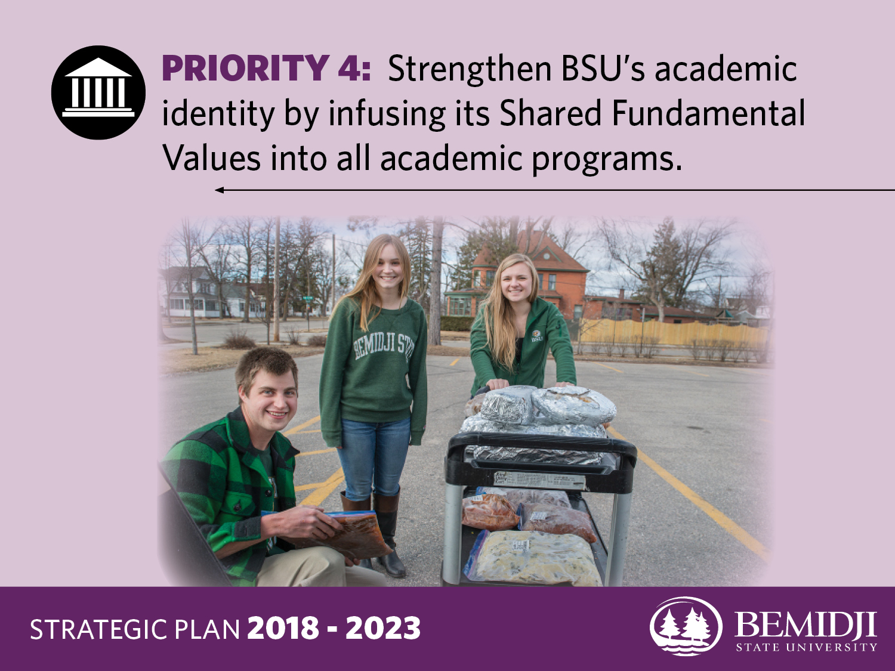

Slide 43
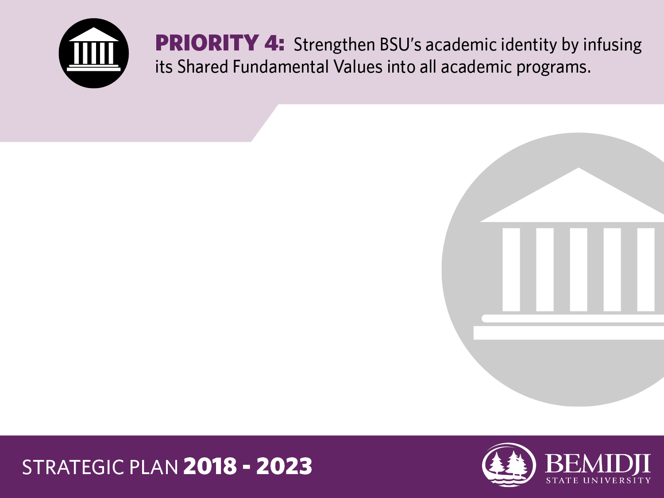
GOAL 1
By Fall 2019, ensure that the Master Academic Plan is aligned with the Shared Fundamental Values.

Slide 44
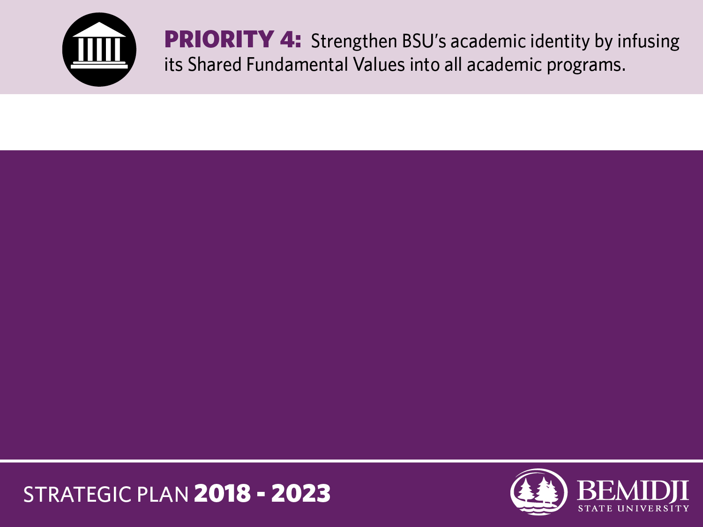
GOAL 1 — KEY ACTIVITY
a. Establish a committee to provide input and direction on the Master Academic Planning process and implementation.

Slide 45
GOAL 2
By Fall 2022, infuse Shared Fundamental Values into the curricula of all academic programs.

Slide 46
GOAL 2 — KEY ACTIVITIES
a. Ensure that the assessment cycle for academic programs includes review of the Shared Fundamental Values within the curricula.

Slide 47
GOAL 2 — KEY ACTIVITIES
b. Develop an assessment tool to review the infusion of the Shared Fundamental Values into the curriculum.

Slide 48
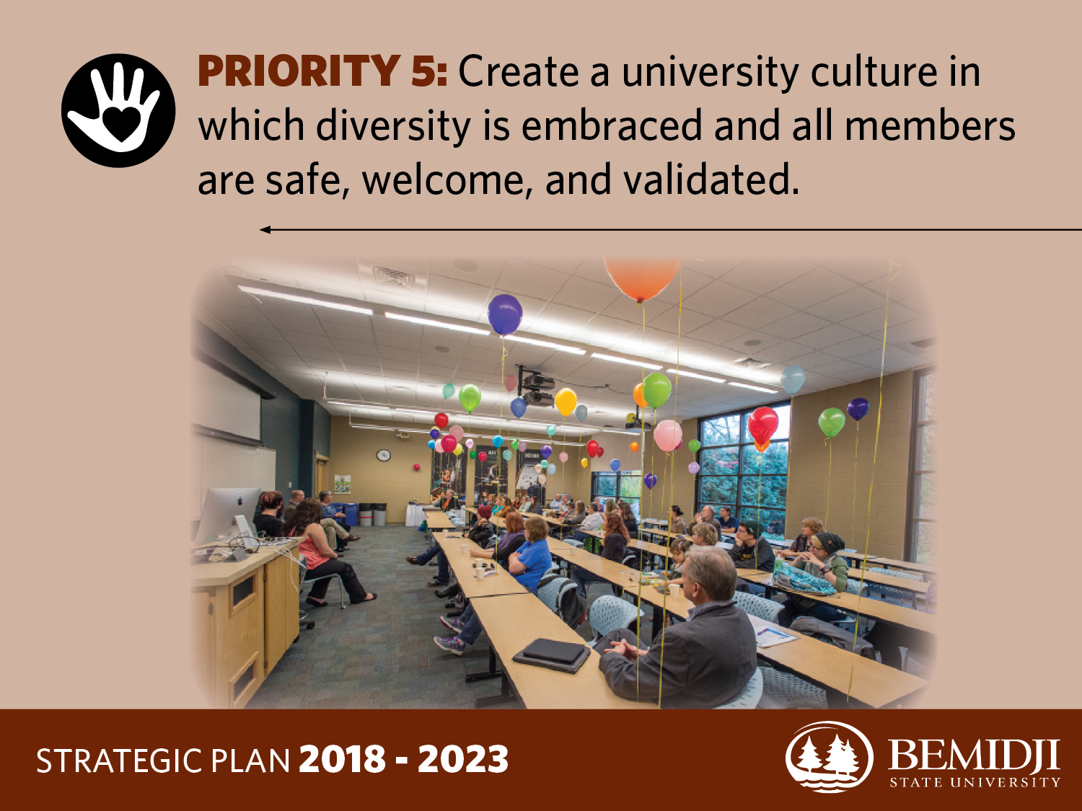

Slide 49
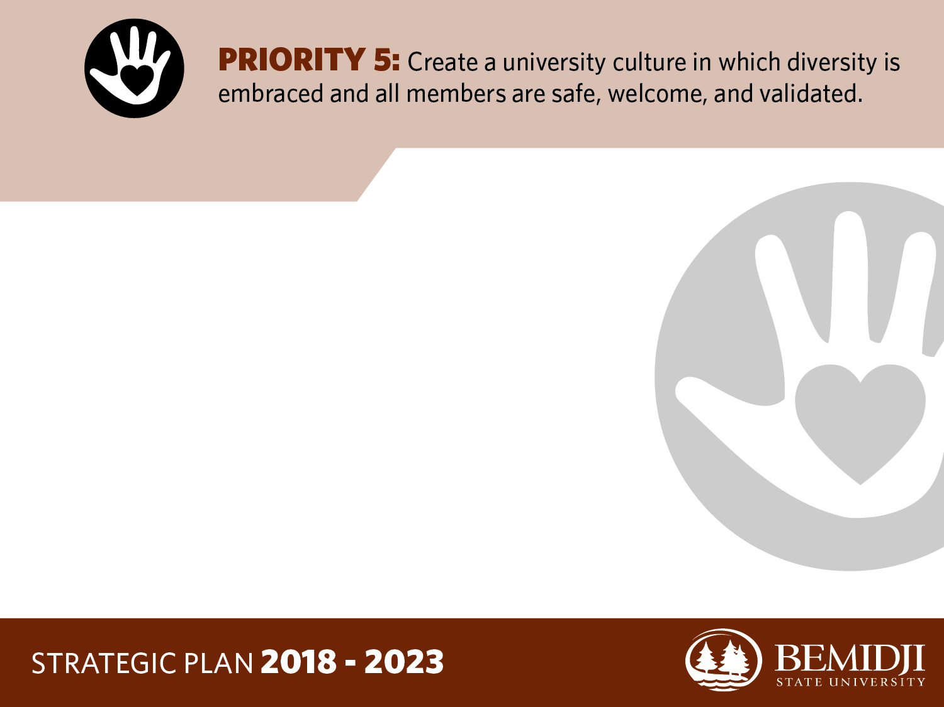
GOAL 1
Increase the number of international students to 300 (156% gain from 2017), students of color to 700 (18.6%); and faculty and staff of
color by 15 (26.8%) by Fall 2022.

Slide 50
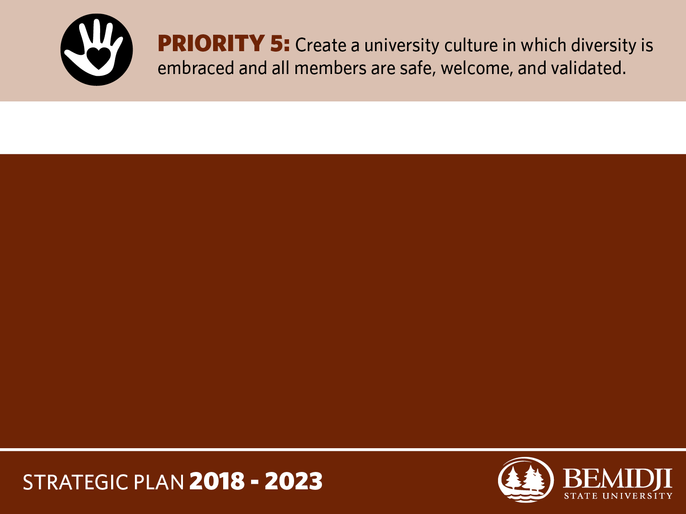
GOAL 1 — KEY ACTIVITIES
a. Increase engagement with access programs that encourage college attainment among historically underserved students.

Slide 51
GOAL 1 — KEY ACTIVITIES
b. Renew and develop articulation agreements with international partners.

Slide 52
GOAL 1 — KEY ACTIVITIES
c. Establish collaborative relationships with Historically Black Colleges and Universities (HBCU) and Hispanic-Serving Institutions (HSI) to recruit faculty, staff, and students.

Slide 53
GOAL 1 — KEY ACTIVITIES
d. Review hiring practices and job qualifications to widen pools of potential candidates.

Slide 54
GOAL 1 — KEY ACTIVITIES
e. Review and expand international scholars program.

Slide 55
GOAL 2
Achieve an increase of at least 0.25 in the mean response to campus climate survey questions about personal experience of a welcoming environment for all aspects of diversity by Spring 2022.

Slide 56
GOAL 2 — KEY ACTIVITIES
a. Open a diversity center on campus by Fall 2018.

Slide 57
GOAL 2 — KEY ACTIVITIES
b. Use teaching, training, and dialogue to increase diversity competence among individuals and within organizational units.

Slide 58
GOAL 2 — KEY ACTIVITIES
c. Increase the BSU mean for the five NSSE diversity questions to at least the state university mean by 2020.

Slide 59
GOAL 2 — KEY ACTIVITIES
d. Develop and promote support networks for diverse groups of students and employees.

