Slide 1
BSU & NTC Strategic
Planning Forums
December 13-14, 2022
Notes:
Today’s agenda is primarily focused on an update to campus regarding strategic planning, though we will provide some additional updates at the end

Slide 2

What Is Strategic Planning?
Traditional Strategic Planning
  Centralized, Structured, and Linear
  Mission, Vision, Values + SWOT → Priorities, Initiatives, Goals, Tactics, Timelines, etc.
Notes:
Research into strategic planning demonstrates they are most effective when:
Paired with large infusions of new resources - unlikely for us (note that fundraising success typically follows institutional success; it rarely precedes it)
Coupled with significant institutional events or crises - the pandemic and enrollment/fiscal challenges could serve this role for us
Designed to get to the day-to-day behavior and activity of front-line employees – this will be a key for us

Slide 3
What Is Strategic Planning?
Traditional Strategic Planning
  Centralized, Structured, and Linear
  Mission, Vision, Values + SWOT → Priorities, Initiatives, Goals, Tactics, Timelines, etc.
Modern Planning
  More agile, dynamic, and responsive
  Greater attention to differentiation
  Smaller with de-centralized plans that align to the institutional plan
  Greater attention to metrics and dashboards
Notes:
Modern planning:
Less bound by time
NB responsiveness to changes during the planning cycle (e.g., pandemic)

Slide 4
BSU & NTC Planning Charge & Assumptions
No upfront change to mission, vision, or values
One plan, ~3 priorities, ~3 institutional initiatives per priority
The plan will inform budget, personnel, and program decisions/responsiveness
Operationalization through multiple plans
Priorities and initiatives to be “stress tested”
Framework by February; Plan by April
Notes:
This is a short summary of Strategic Planning Workgroup (SPG) charge

Slide 5
Threats
Public skepticism regarding the value of higher education
Decreasing trend in state fiscal support
Evolving pathways to credentials
Shifts in needed workforce knowledge, skills, and dispositions
Changes in the higher education workforce
Inequities in the local/regional workforce and economy
Notes:
Content on Slides 5-8 come from a preliminary joint cabinet retreat and work with EAB
Regarding higher ed workforce, note (a) Baby Boomer retirements, (b) smaller Gen X, and (c) fewer Gen X and Millennials valuing careers in higher education
Regarding local/regional inequities, note content from Greater Bemidji

Slide 6

Opportunities
BSU-NTC Alignment
Integrative Work with Regional Native Nations and People
Diversity, Equity, & Inclusion
Untapped Student Markets
Community/Regional Collaboration
Innovations in Educational Delivery
Notes:
History: Post-pandemic growth has focused around access, affordability, and innovation – these should be strengths of ours

Slide 7
Internal Scanning
Strengths
Our Employees and People
Location
DEI and Growing American Indian Collaboration
Academic and Co-curricular Programs
Campus Ethos
Readiness for Change

Slide 8
Internal Scanning
Strengths
Challenges
Our Employees and People
Location
DEI and Growing American Indian Collaboration
Academic and Co-curricular Programs
Campus Ethos
Readiness for Change
Bureaucracy and Processes
Financial Challenges
Resistance to DEIA+ and American Indian Collaboration
Marketing and Telling Our Story
Infrastructure Needs
Resistance to Change
Notes:
Note how some concepts are strengths and weaknesses

Slide 9
Holistic Student Success
Diversity, Equity, and Inclusion
Notes:
Established starting point – core values of holistic student success and DEI

Slide 10
Holistic Student Success
Value
Diversity, Equity, and Inclusion
Notes:
Established end point of value → Equity 2030 and Postsecondary Value Commission

Slide 11
Holistic Student Success
Priority 1
Priority 3
Priority 2
Value
Diversity, Equity, and Inclusion
Notes:
To be developed: ~3 strategic priorities

Slide 12
Stress Testing Priorities
Core Values
Meaningful
Replicability
Attainability
Measurable
Value Proposition
“Campaignable”
Subtraction
Priority 1
Priority 3
Priority 2
Notes:
These will start as broad concepts, but then be refined through a stress test process

Slide 13
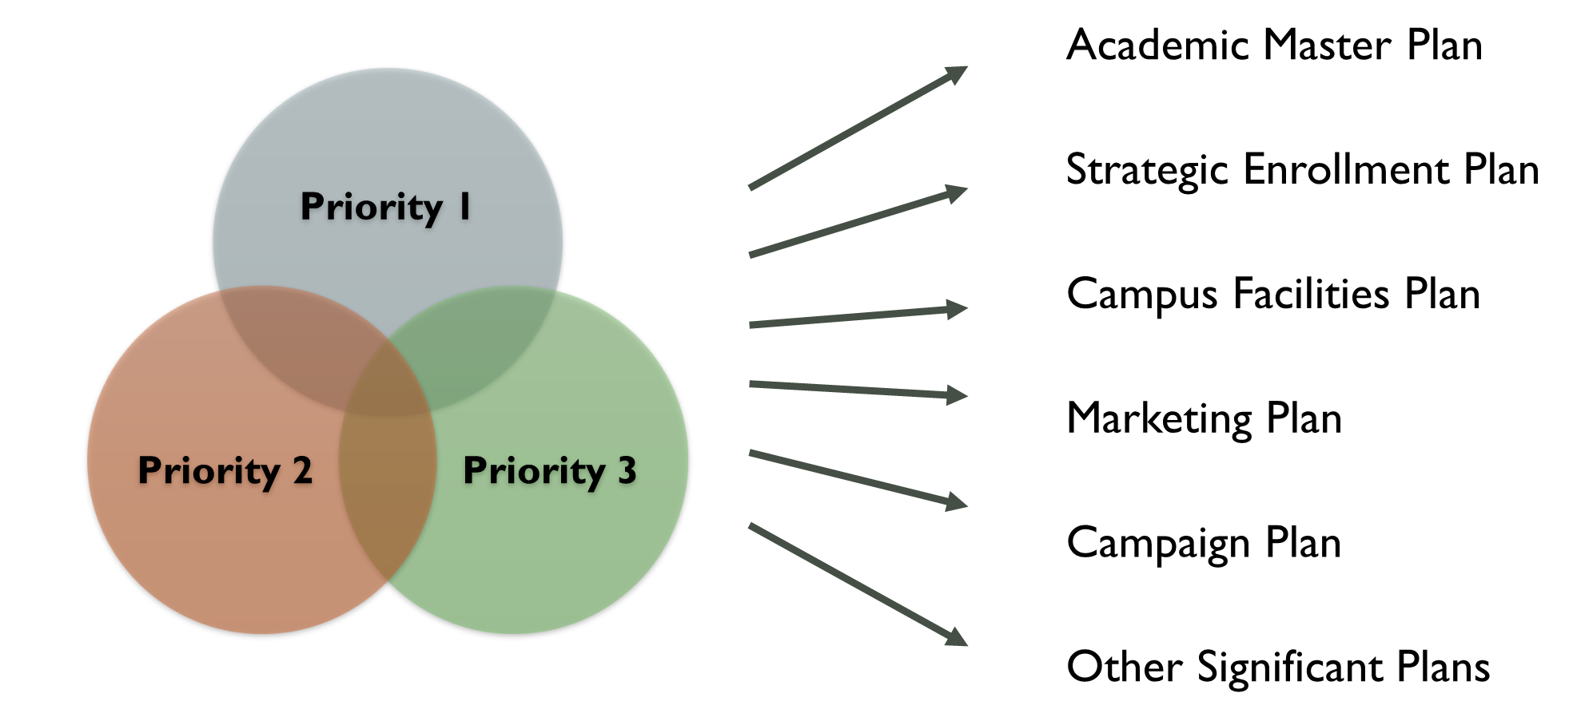
ALIGNMENT
Notes:
Once established and refined, these ~3 priorities will become the guiding priorities for all other campus plans (thus a decentralized yet coordinated approach)

Slide 14
Priority 1
Institutional Initiative
Institutional Initiative
Institutional Initiative
Notes:
After strategic priorities are established and refined, we will develop ~3 institutional initiatives for each priority area

Slide 15
Timeline
January-February
  SPG → Framework (Priorities)
February-March
  Framework Consultations & Feedback
  SPG → Institutional Initiatives
March-April
  Institutional Initiative Consultations & Feedback
May
  Final Plan

Slide 16
Additional Updates
Budget
Personnel
Cabinet Outcomes
Shout Outs
Notes:
Budget updates: (a) Cautiously hopeful regarding MN surplus; (b) BESI plan at MN State Offices; (c) Internal locus of control work needs – no survey responses for own area – “How can I contribute to the solution?”
Personnel updates: (a) VPFA, (b) VPA, (c) Head of Staff
Cabinet outcomes: Under “cabinet” on the OTP webpages for BSU and NTC
Shout outs:
BSU: Athletics, Music, IIEP, TAD, Social Work ($100K from BlueCross), Fundraising
NTC: CODA, Nursing collaboration movement, AIRC position, Sanford sponsoring coffee at student success center

