Slide 1

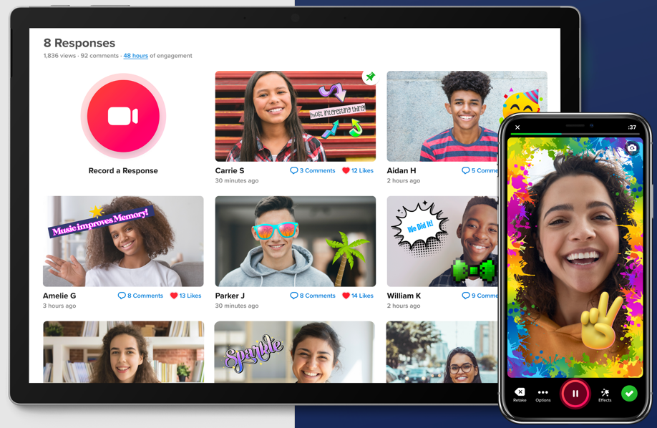
Flipgrid
Make Your Online Classes more Lively
Halbana Tarmizi
Business Administration

Slide 2
Agenda
Challenges in online learning / teaching
What could be done?
What is FlipGrid?
Features of FlipGrid
Steps in setting FlipGrid
Share and give feedback
Tips in using FlipGrid
What students are saying…
Resources for FlipGrid
Let’s Try it

Slide 3

Challenges with Online Classes
Barely interaction between faculty and students (Unengaging)
Interactions mostly through E-mails (Text heavy)
Students can’ really develop their communication skills (Esp. Oral)
Students feel isolated
Faculty feels helpless
Everybody feels frustrated

Slide 4

What Could Be Done?
Less text, more visualization (E.g., recording lectures)
Add synchronous components (E.g., Zoom meetings)
Provide interactive activities
Interaction not only between faculty and students, but also among students.

Slide 5

What is FlipGrid?
FlipGrid mission is ….
  To help you empower every learner on the planet to share their voice and respect the diverse voices of others
It is Microsoft’s free video discussion platform.
It was created in 2015
It was acquired by Microsoft in June 2018
Microsoft sees Flipgrid as an effective tool to help teachers and students build social emotional skills beyond traditional curricula.
FlipGrid is available as Web-based and App for SmartPhone

Slide 6

Features of FlipGrid
Easy to use
Simple User Interface
It allows up to 10-minute recording
Instructor can adjust recording time for students from 15 sec to10 minutes
Integrated with Microsoft system (e.g., login using starID@minnstate.edu)
Instruction can be recorded or written or linked from other sources such as YouTube.

Slide 7
Features of FlipGrid
Students can login using email or username
Topic can be moderated
Option for responding to students’ posting either with Video or Text comments or both
Set schedule when the topic is active
Notification for new videos
Various effects that can be incorporated

Slide 8


Steps in Setting FlipGrid
Login with StarID@minnstate.edu
Setup a topic (or a Group – if there will be more than one topics)
For each topic set the following:
  Title
  Prompt (Text – what students need to address in their recordings)
  Add your own recording with instruction for students
  Need to add at least one student (either using email or username): more about permission: Link.
  (Optional) set guest password – at least 8 characters and combination of two or more of letter, number etc.

Slide 9
Steps in Setting FlipGrid
For each topic set the following (continue):
  Set the recording duration for responses (up to 10 minutes)
  Moderated or not
  Reply by others as Video/Text/both
  Can add attachments
  Set the active time period
  Notification
  On/Off: allow students to add attachments, to like a video, to download and share, show view count, video editing, adding sticky notes
  Setting the Feedback

Slide 10
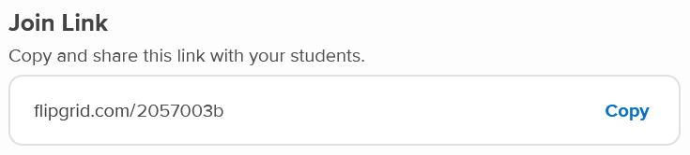
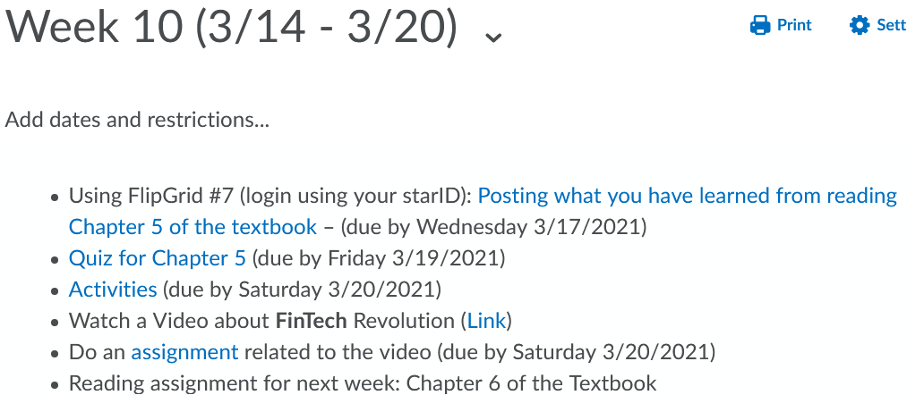
Share and Give Feedback
Sharing a topic can be done by clicking the SHARE button, and copy the unique code.

Slide 11
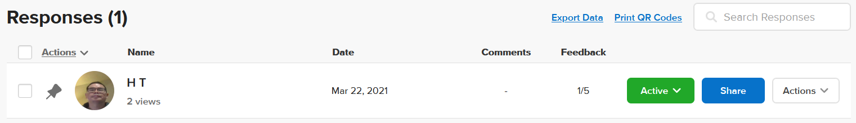
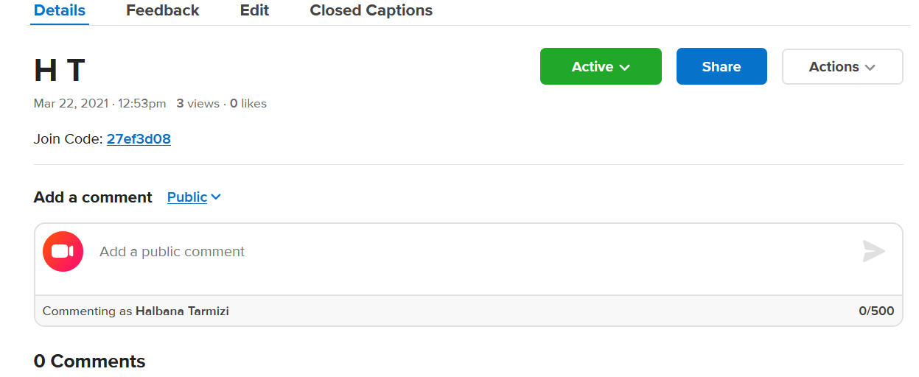
Share and Give Feedback
Feedback can be given to each student while watching his/her video (click on student name to watch the video)

Slide 12
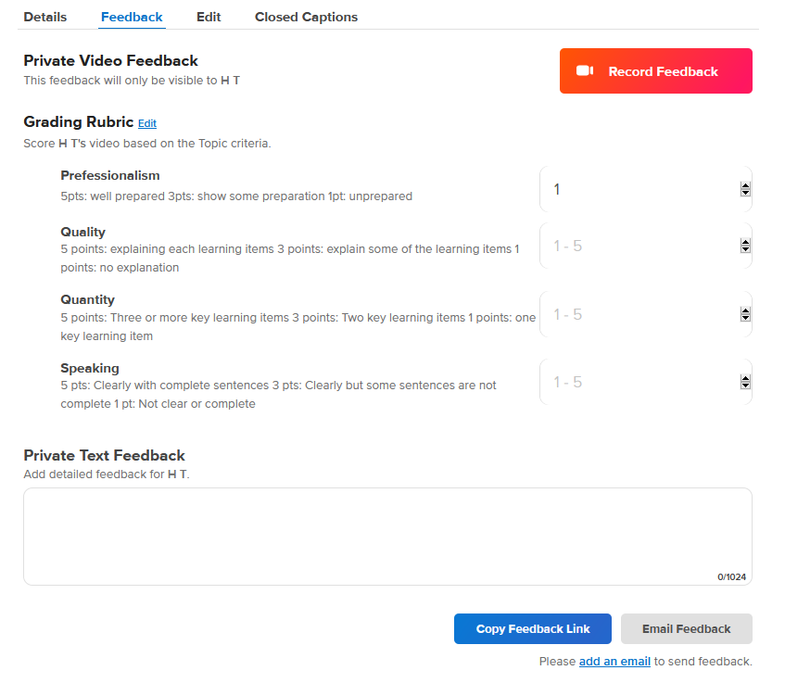

Slide 13

Tips in using FlipGrid
Don’t use email as permission for students to join (our students have various email domains representing various MnSCU institutions)
Better to set duration for the reponse longer than shorter (e.g., 5 minutes or more)
Have a clear rubric how you will grade the posting
Could use moderation if you don’t want other students to just repeating what already posted by others
Could ask students to response to others to create more engagement (need to have a clear guidance what is expected in the reponses)

Slide 14

What Students are saying …
“I really enjoyed using the Flipgrid platform for discussions, as I have never had video discussions in a course before. This was so much better than having a traditional discussion board in D2L. I would have liked to see more interaction among my classmates by responding to each other’s videos. The one week where we had to vote to see who had the best idea for augmented reality was fun because many people watched each other’s videos.”
“I felt the FlipGrid posting requirements were somewhat uncomfortable at first but became a great learning tool as the class progressed. I feel that more and more companies are moving to video conferencing and these assignments improved confidence in using that technology.”
“FlipGrid was great to use - I’ve never used this before; however, it was nice to be able to use it throughout the 8-weeks and get more comfortable with its software capabilities. I would suggest incorporating the feedback comments as part of the assignment requirements.”

Slide 15

Resources for FlipGrid
FlipGrid Help Center: https://help.flipgrid.com/hc/en-us
Various Topics created by FlipGrid community: https://admin.flipgrid.com/manage/discovery
Tutorial for teachers: https://youtu.be/56AMBZaNFLo
Tutorial for students: https://youtu.be/645iztDJlTw

Slide 16
Let’s Try it – Respond to a topic
Posting a response to a Topic: https://flipgrid.com/396a8fb3
Password: bemidji56601

Slide 17
Let’s Try it – Create a Topic
Creating your Topic on FligGrid
Go to https://info.flipgrid.com/
Click on the Educator Sign-Up button
Click on Sign-Up with Microsoft button
Use your starID@minnstate.edu for login
Could be that a text will be sent to you for authentication
Once you are in, create a topic (any topic that would like others to repond)
For permission: use Student Email (add domain @minnstate.edu and @bemidjistate.edu). Turn on Guest Password (set the password: beavers2021)
Share your topic with others (copy and paste the code through the Chat channel)

Slide 18
Any Question?

