Slide 1
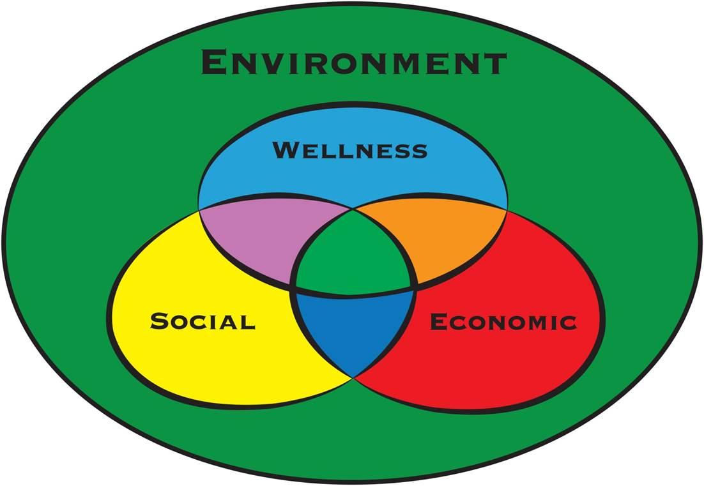
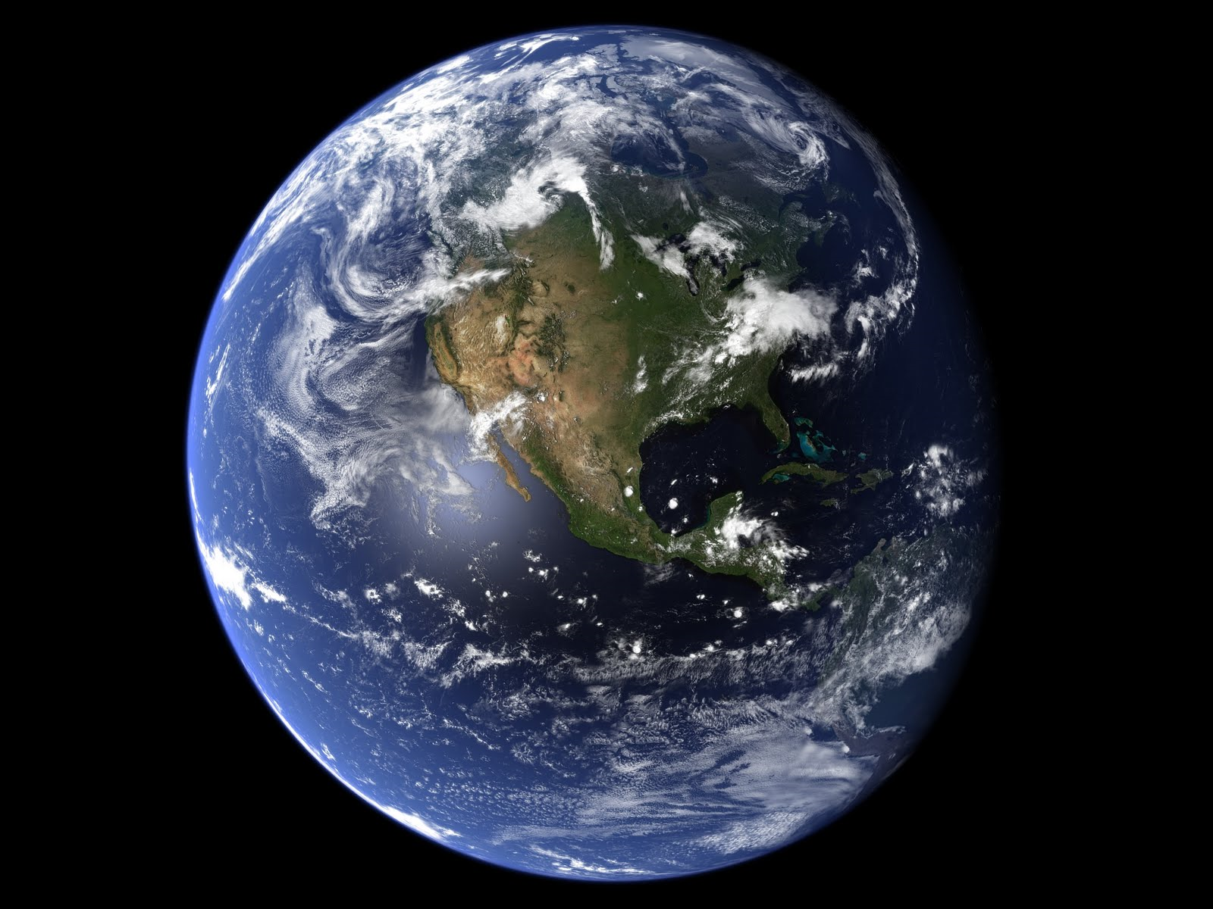
Social Movements and Change:
Energy & Climate

Slide 2
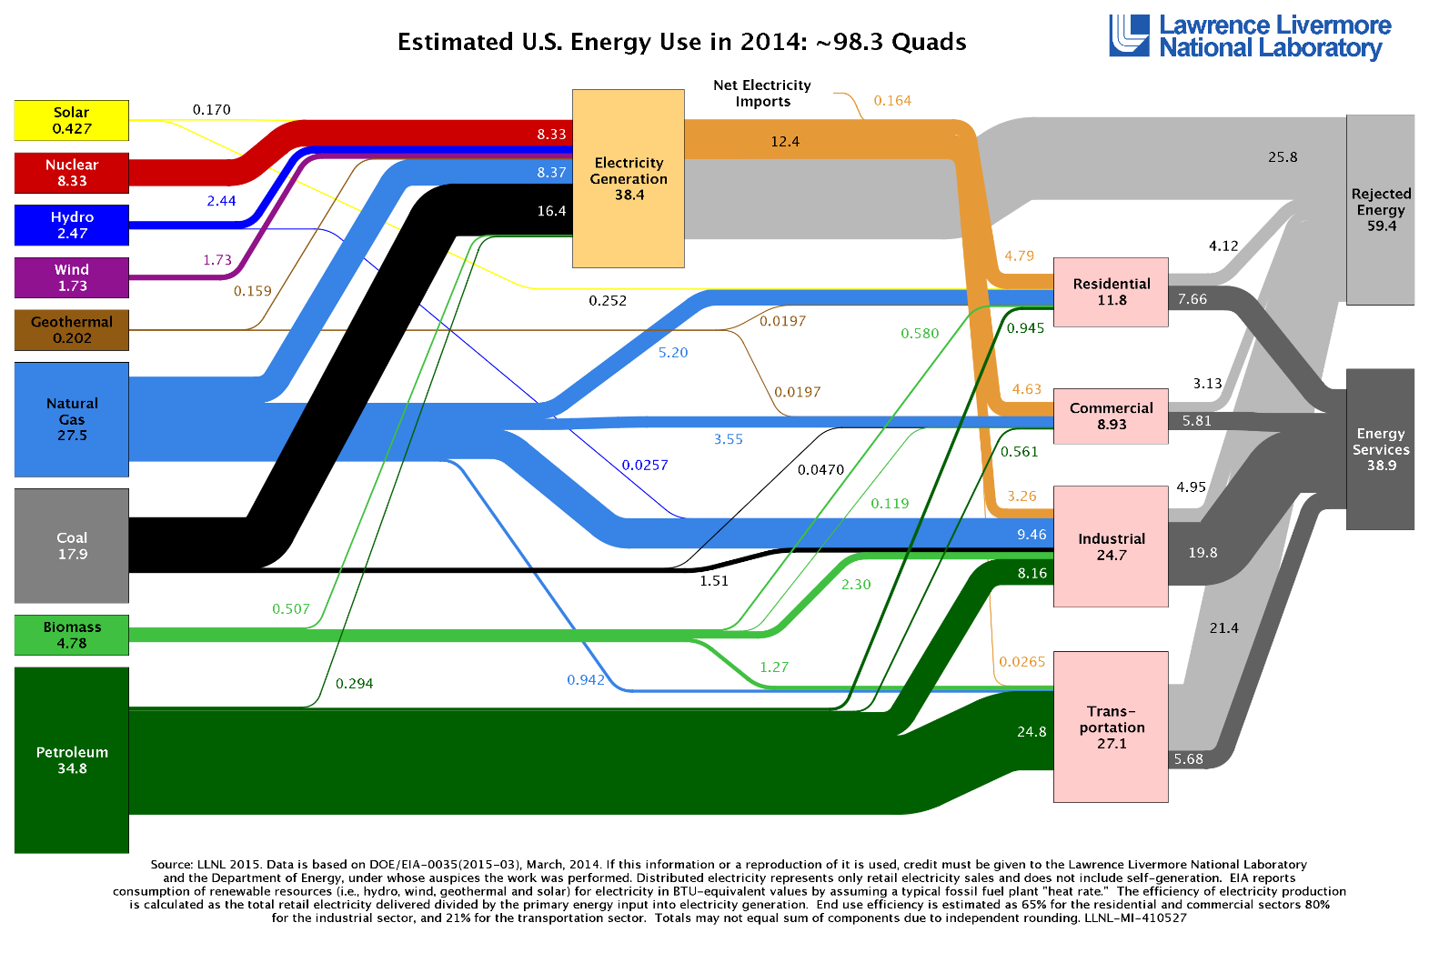
10% Renewable
8% Nuclear
82%
Fossil Fuels

Slide 3
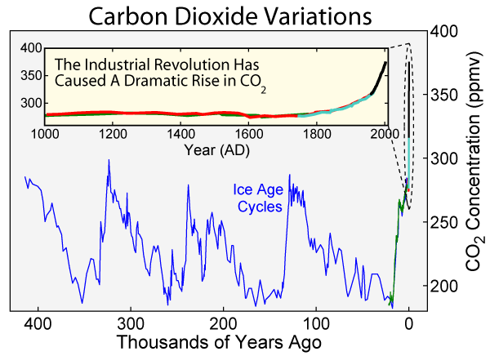
280 ppm (Pre-indiustrial)
400 ppm (Today)

Slide 4
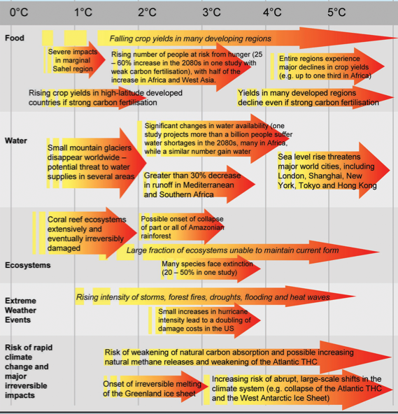
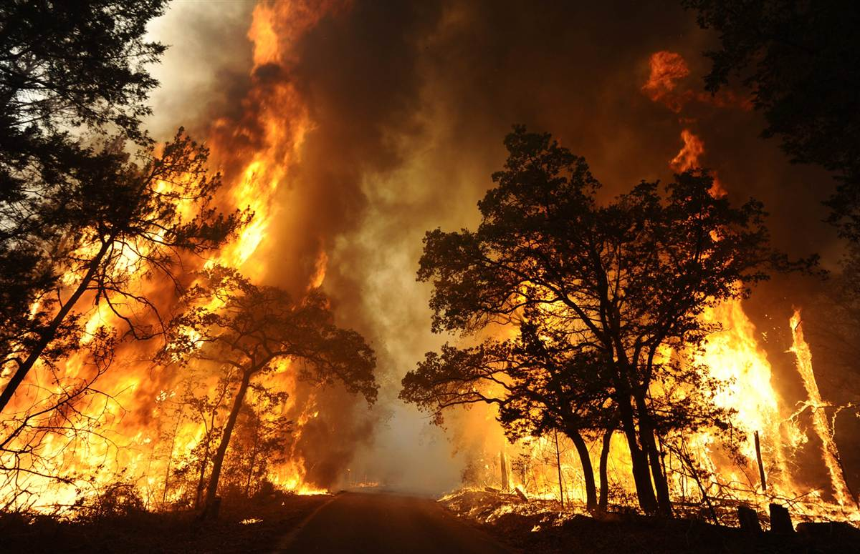
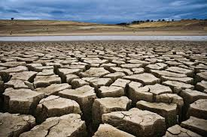
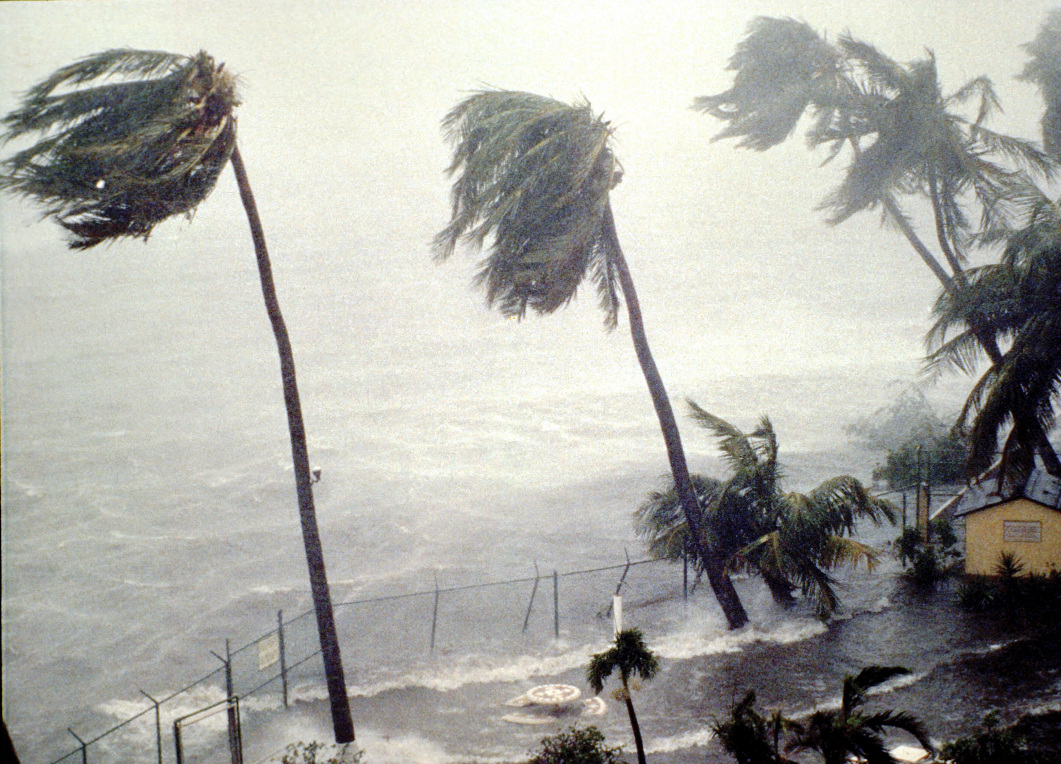
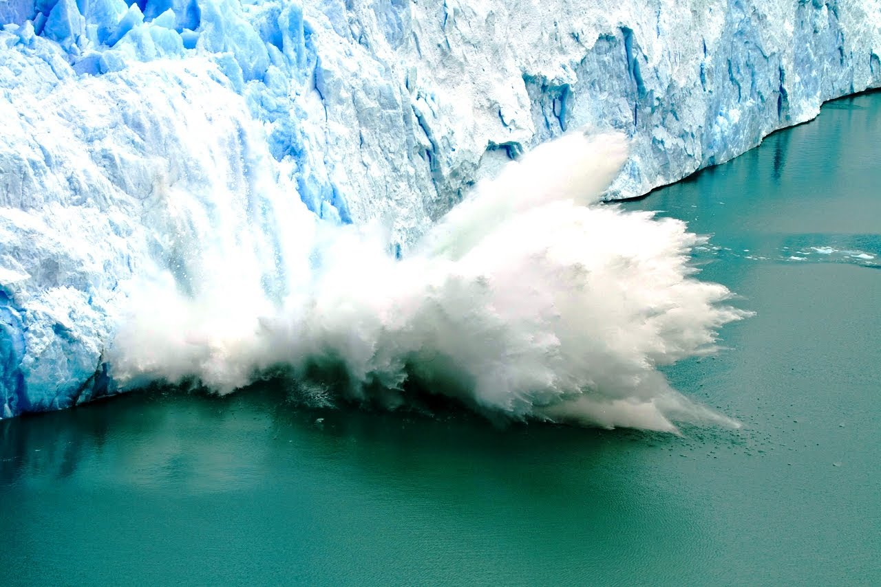
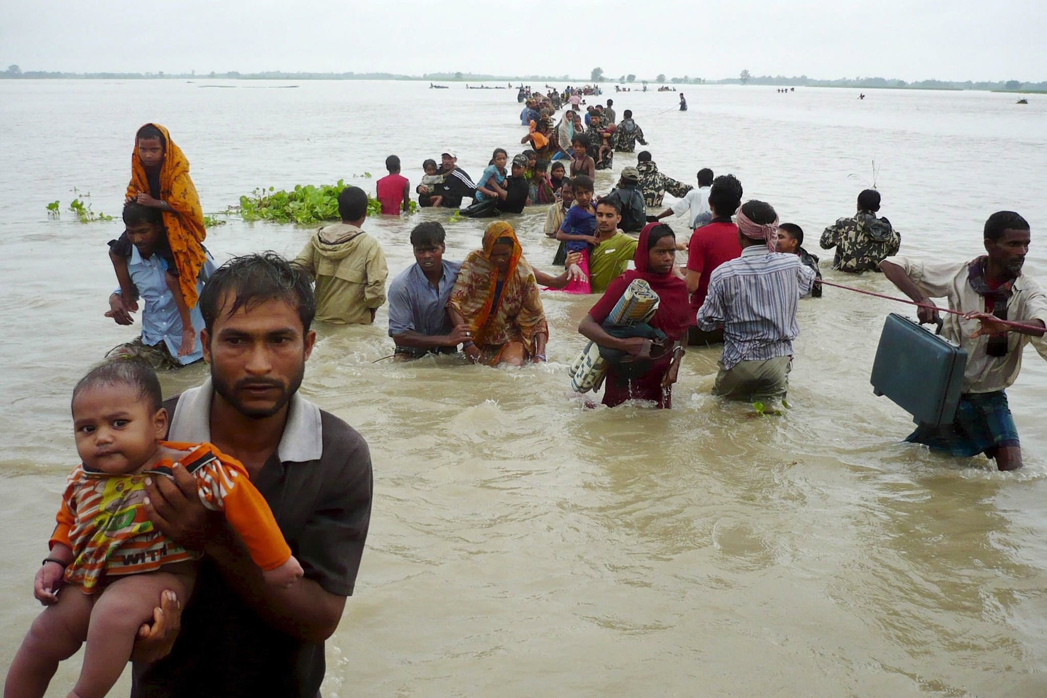

Slide 5
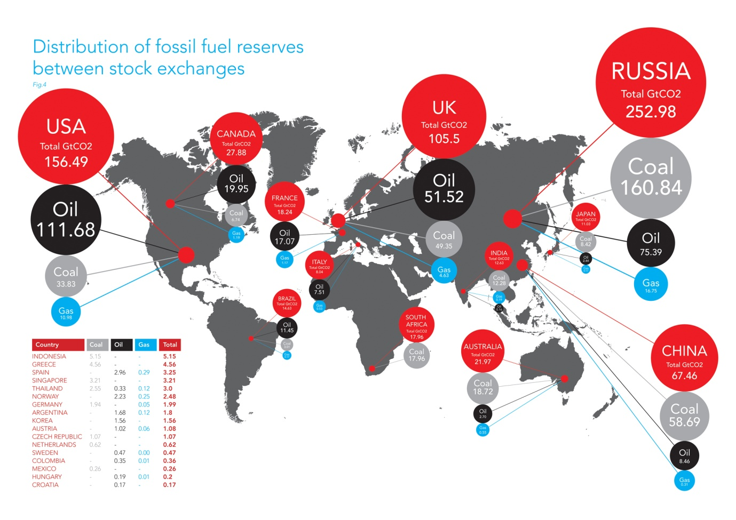
2795 Gt
Global
Fossil Fuel
Reserves
2° C
565 Gt
450 ppm (High risk)
350 ppm (Safe)
Notes:
Here are the top 10 countries with listed reserves. By allocating reserves to exchanges, it is possible to build up a picture of where reserves are listed on the stock market. The map shows how the listings of coal, oil and gas reserves are distributed, indicating that capital markets are supporting the continued exploitation of fossil fuel reserves around the world

Slide 6

“This Changes Everything”

Slide 7
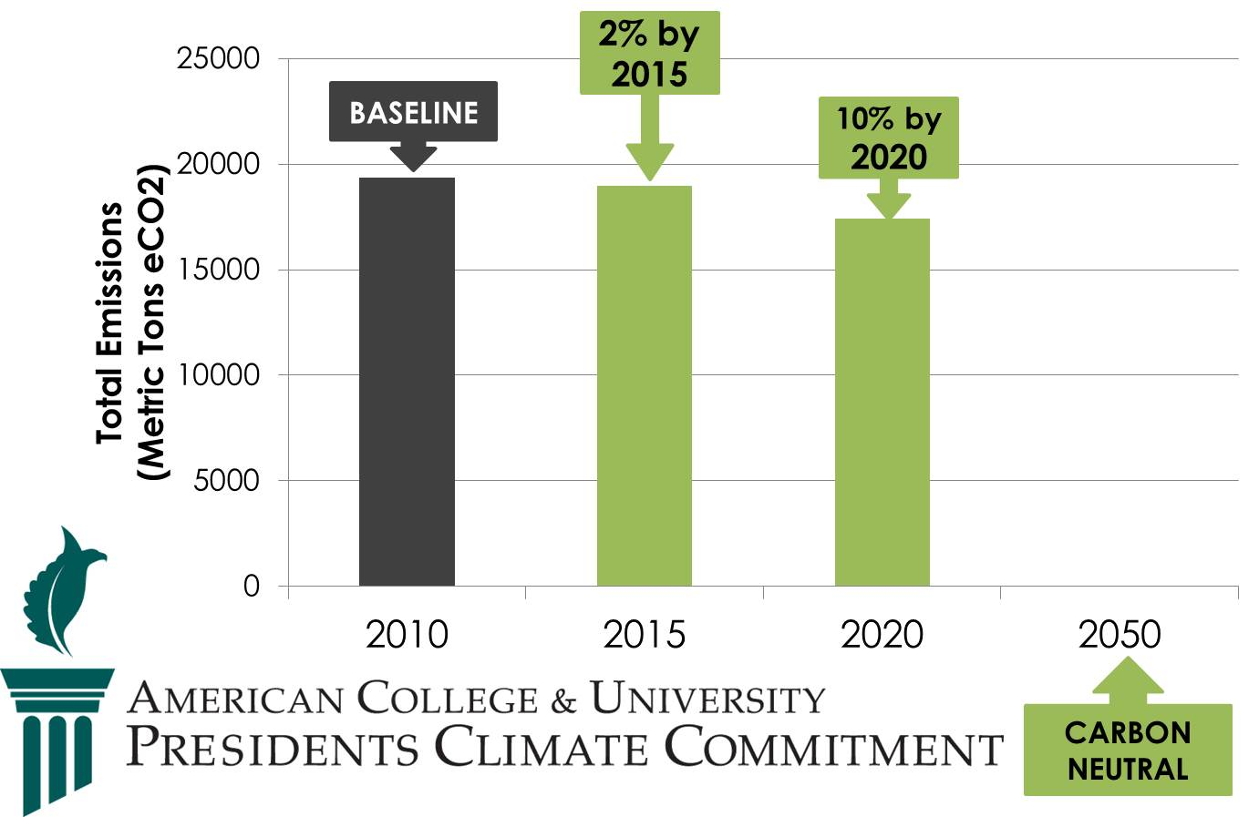
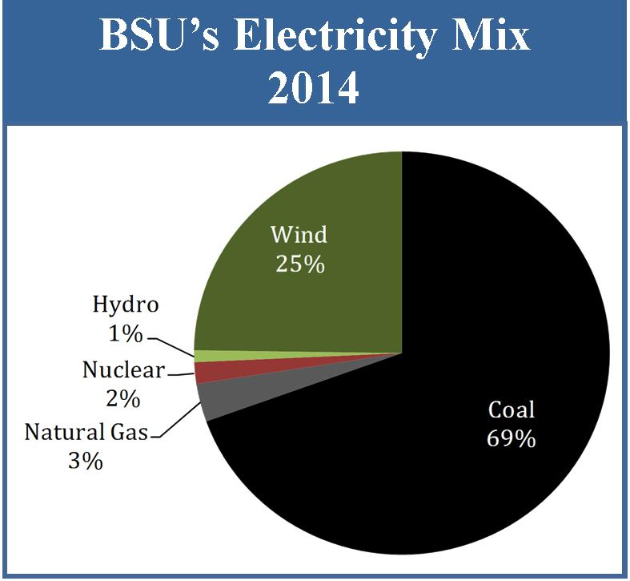
Notes:
The University has decreased it’s electricity use by 7.5% since 2010.

Slide 8
“Divestment”

Slide 9
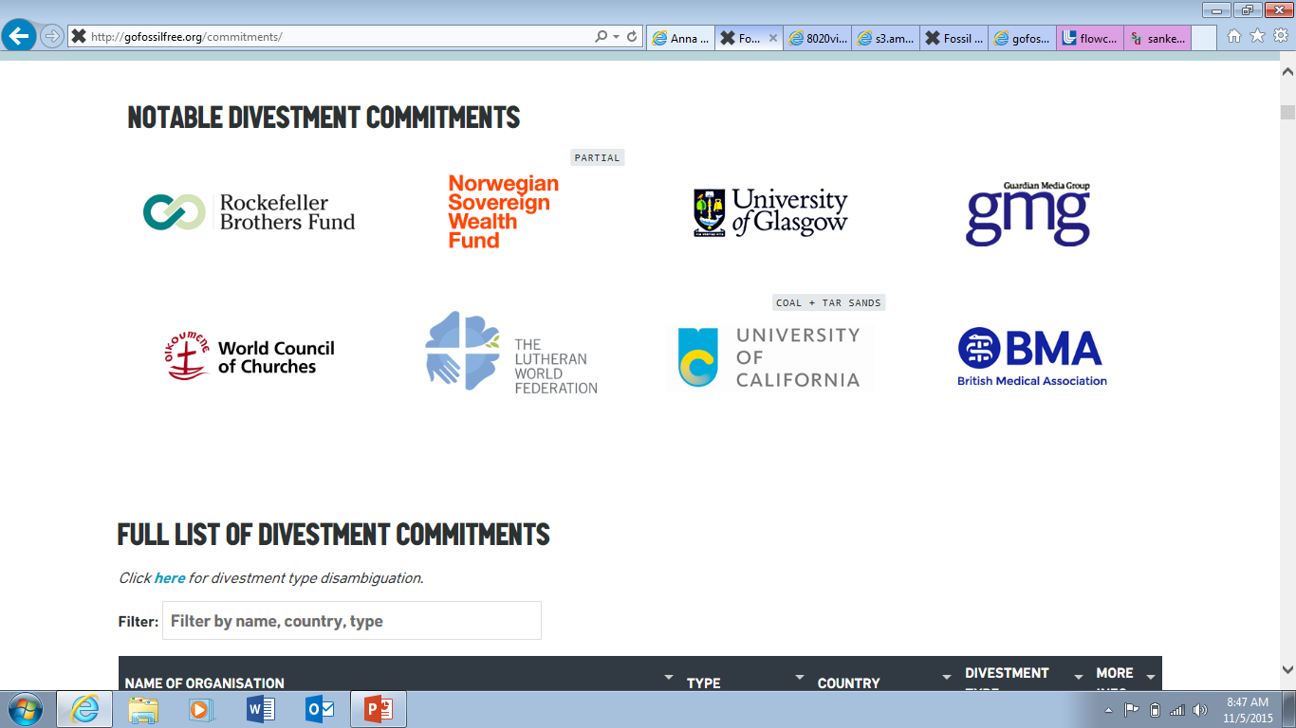

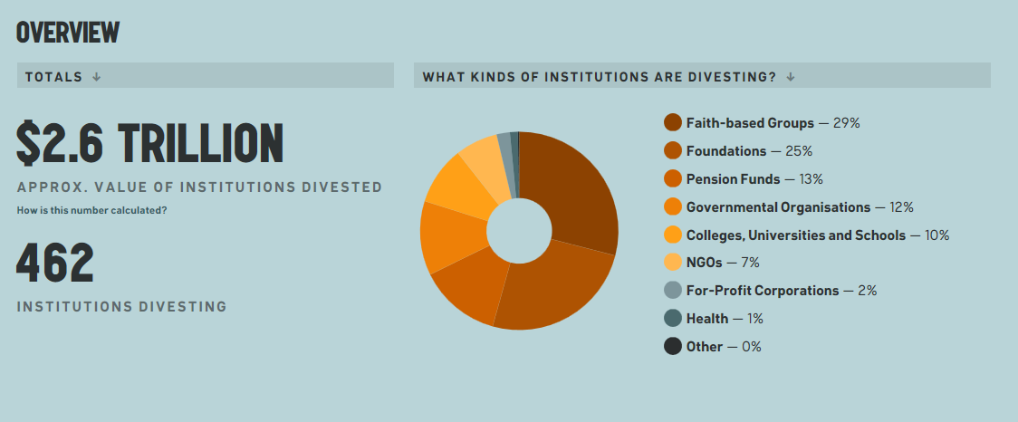

Slide 10



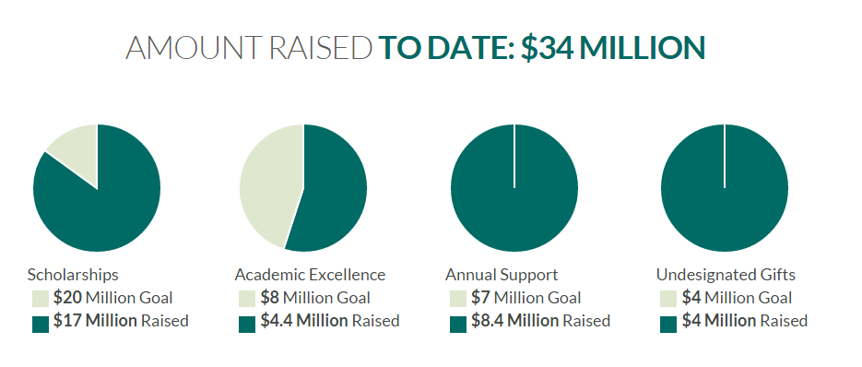
Dr. Richard Hanson
President
BSU & NTC
Steve Vogt
Investment Committee
BSU Foundation

Slide 11
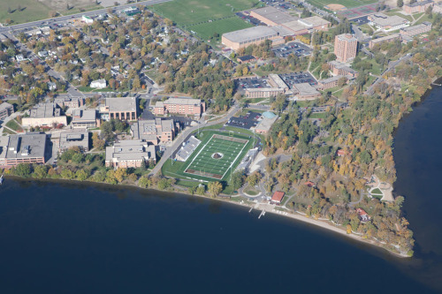
What is our responsibility?
Signature Themes
Civic Engagement, Multicultural Understanding & Environmental Stewardship

